Slide 1
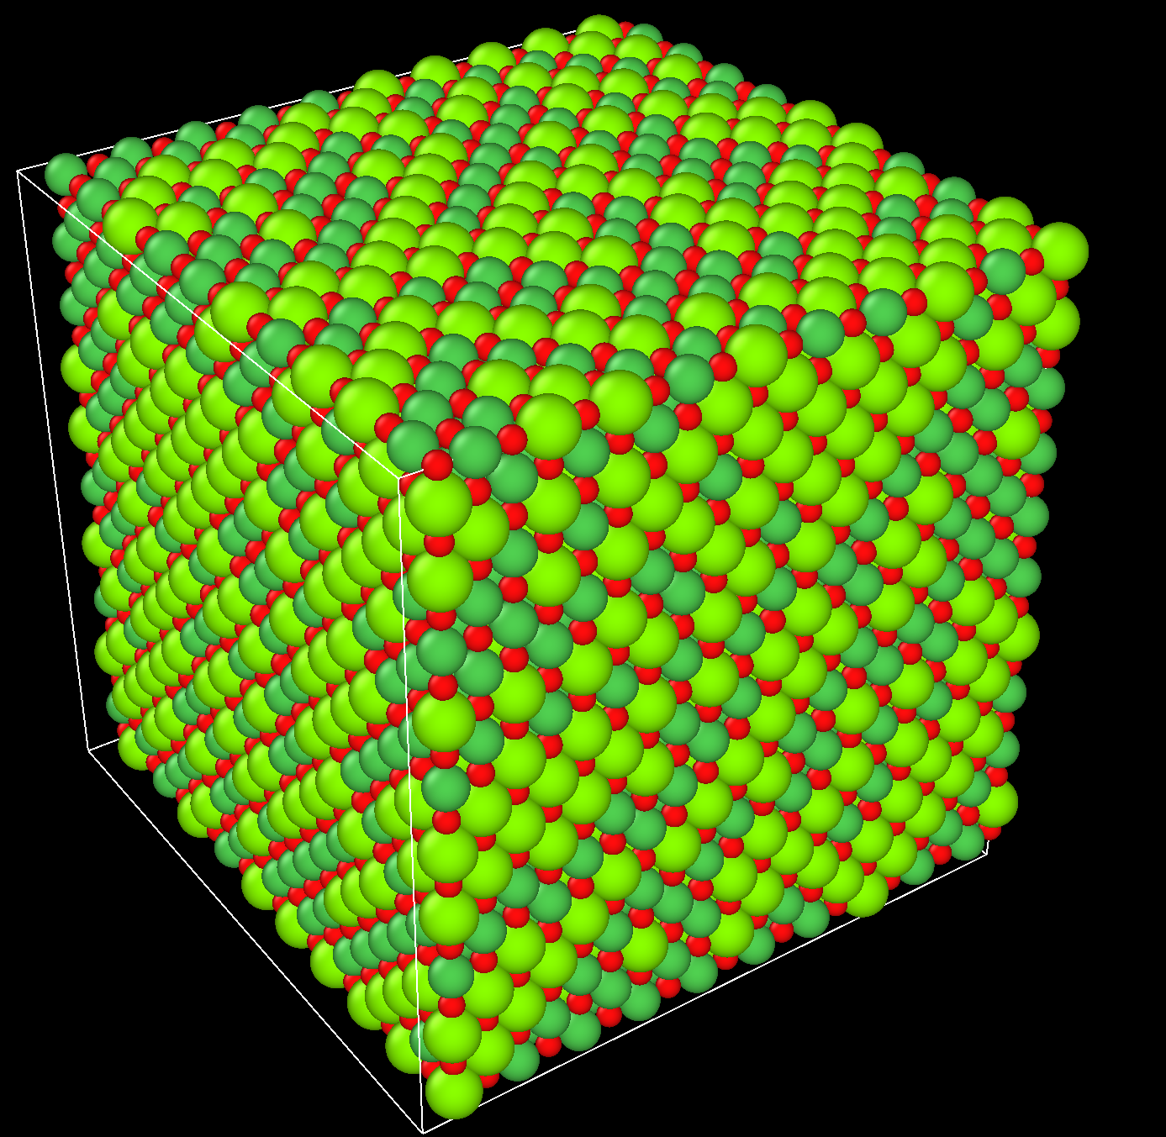
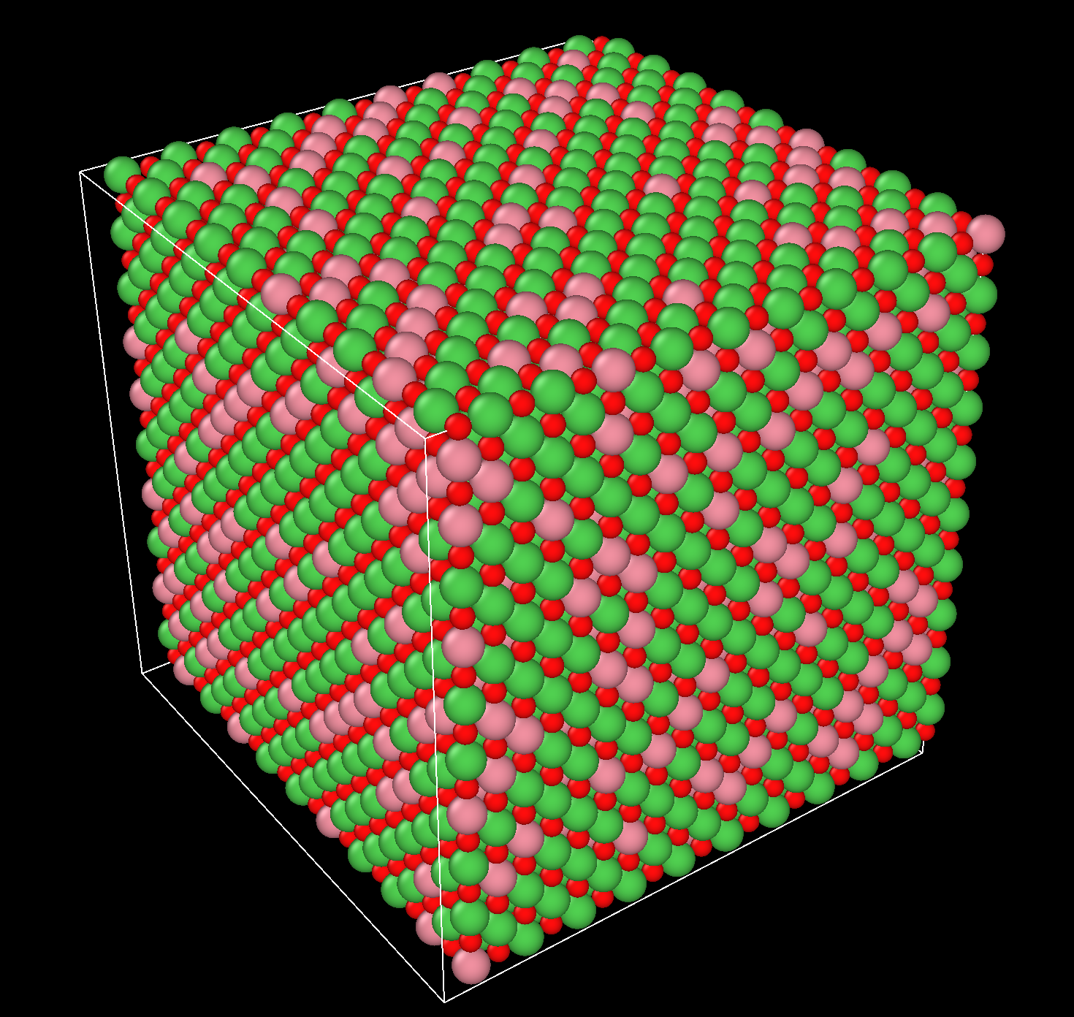
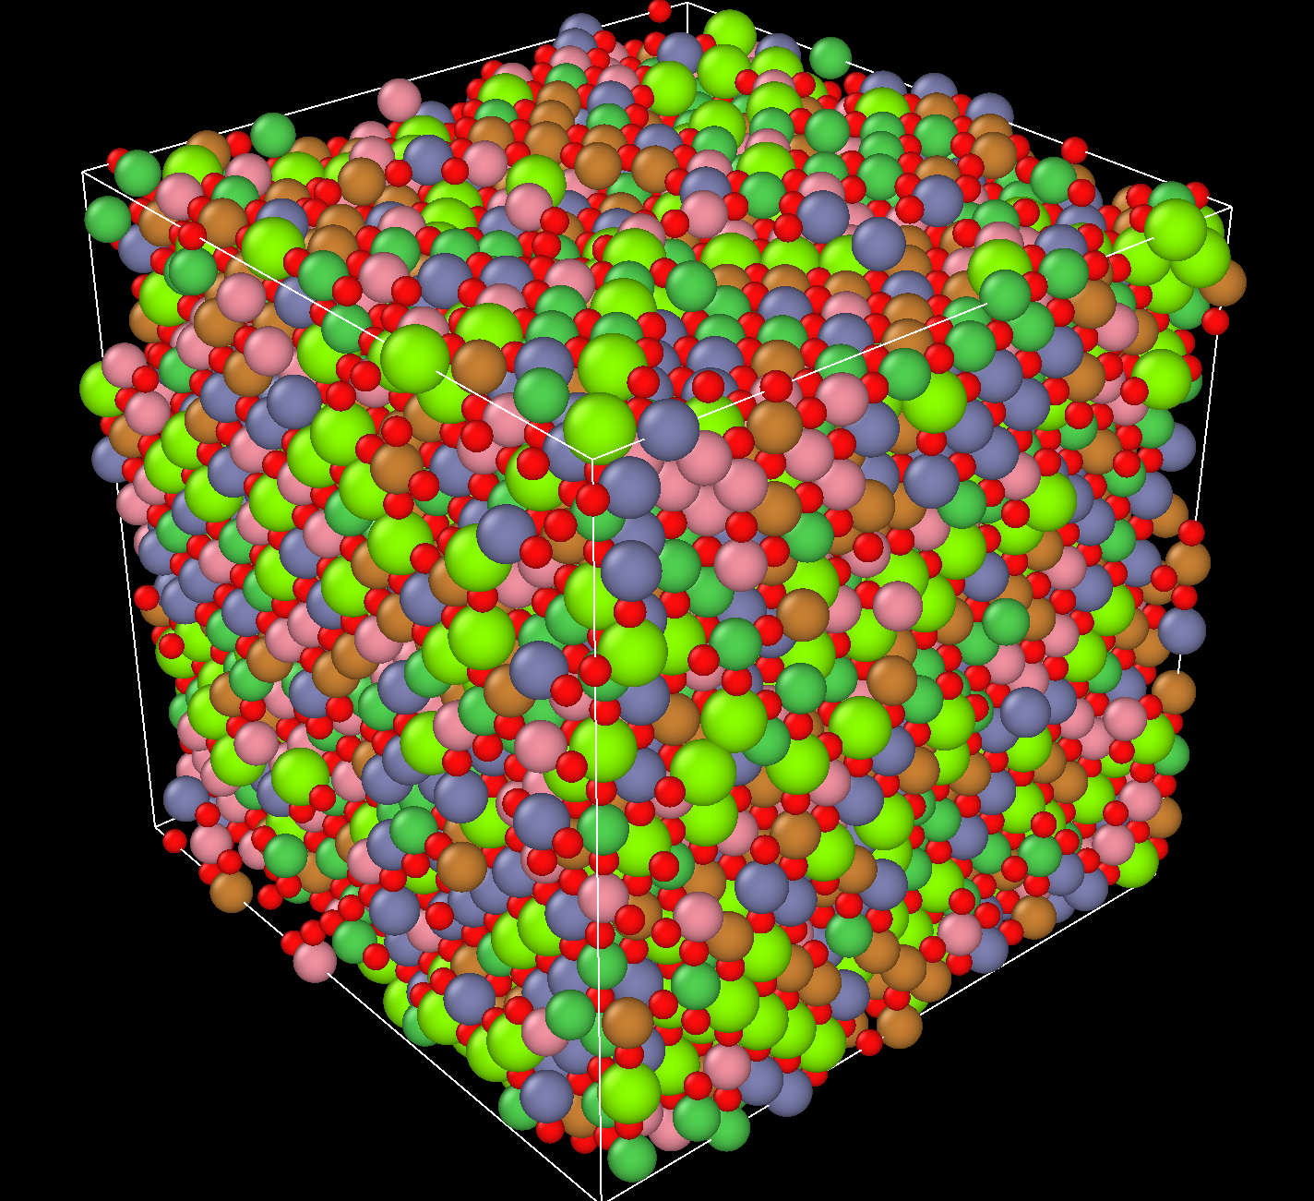

Thermal properties of high-entropy alloys - Data & Graphs (Lazy Version)
MgNiO – CoNiO – J14 Potential
Huy Nguyen

Slide 2
MgNiO Potential

Slide 3
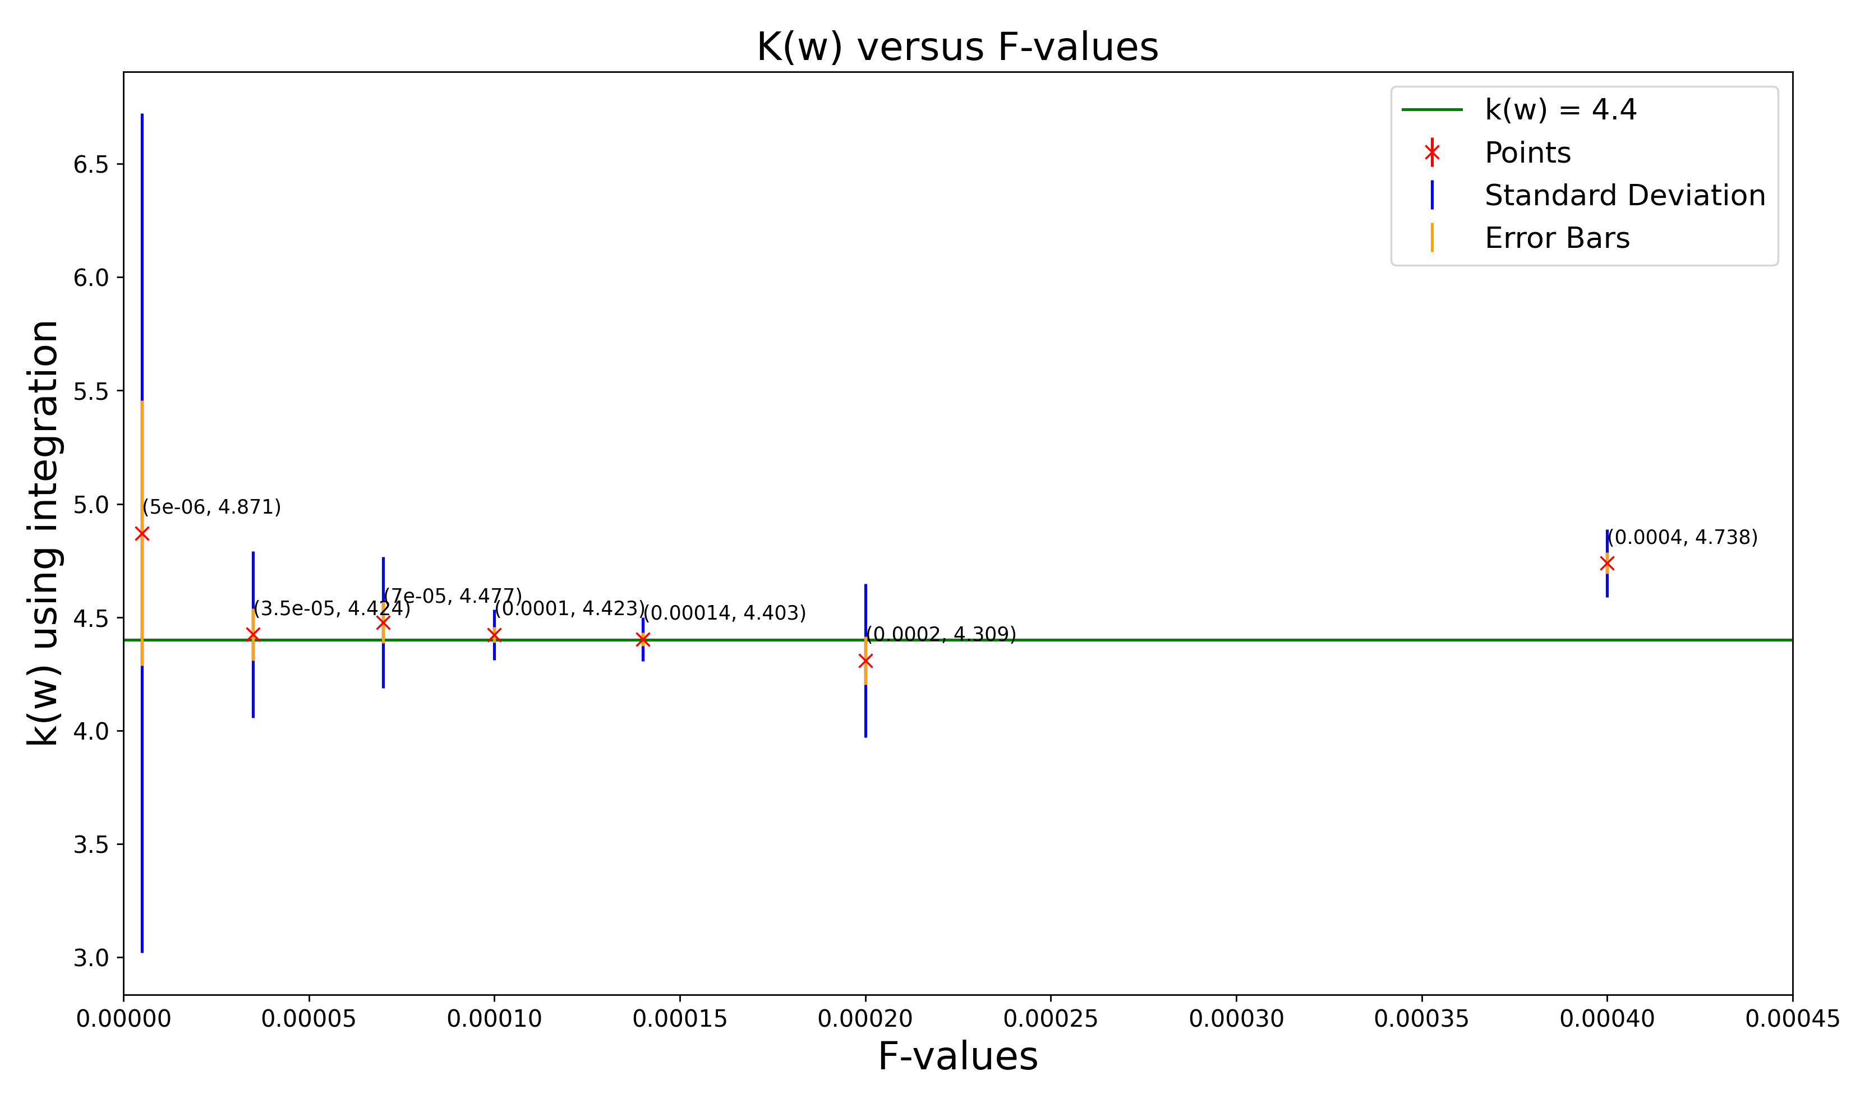
Plot of k(w) versus F-values for Temp = 300K

Slide 4
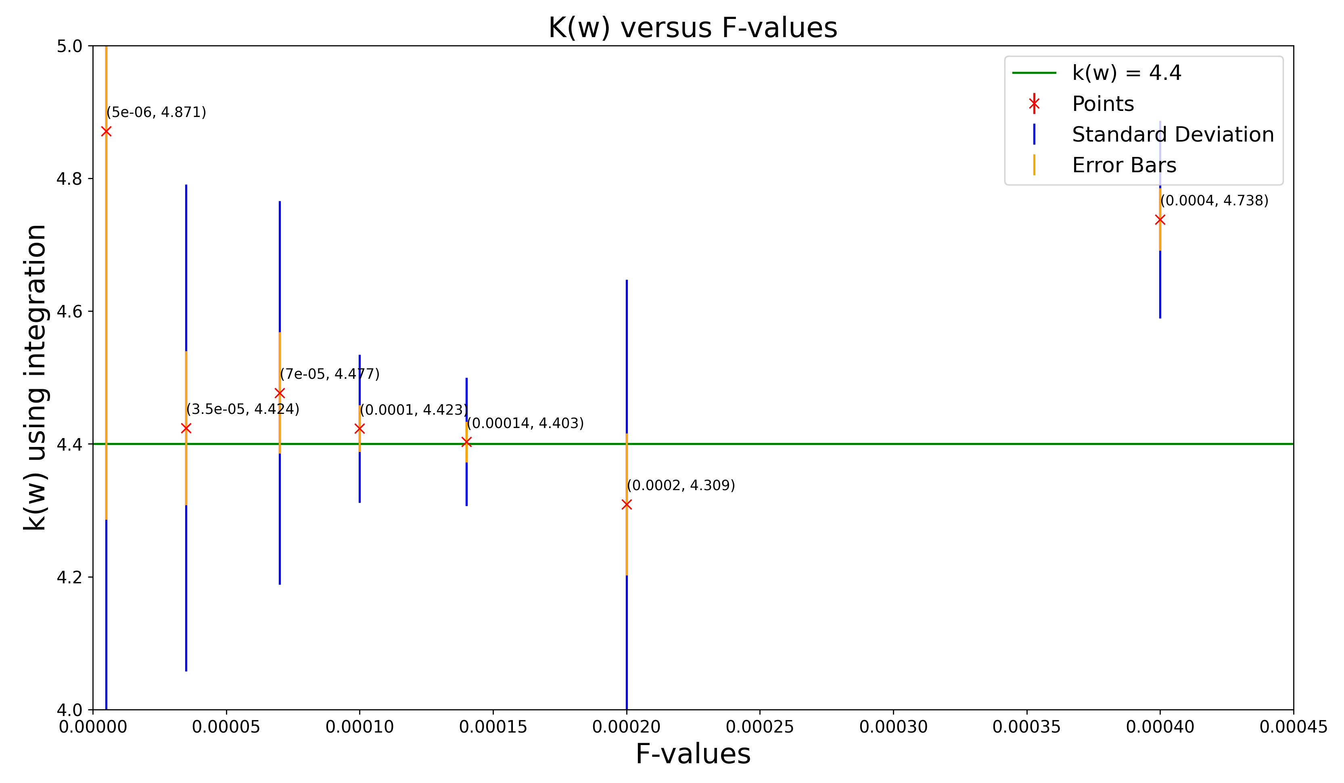
Plot of k(w) versus F-values for Temp = 300K (Zoom In)

Slide 5
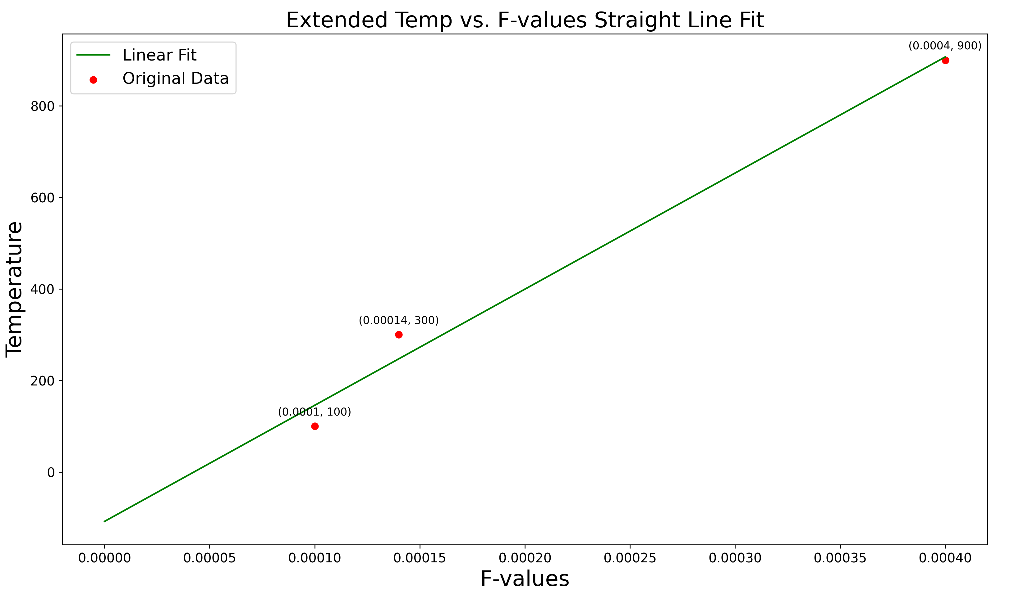
Possible Graph Fits for T vs F-optimized

Slide 6
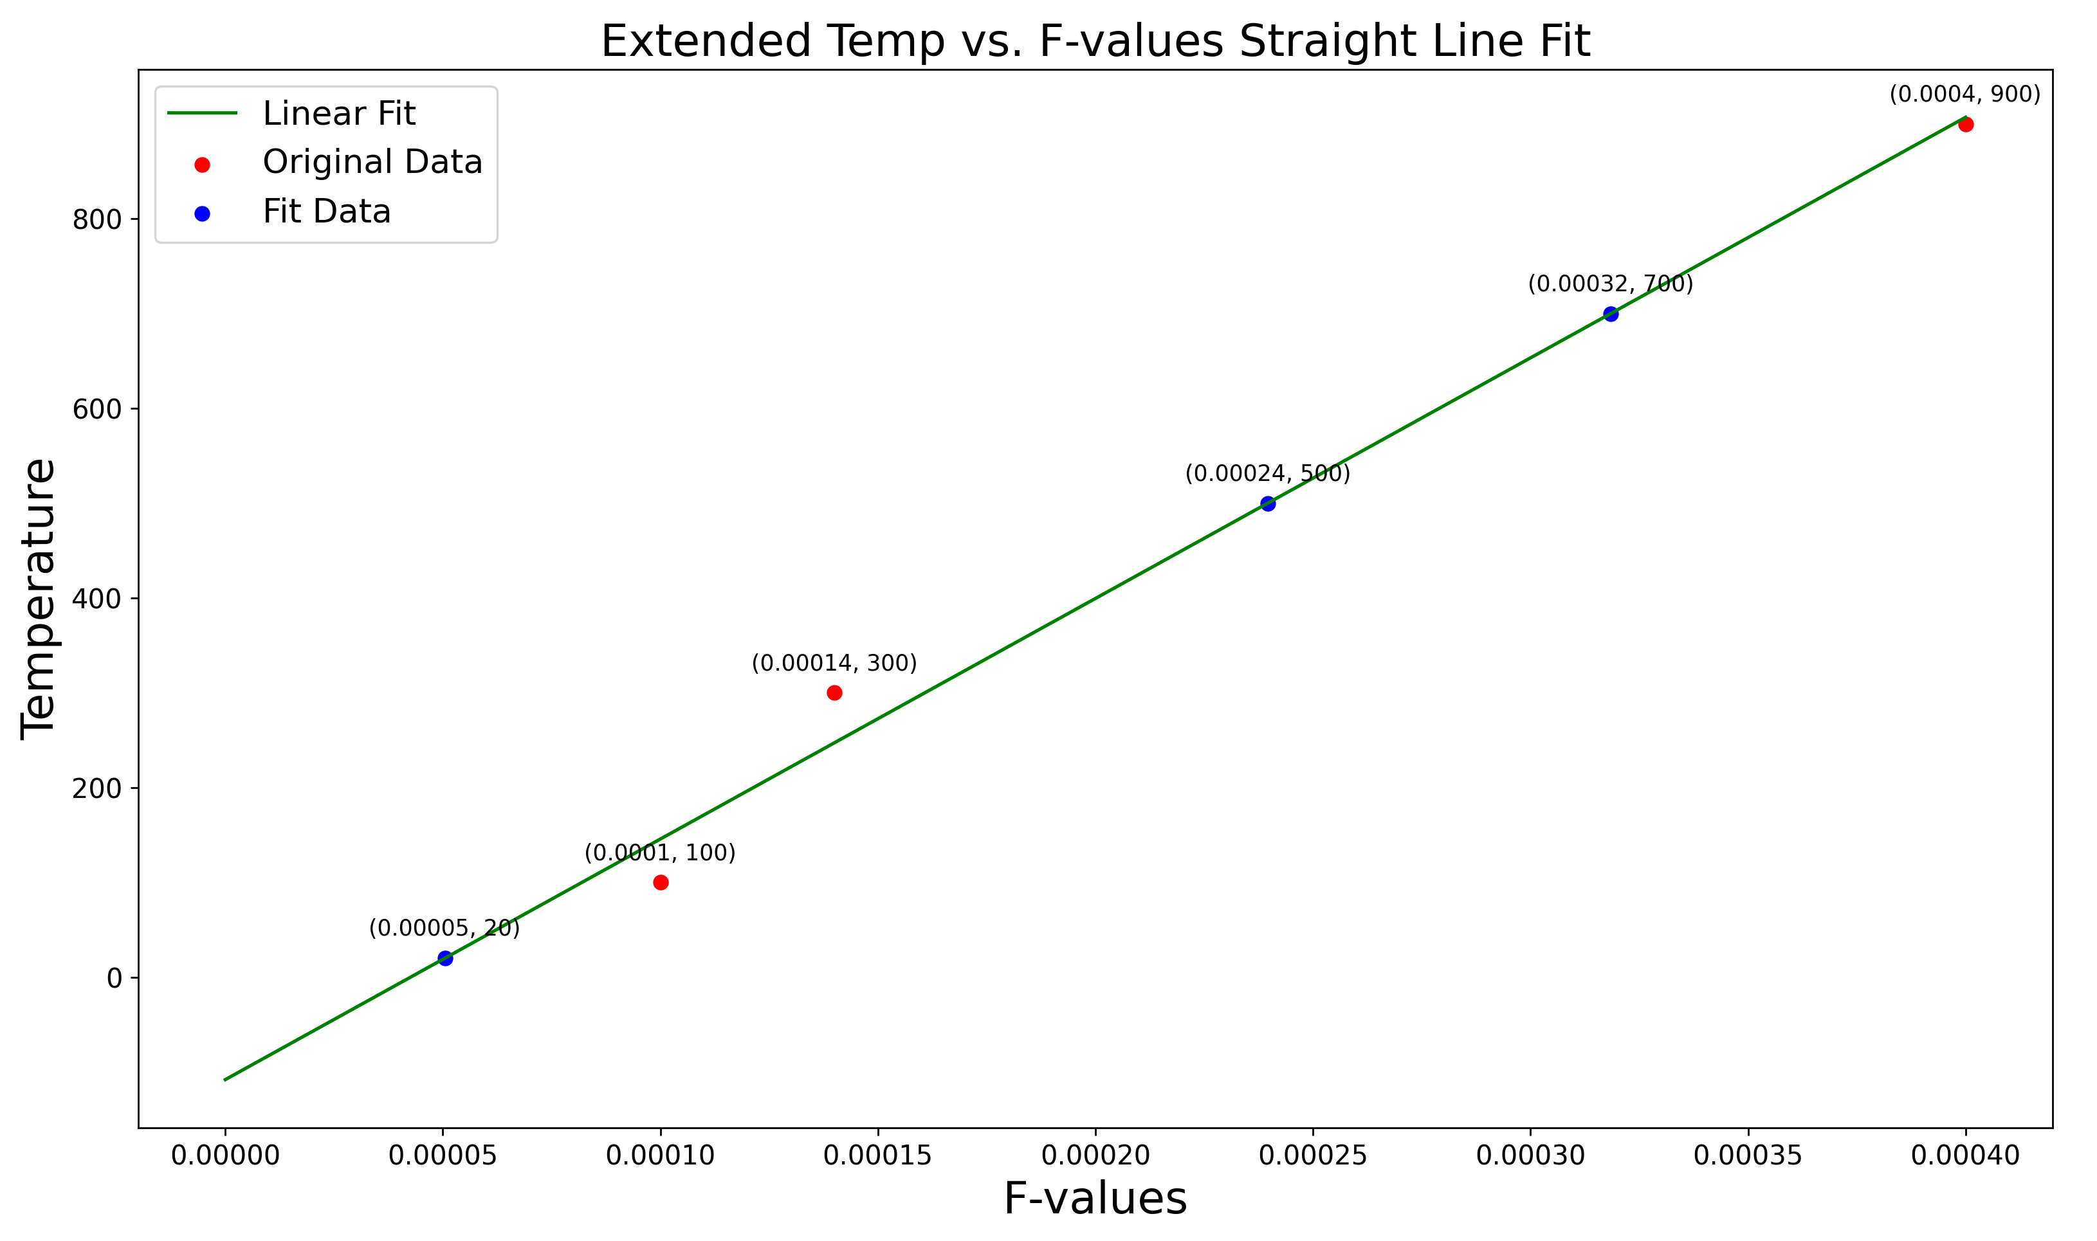
Possible Graph Fits for T vs F-optimized

Slide 7
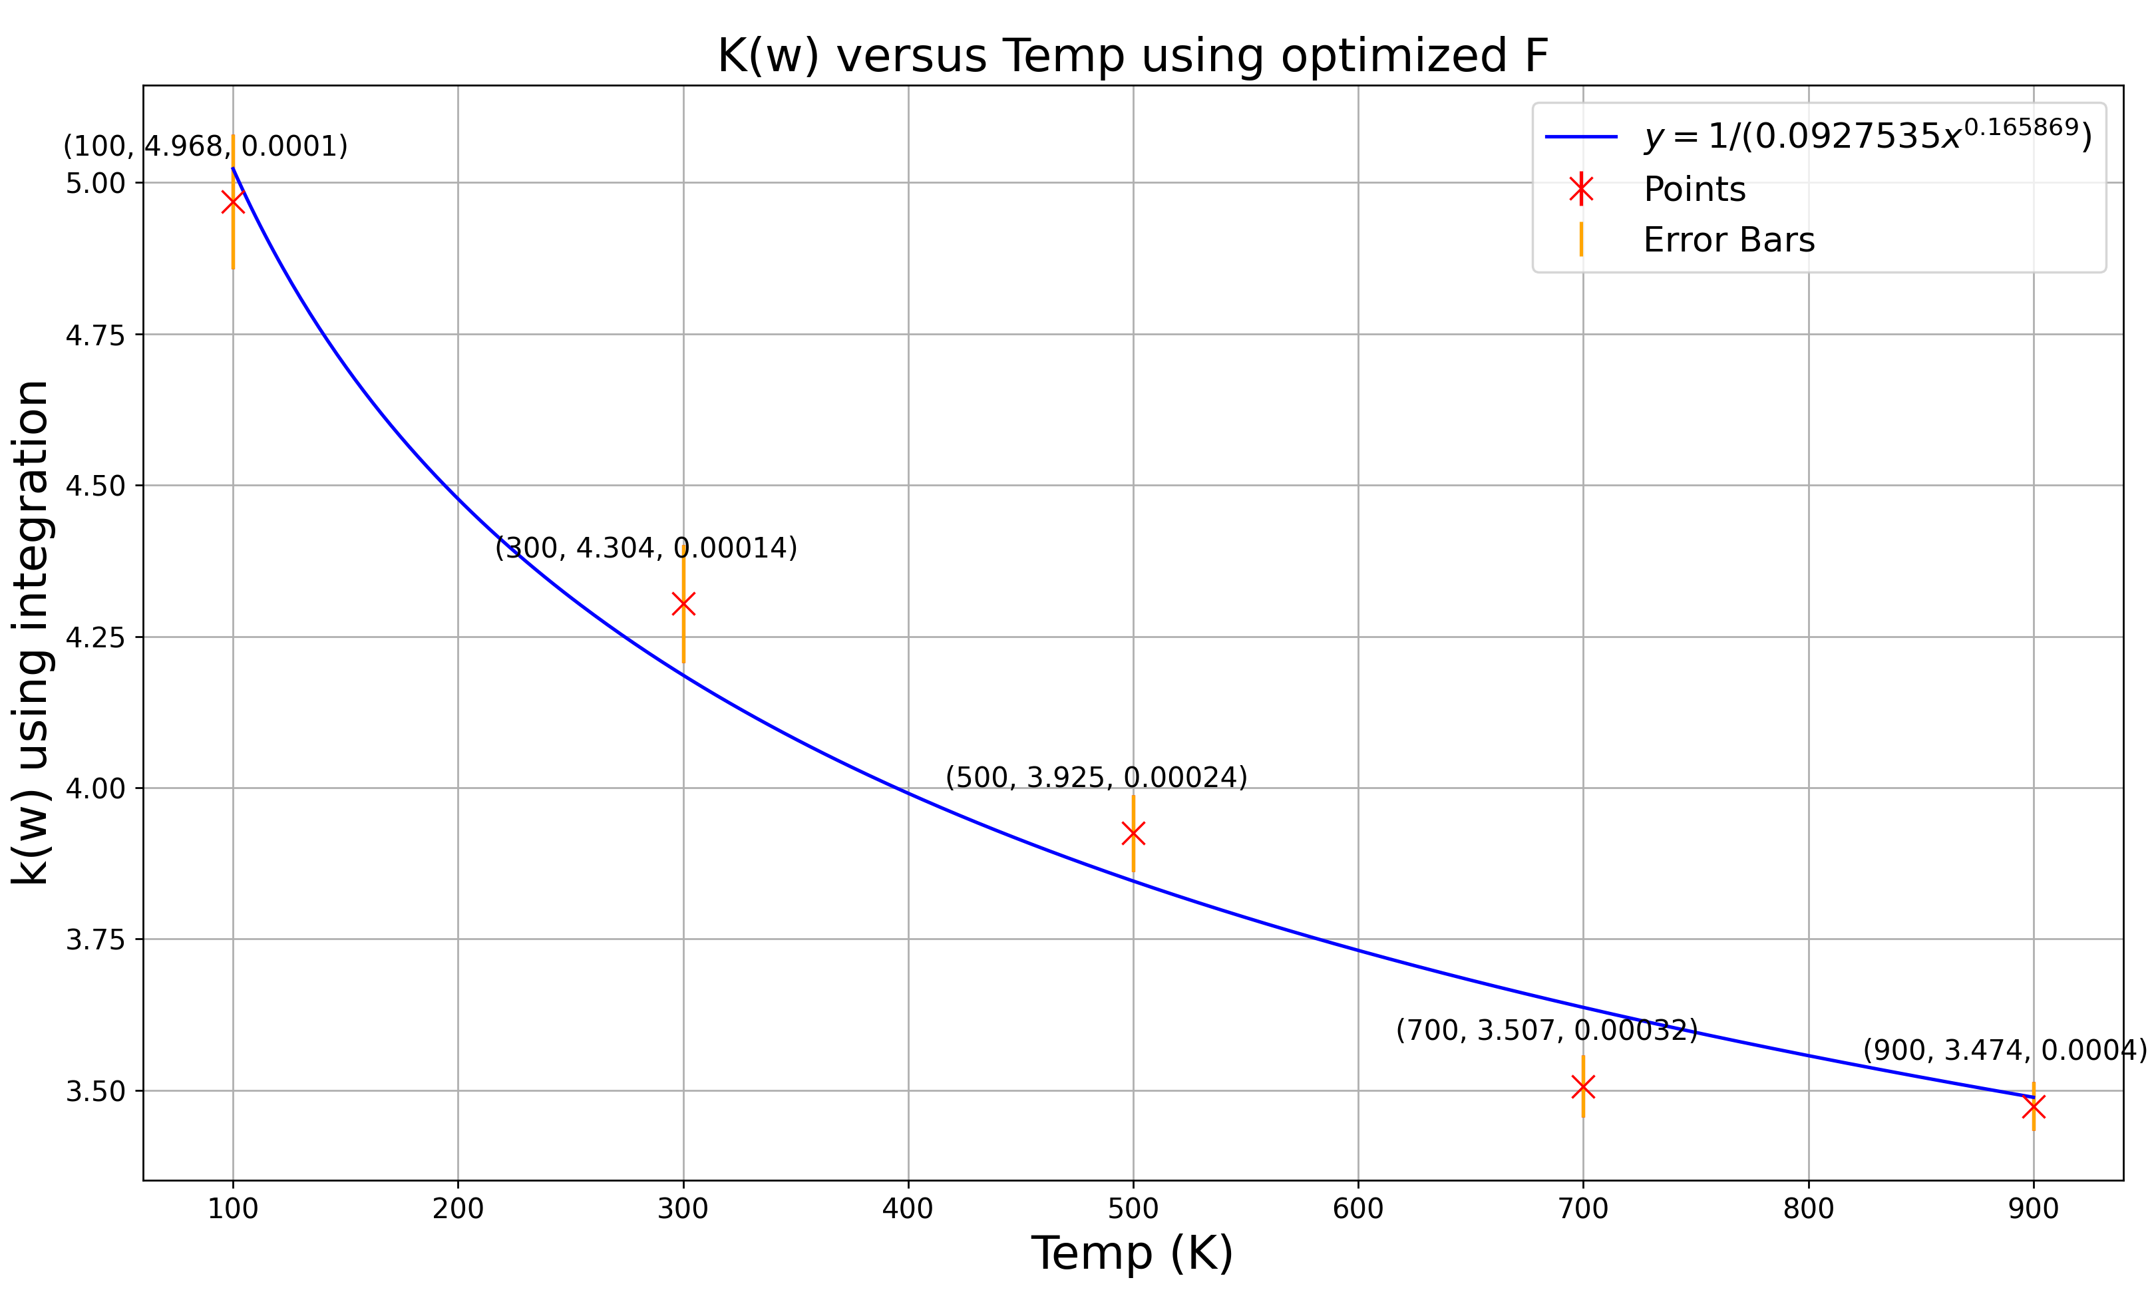
Plot K(w) versus Temp using Optimized F-values

Slide 8
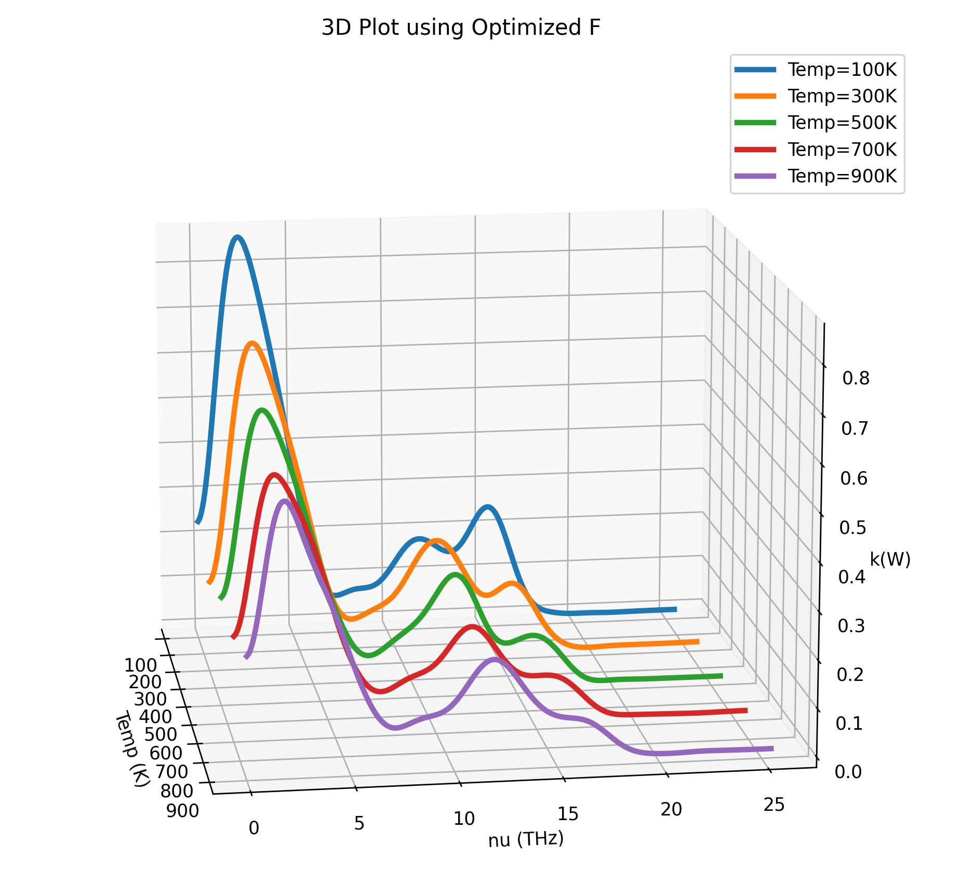
3D Plot using Optimized F with all Temp

Slide 9
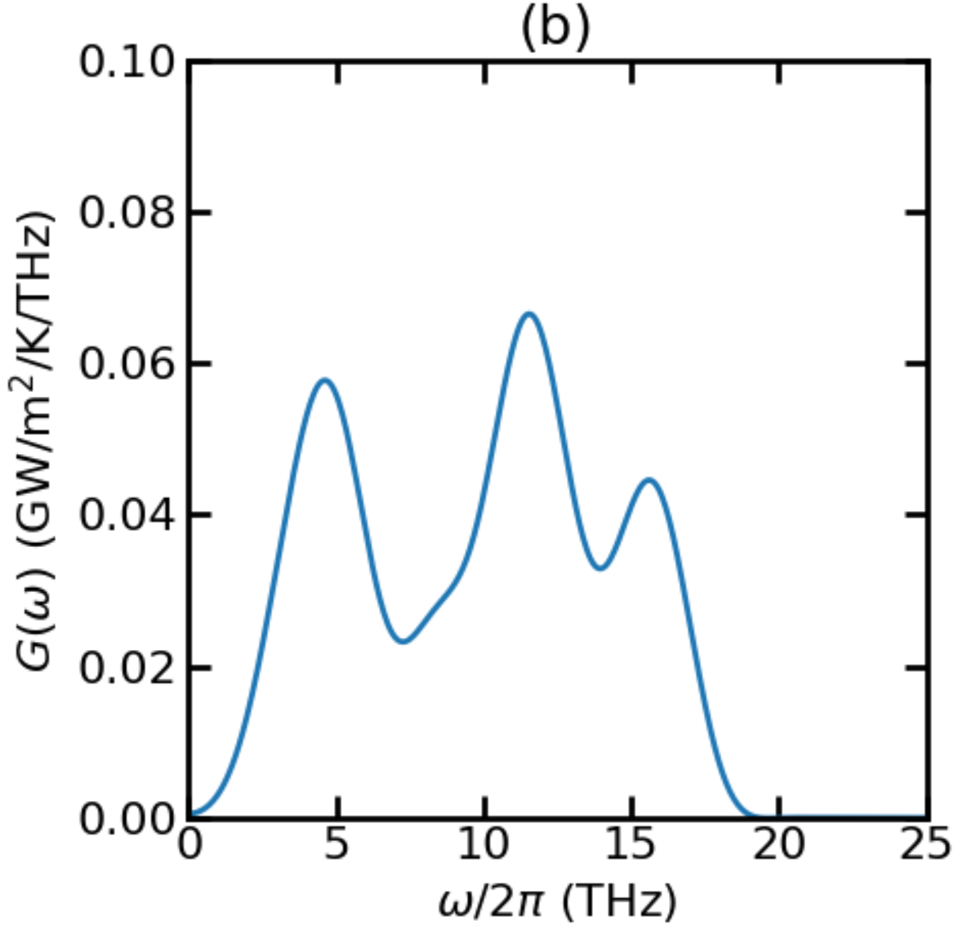
Thermal Conductance for T = 100K

Slide 10
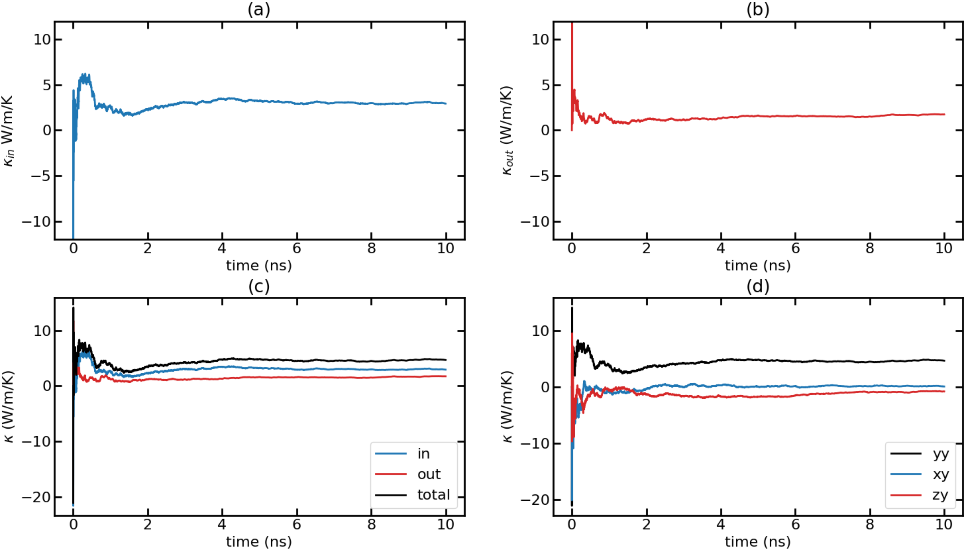
Time-dependent thermal conductivity (k(t) Vs. t) for T = 100K with F = 0.0001 Run 1

Slide 11
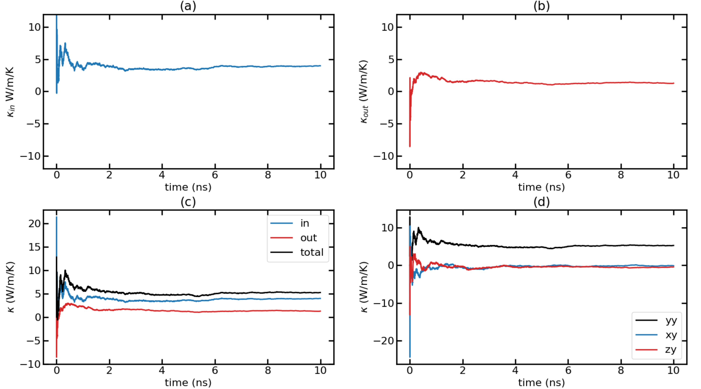
Time-dependent thermal conductivity (k(t) Vs. t) for T = 100K with F = 0.0001 Run 2

Slide 12
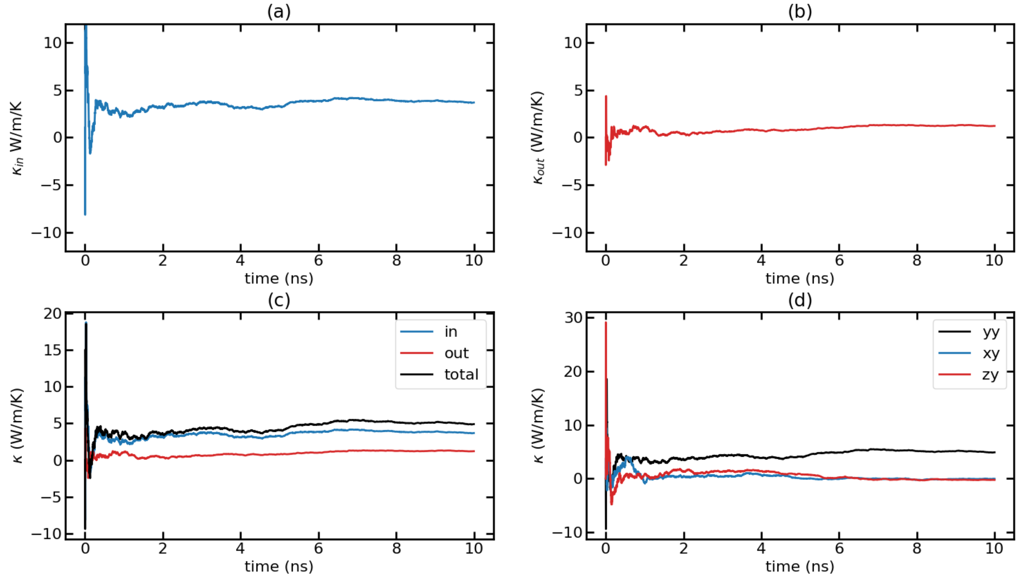
Time-dependent thermal conductivity (k(t) Vs. t) for T = 100K with F = 0.0001 Run 3

Slide 13
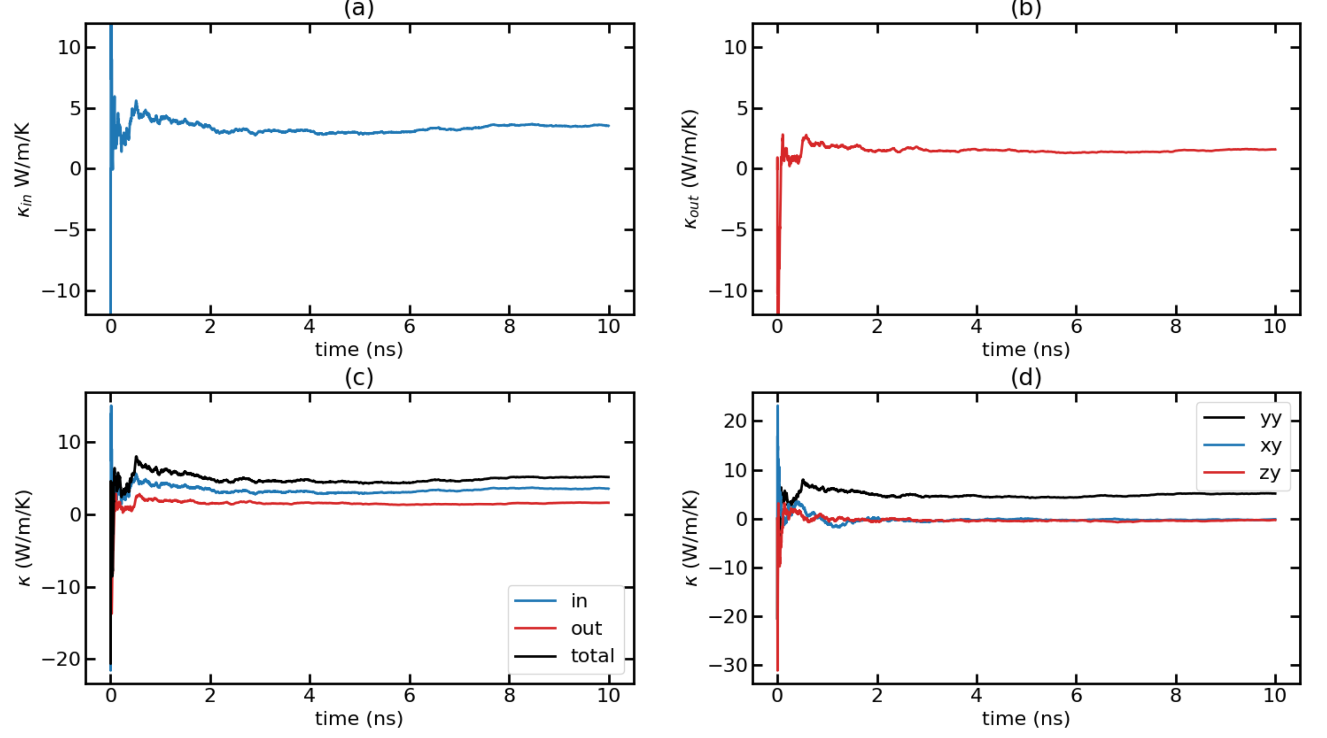
Time-dependent thermal conductivity (k(t) Vs. t) for T = 100K with F = 0.0001 Run 4

Slide 14
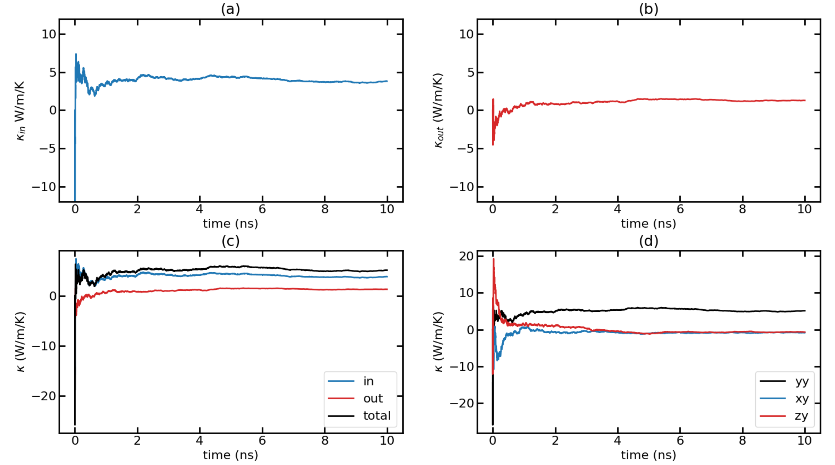
Time-dependent thermal conductivity (k(t) Vs. t) for T = 100K with F = 0.0001 Run 5

Slide 15
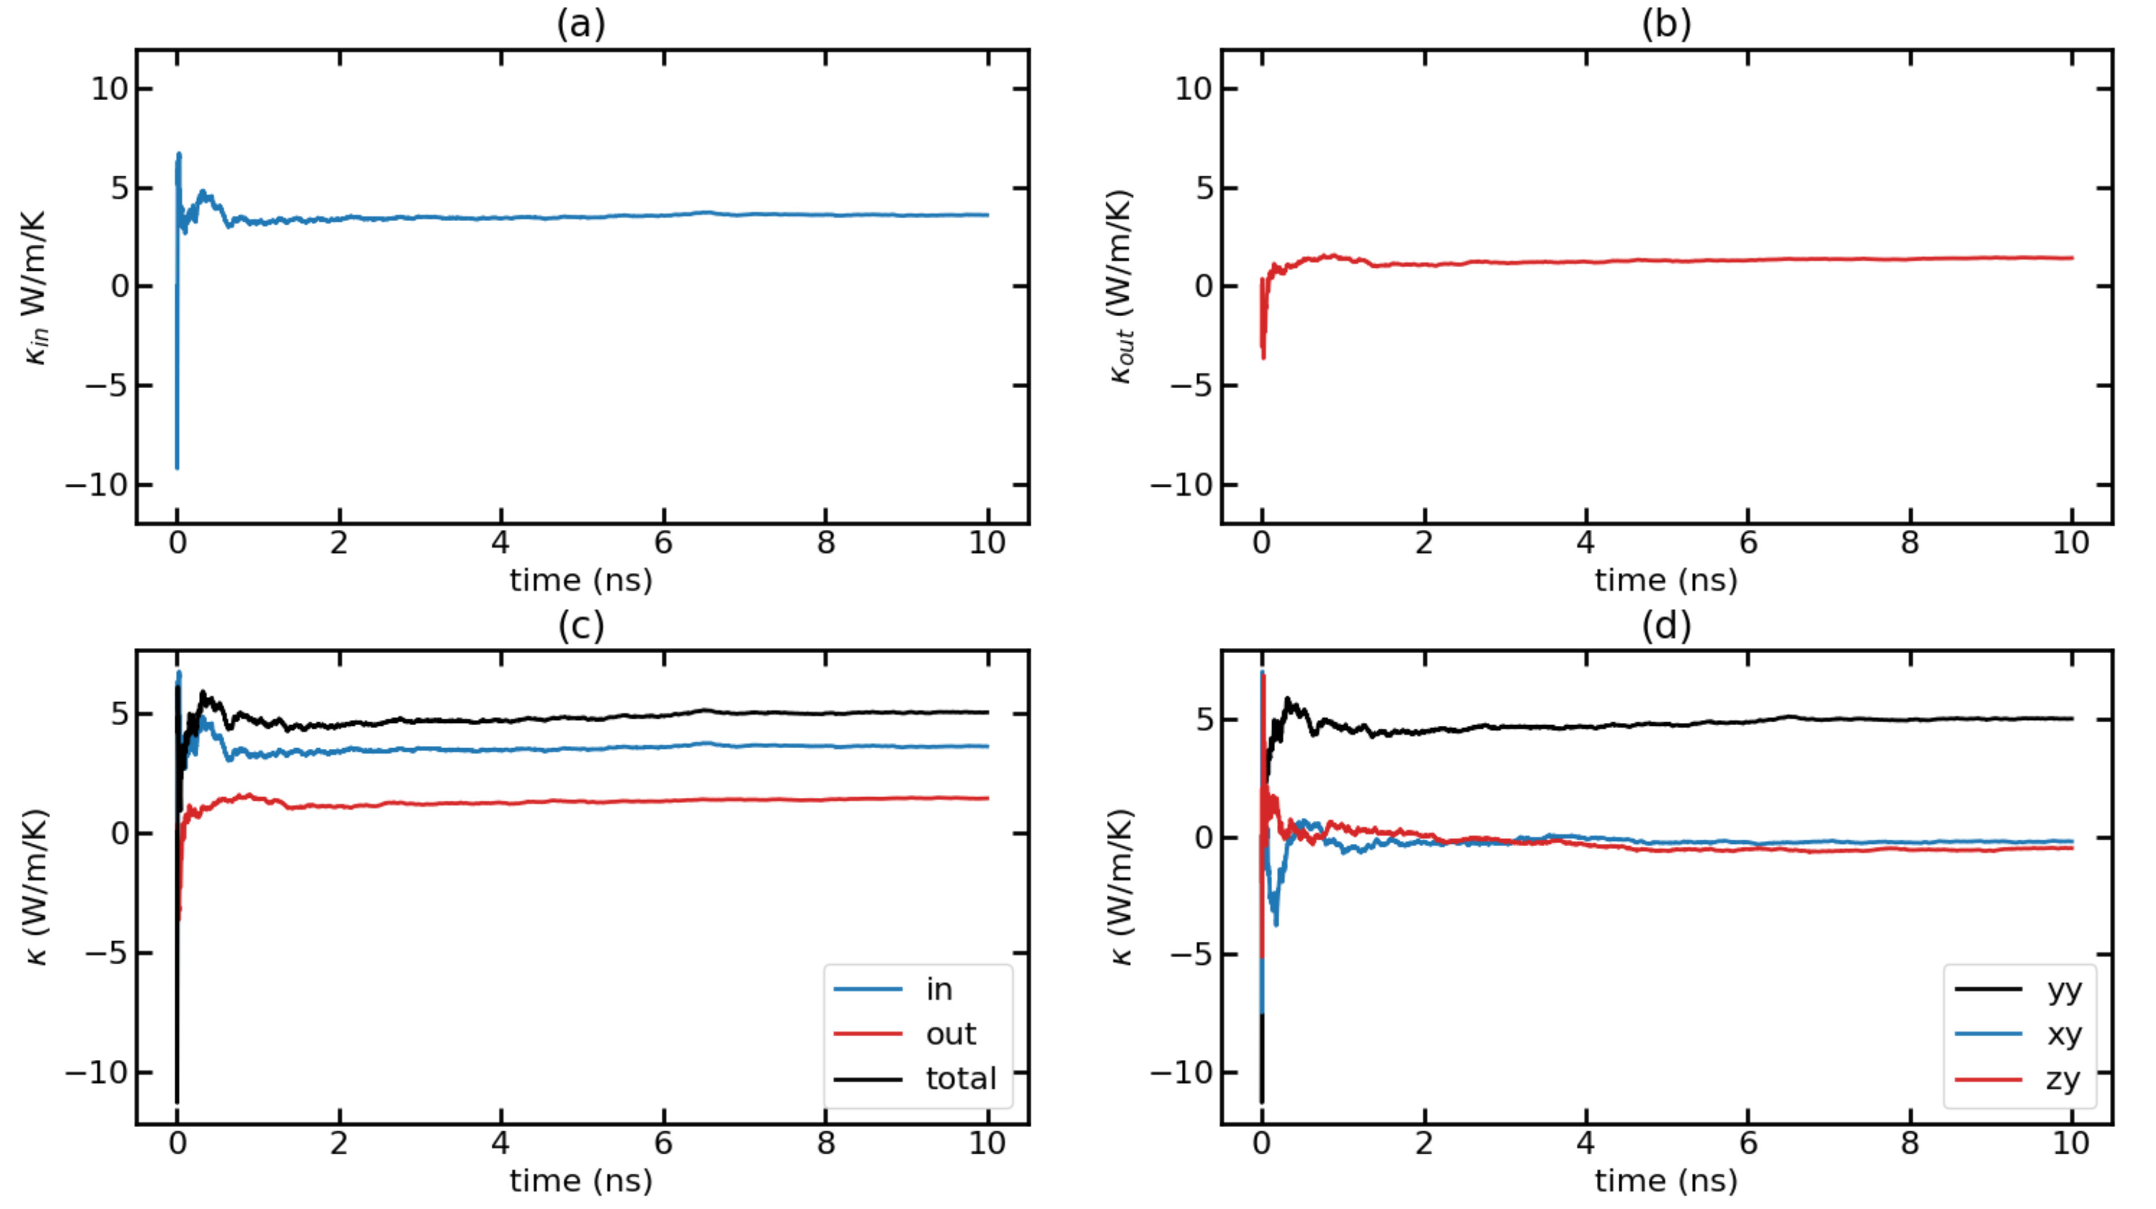
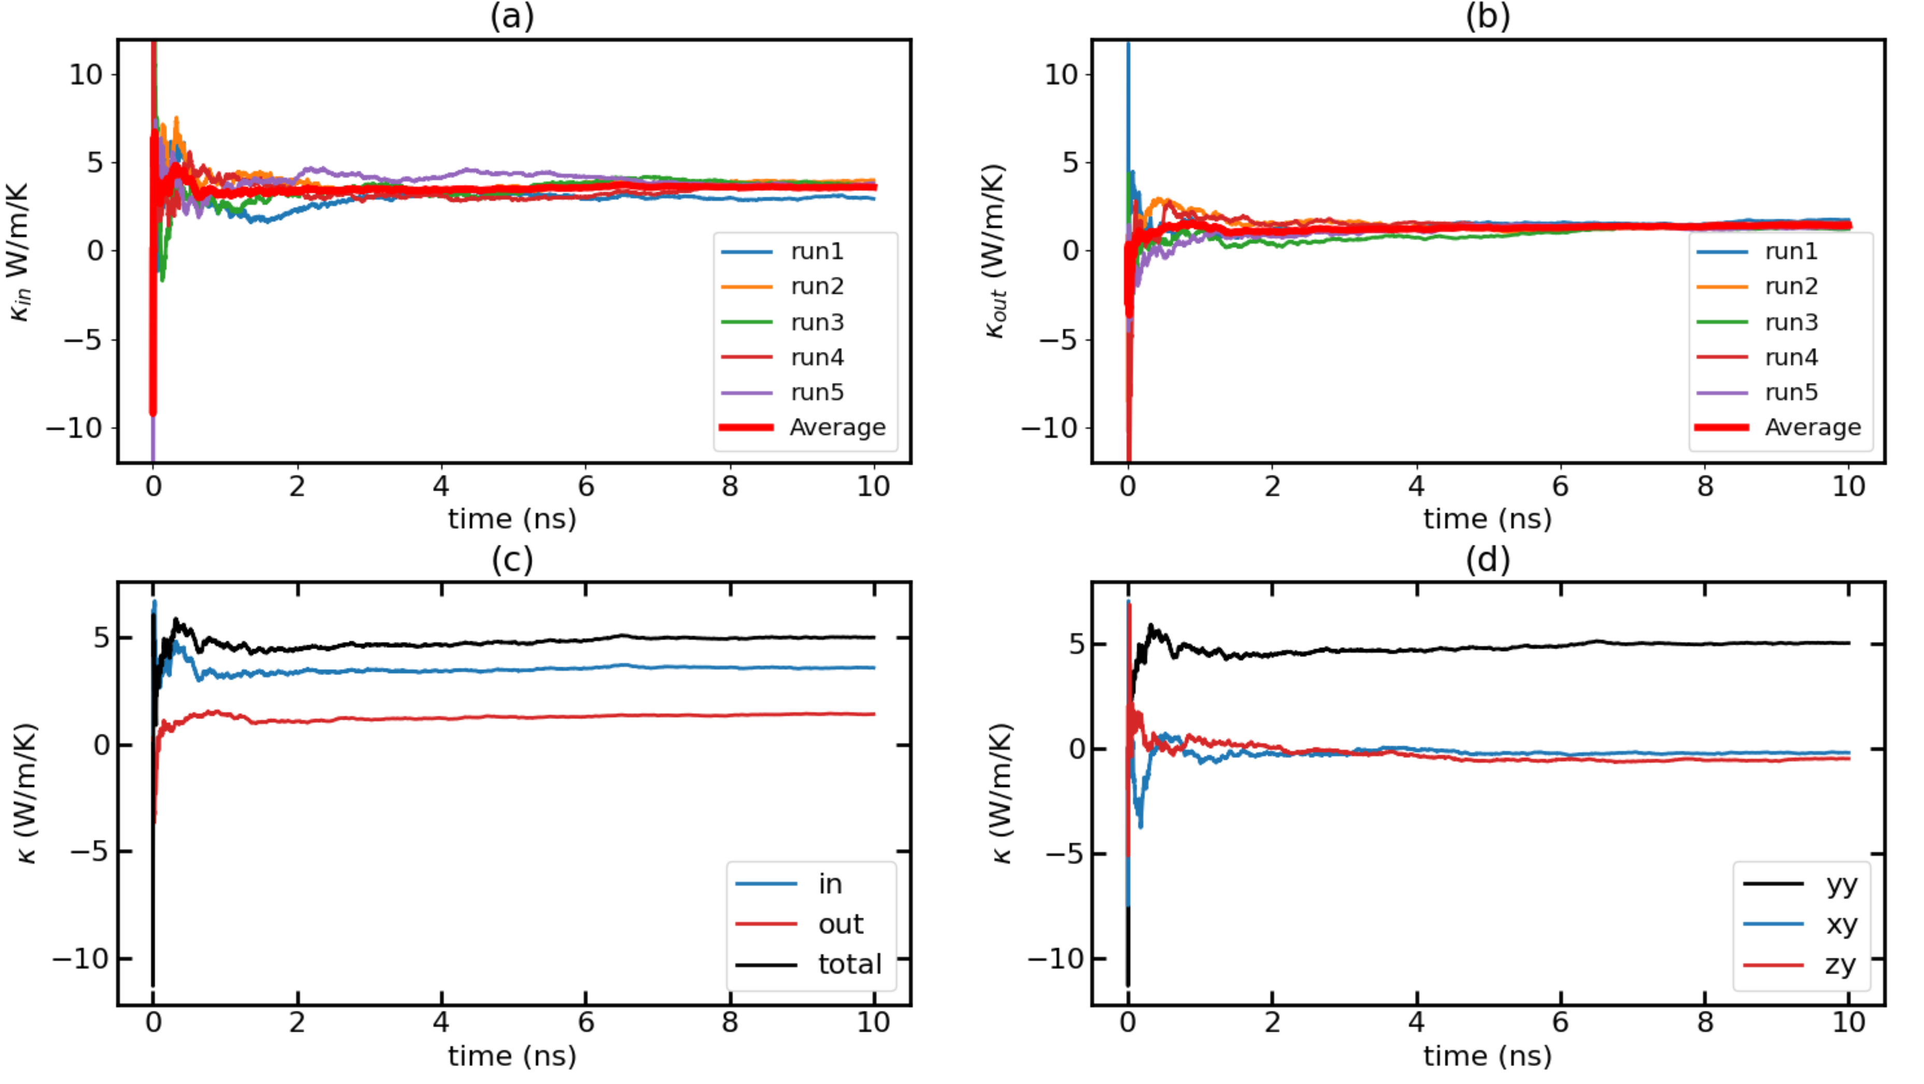
Time-dependent thermal conductivity (k(t) Vs. t) for T = 100K with F = 0.0001 Average Run

Slide 16
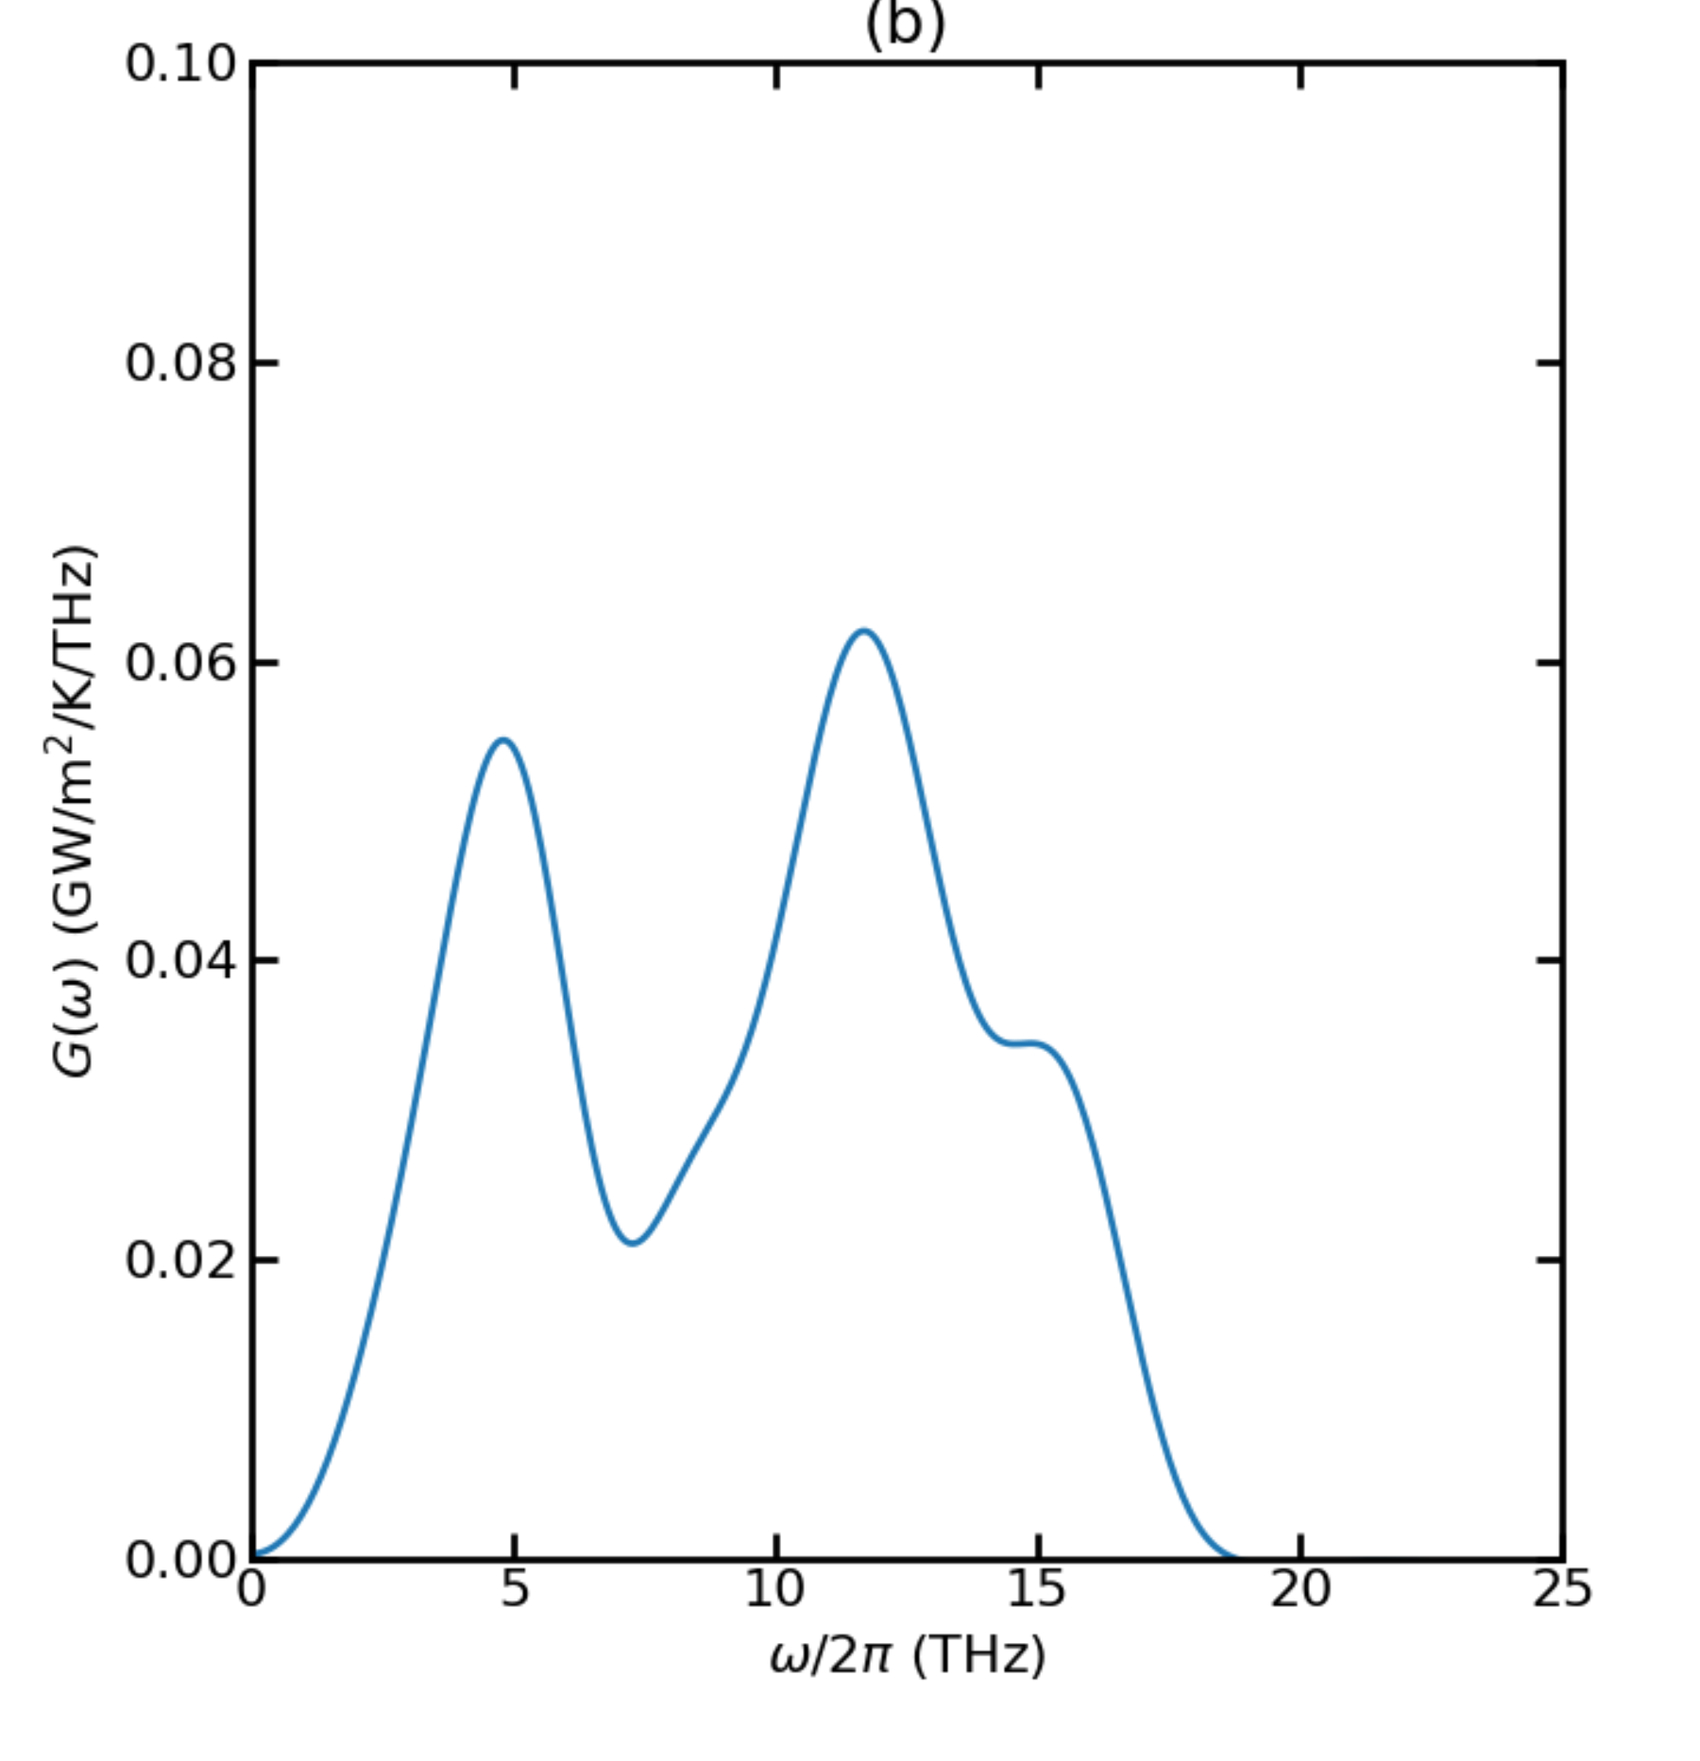
Thermal Conductance for T = 300K

Slide 17
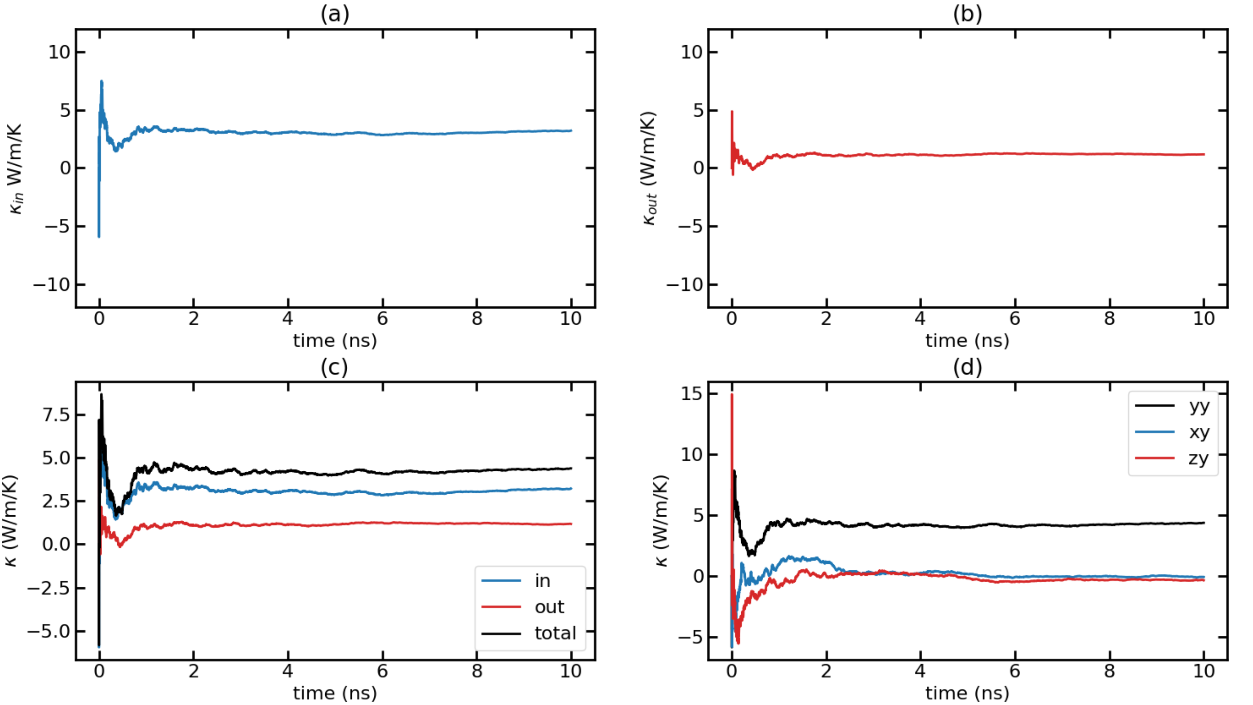
Time-dependent thermal conductivity (k(t) Vs. t) for T = 300K with F = 0.00014 Run 1

Slide 18
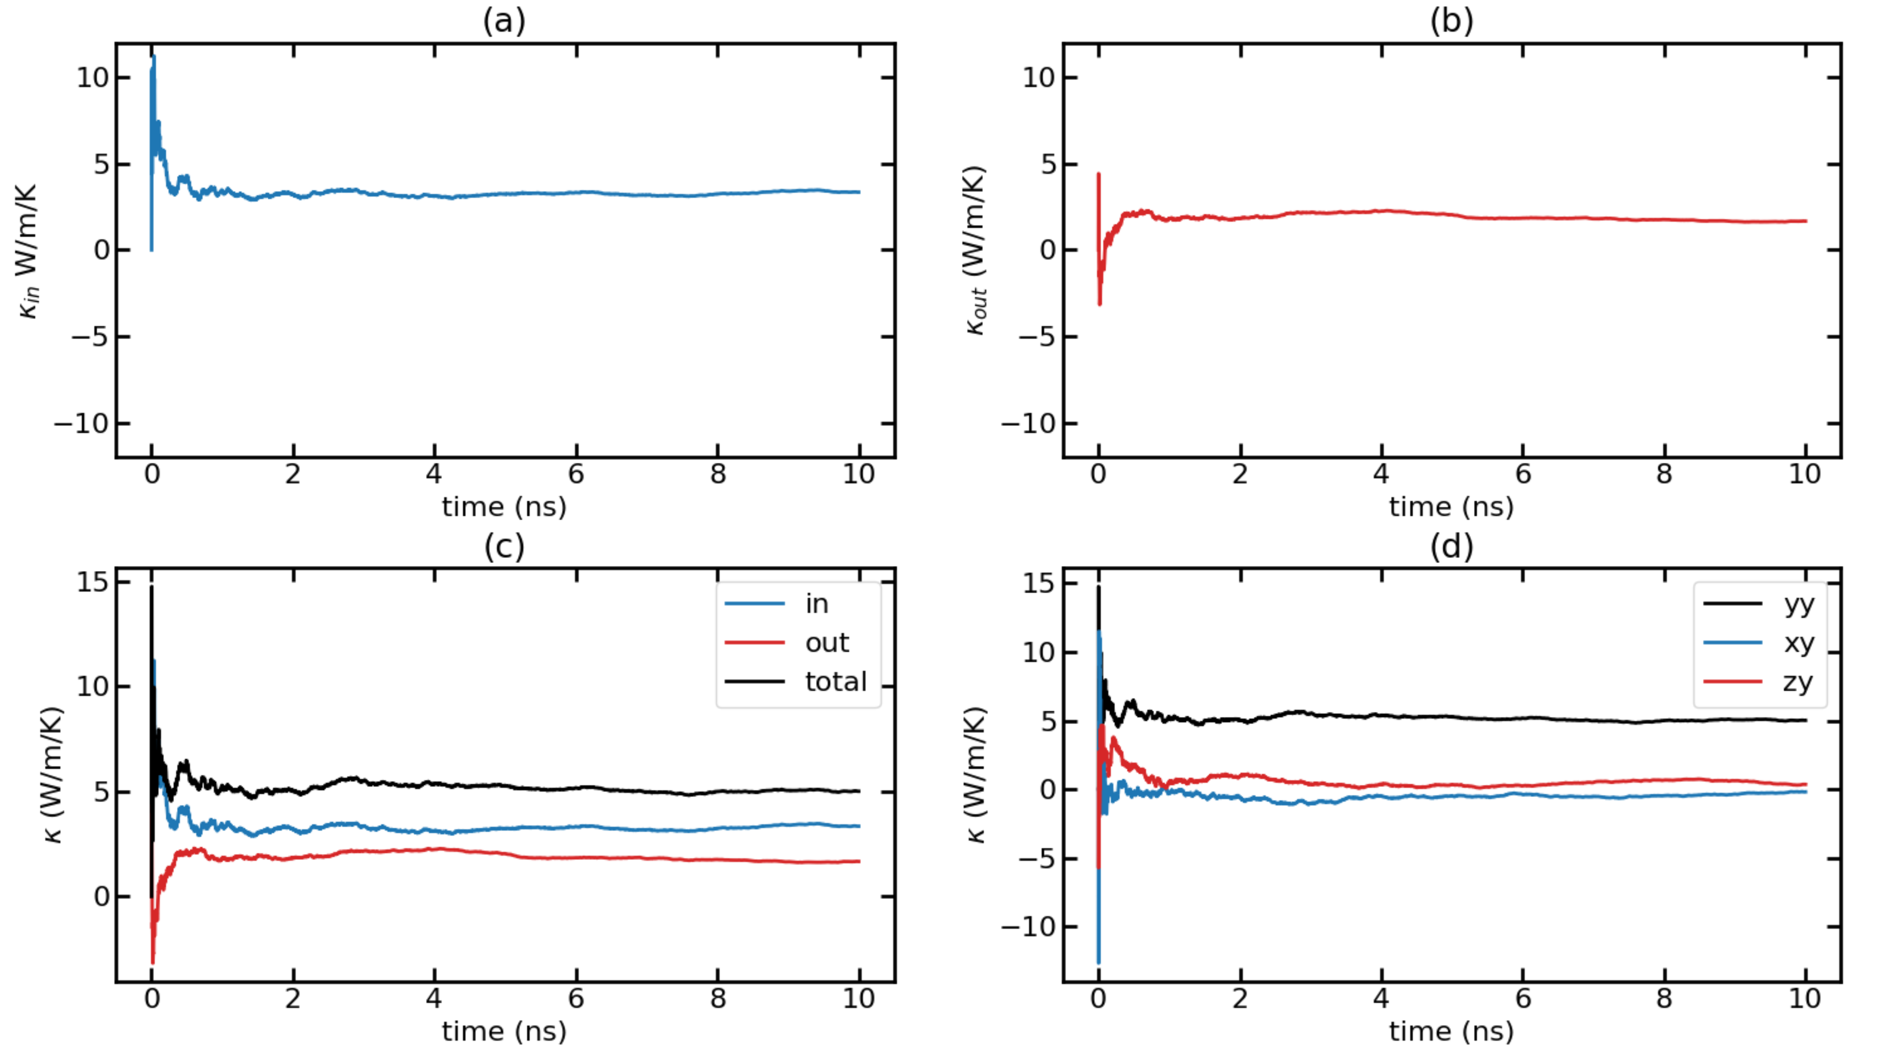
Time-dependent thermal conductivity (k(t) Vs. t) for T = 300K with F = 0.00014 Run 2

Slide 19
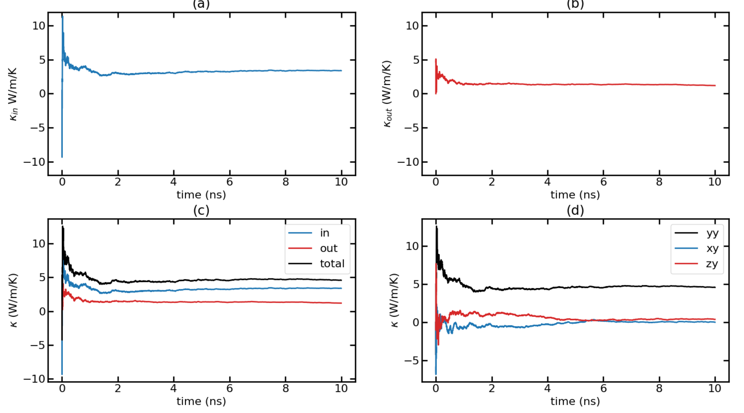
Time-dependent thermal conductivity (k(t) Vs. t) for T = 300K with F = 0.00014 Run 3

Slide 20
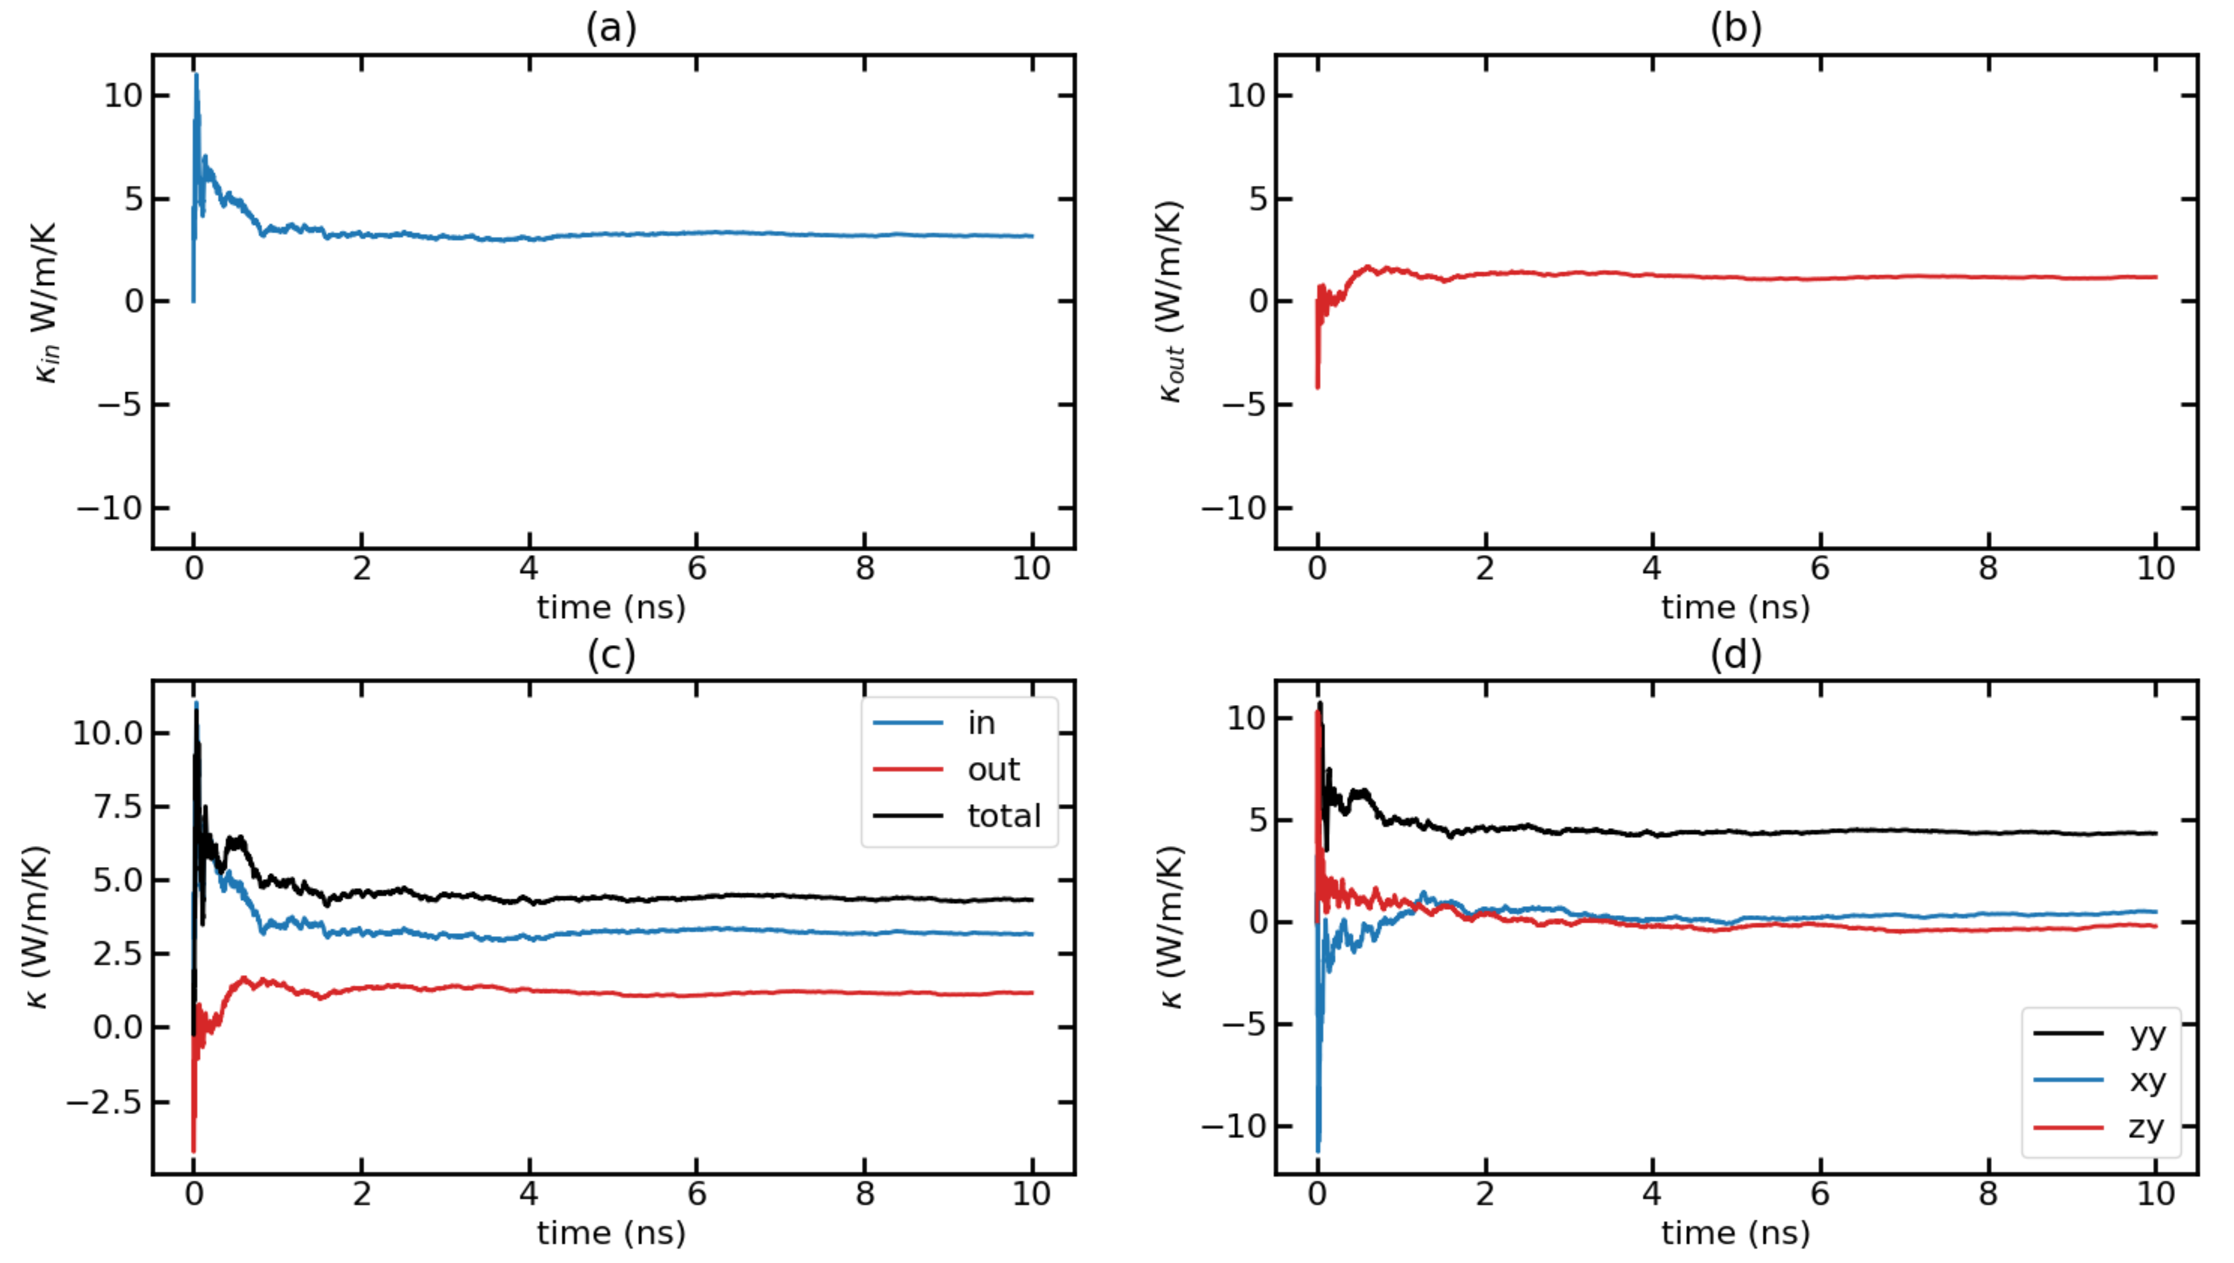
Time-dependent thermal conductivity (k(t) Vs. t) for T = 300K with F = 0.00014 Run 4

Slide 21
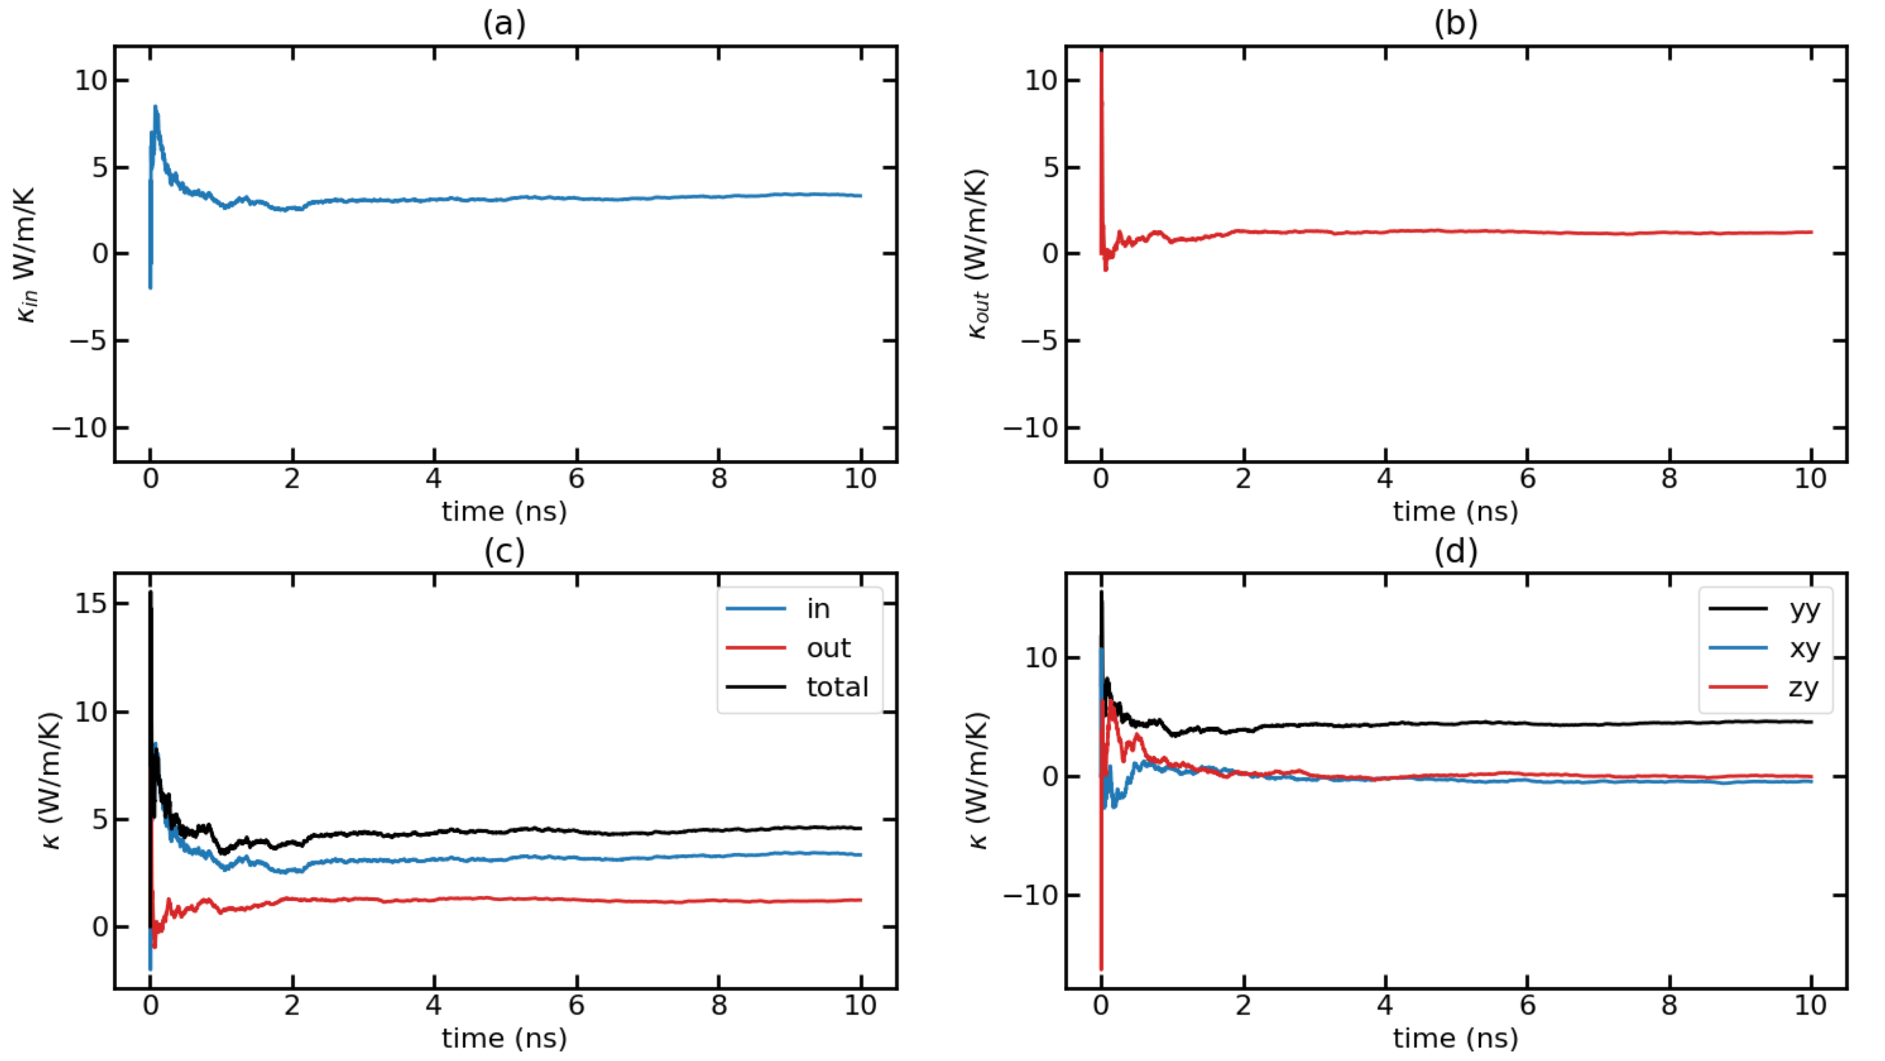
Time-dependent thermal conductivity (k(t) Vs. t) for T = 300K with F = 0.00014 Run 5

Slide 22
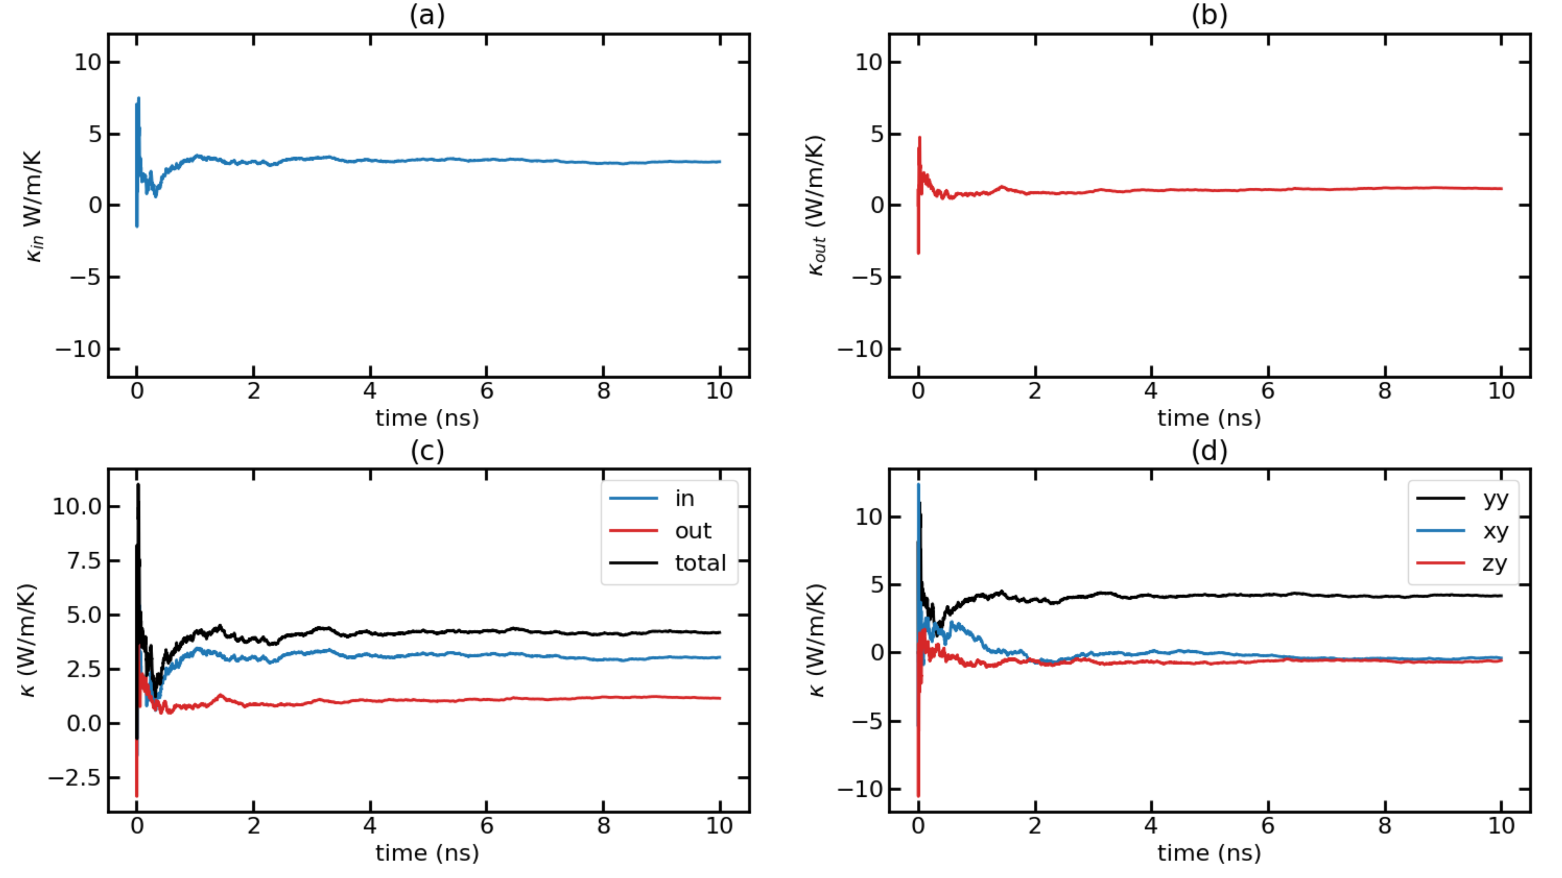
Time-dependent thermal conductivity (k(t) Vs. t) for T = 300K with F = 0.00014 Run 6

Slide 23
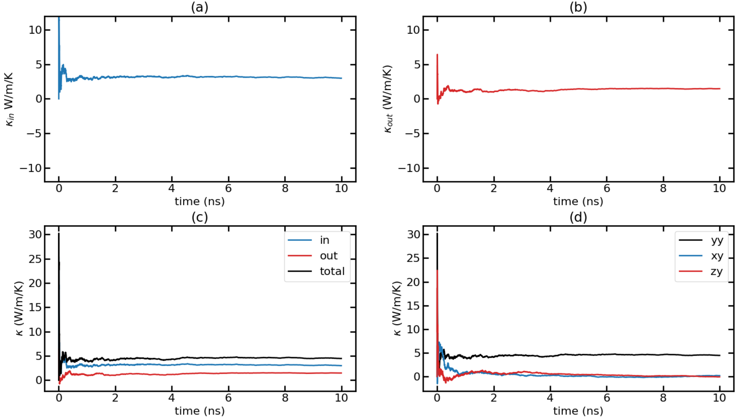
Time-dependent thermal conductivity (k(t) Vs. t) for T = 300K with F = 0.00014 Run 7

Slide 24
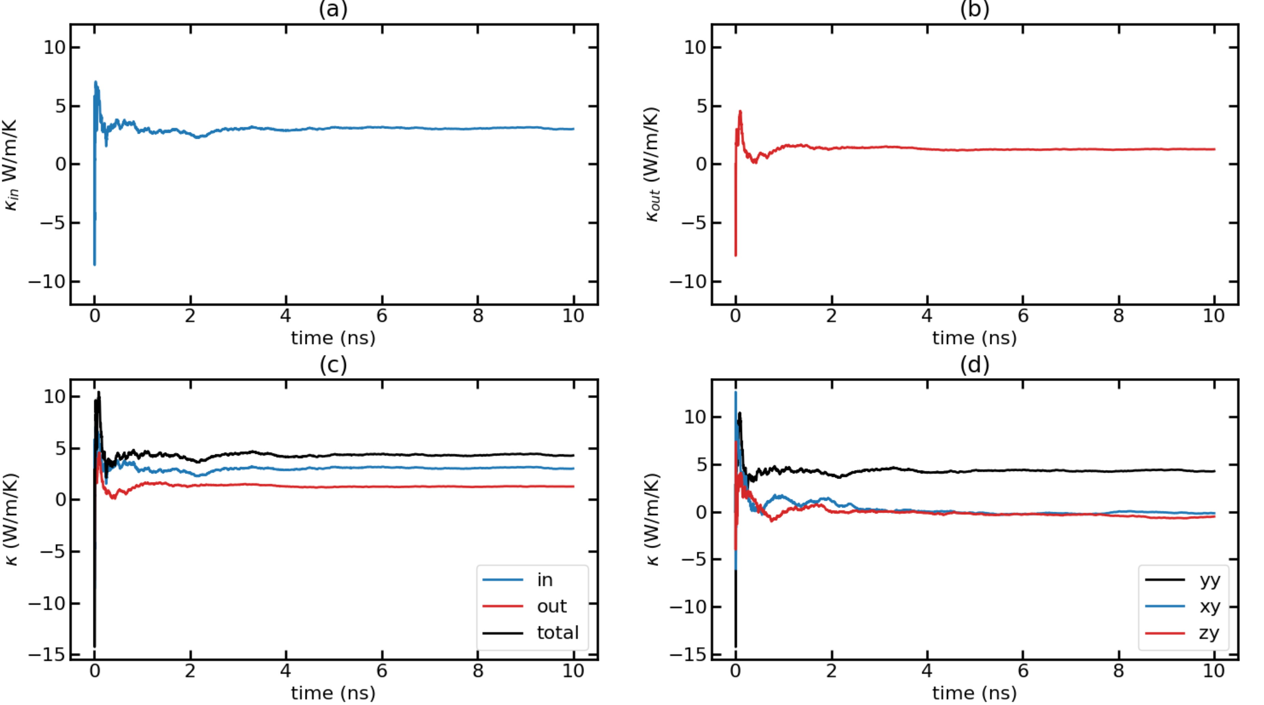
Time-dependent thermal conductivity (k(t) Vs. t) for T = 300K with F = 0.00014 Run 8

Slide 25
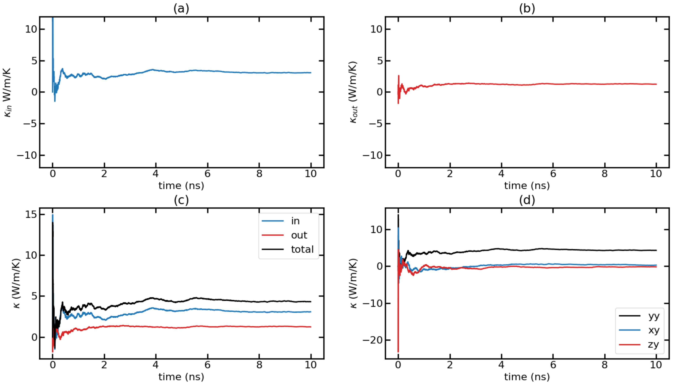
Time-dependent thermal conductivity (k(t) Vs. t) for T = 300K with F = 0.00014 Run 9

Slide 26
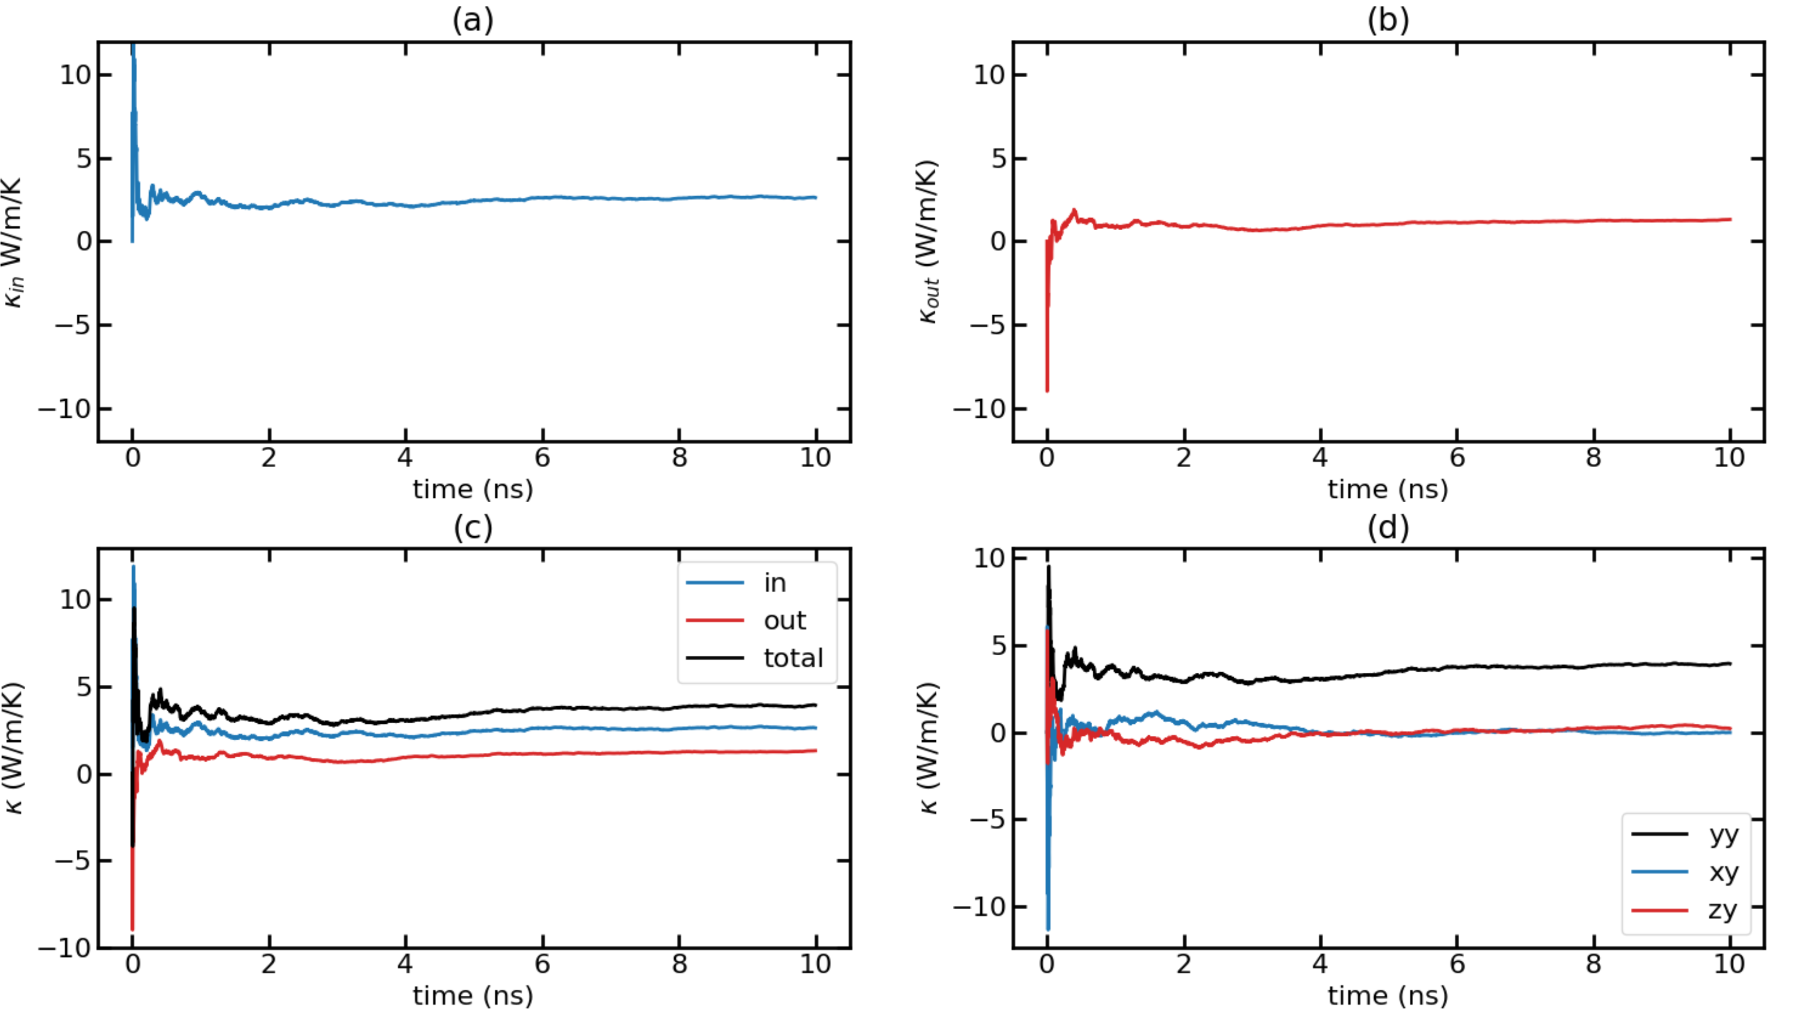
Time-dependent thermal conductivity (k(t) Vs. t) for T = 300K with F = 0.00014 Run 10

Slide 27
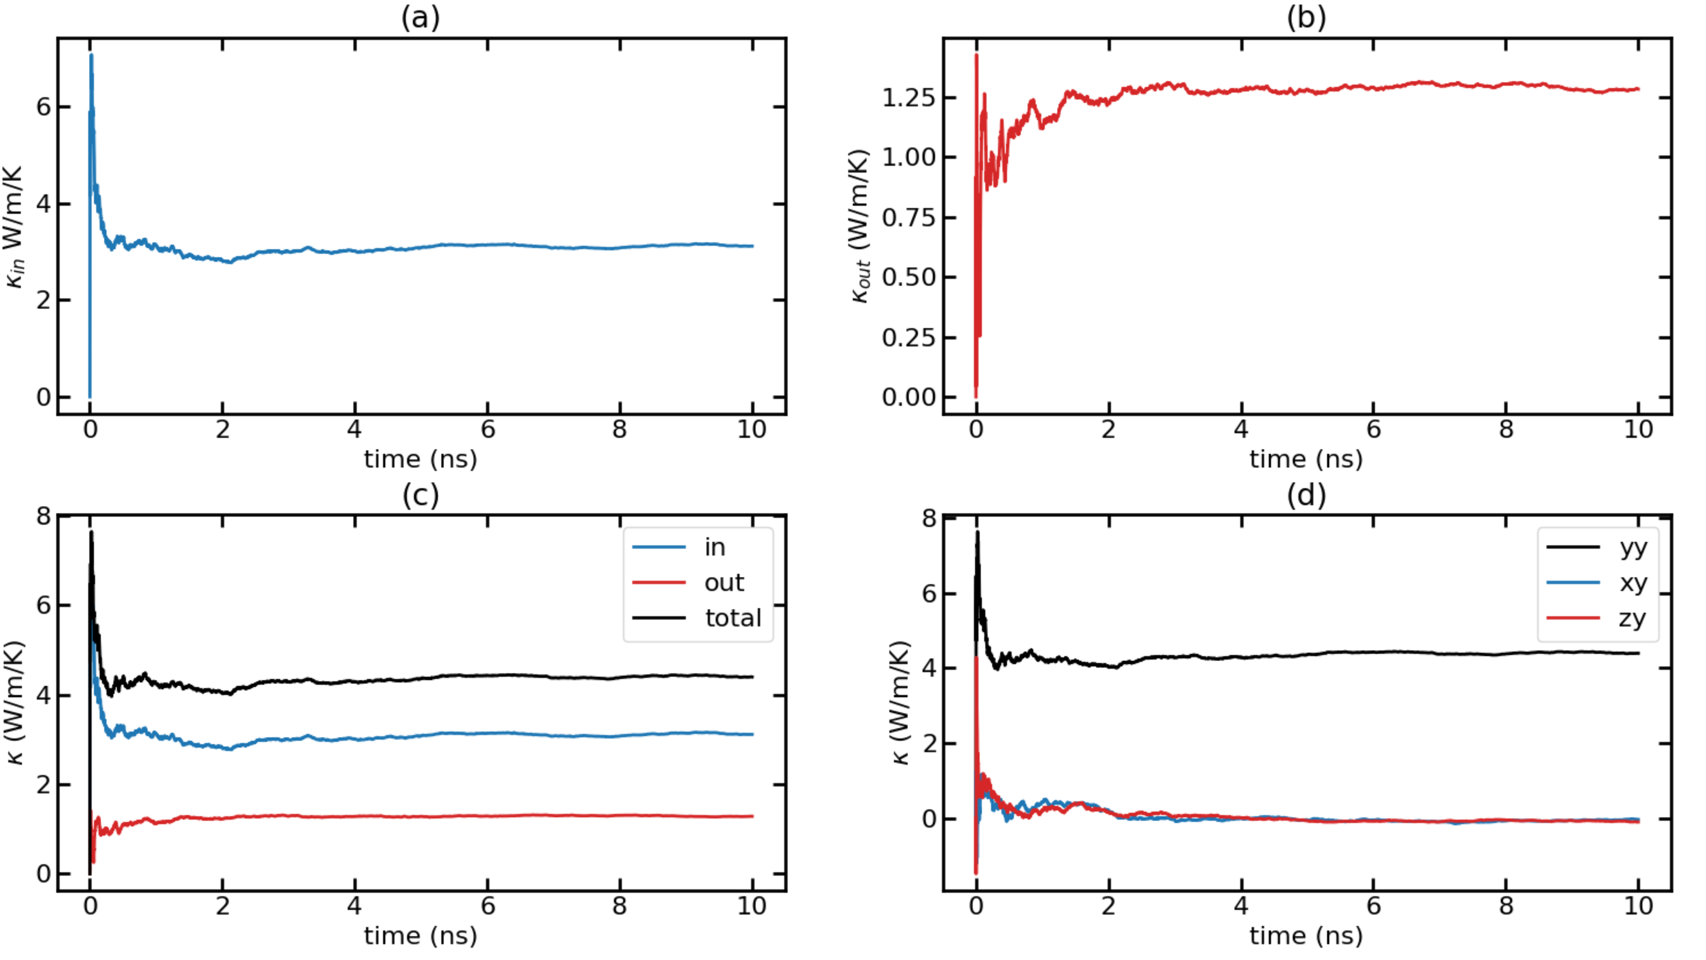
Time-dependent thermal conductivity (k(t) Vs. t) for T = 300K with F = 0.00014 Avg Runs

Slide 28
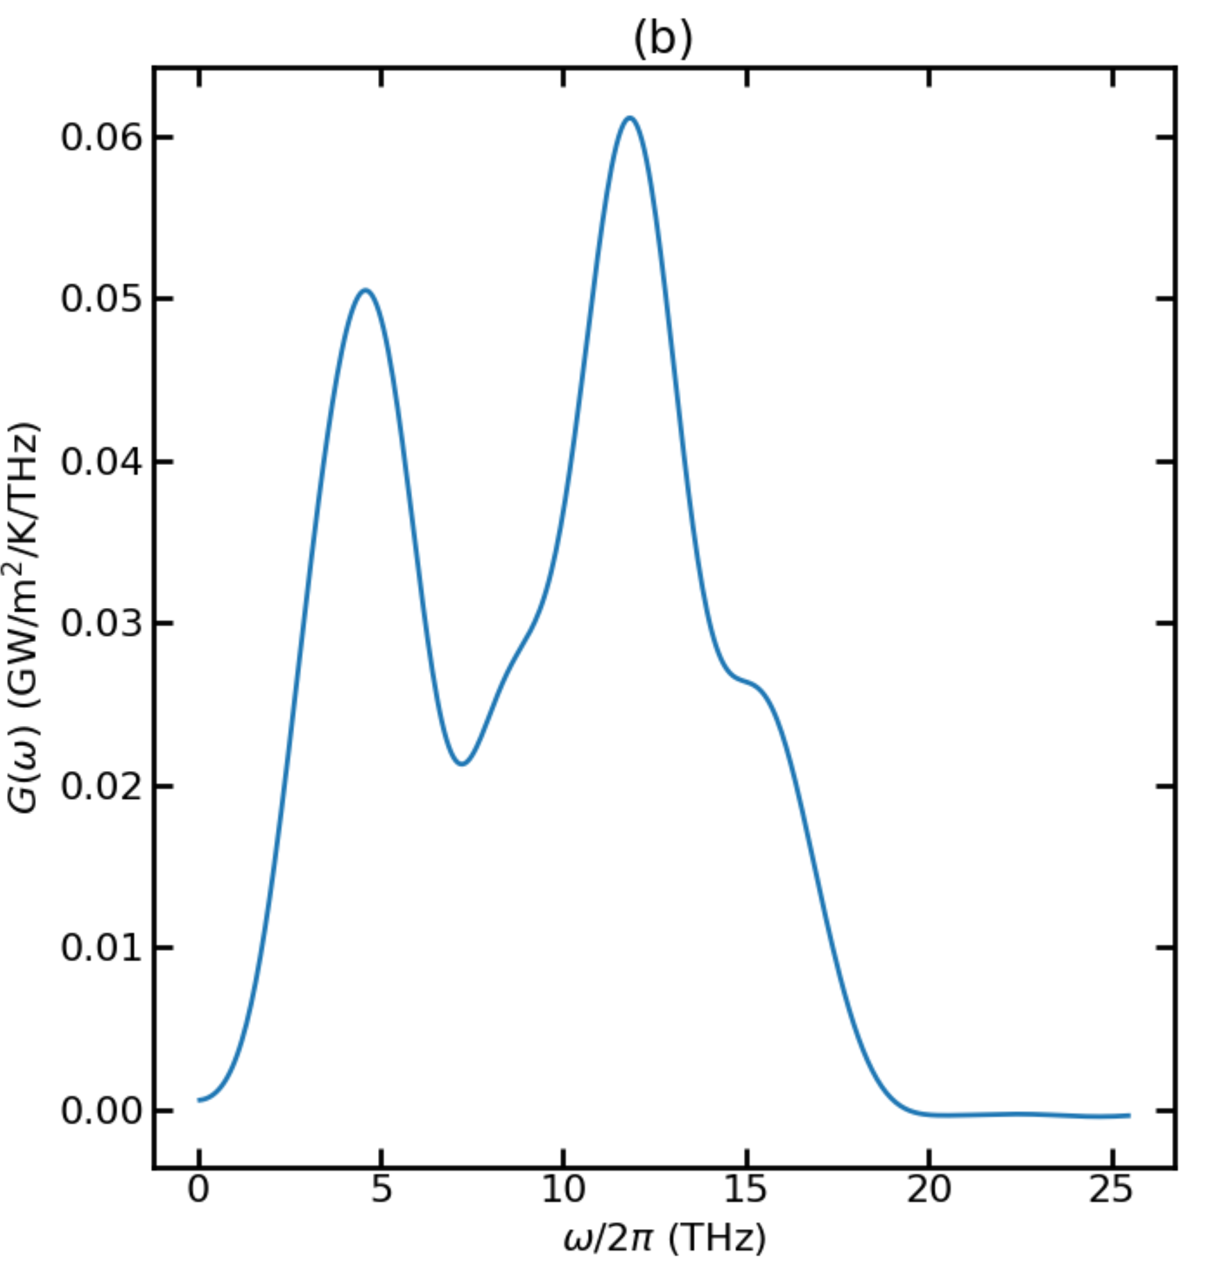
Thermal Conductance for T = 500K

Slide 29
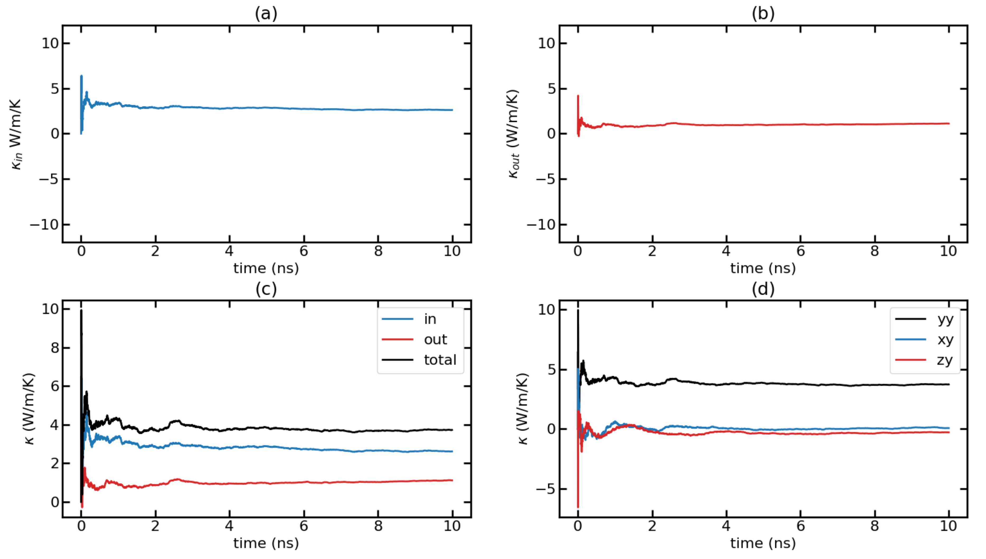
Time-dependent thermal conductivity (k(t) Vs. t) for T = 500K with F = 0.00024 Run 1

Slide 30
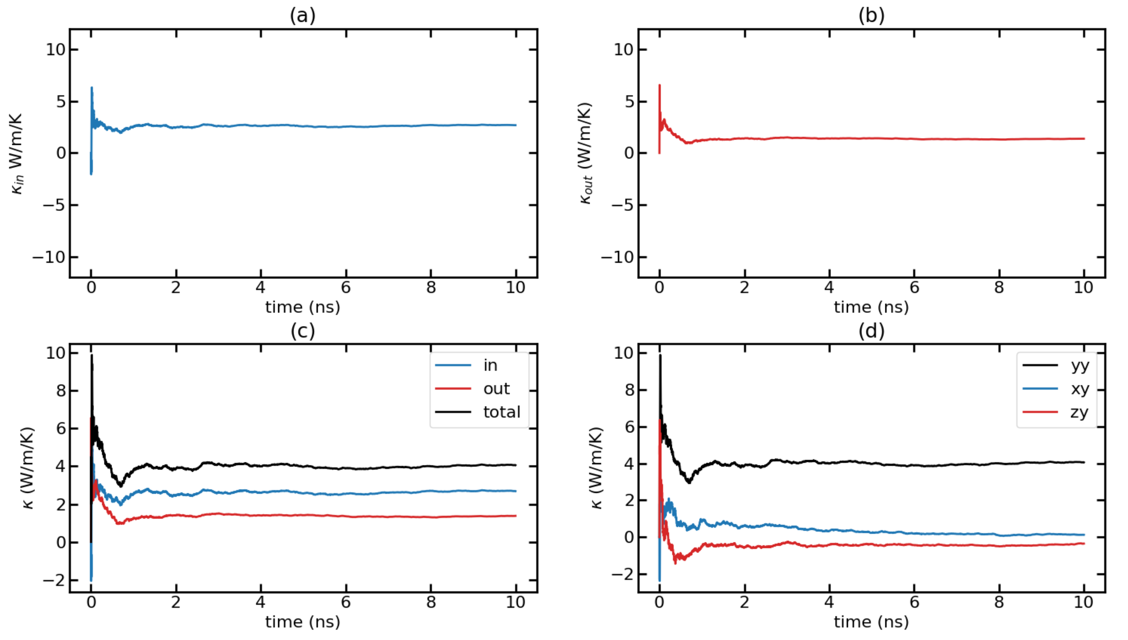
Time-dependent thermal conductivity (k(t) Vs. t) for T = 500K with F = 0.00024 Run 2

Slide 31
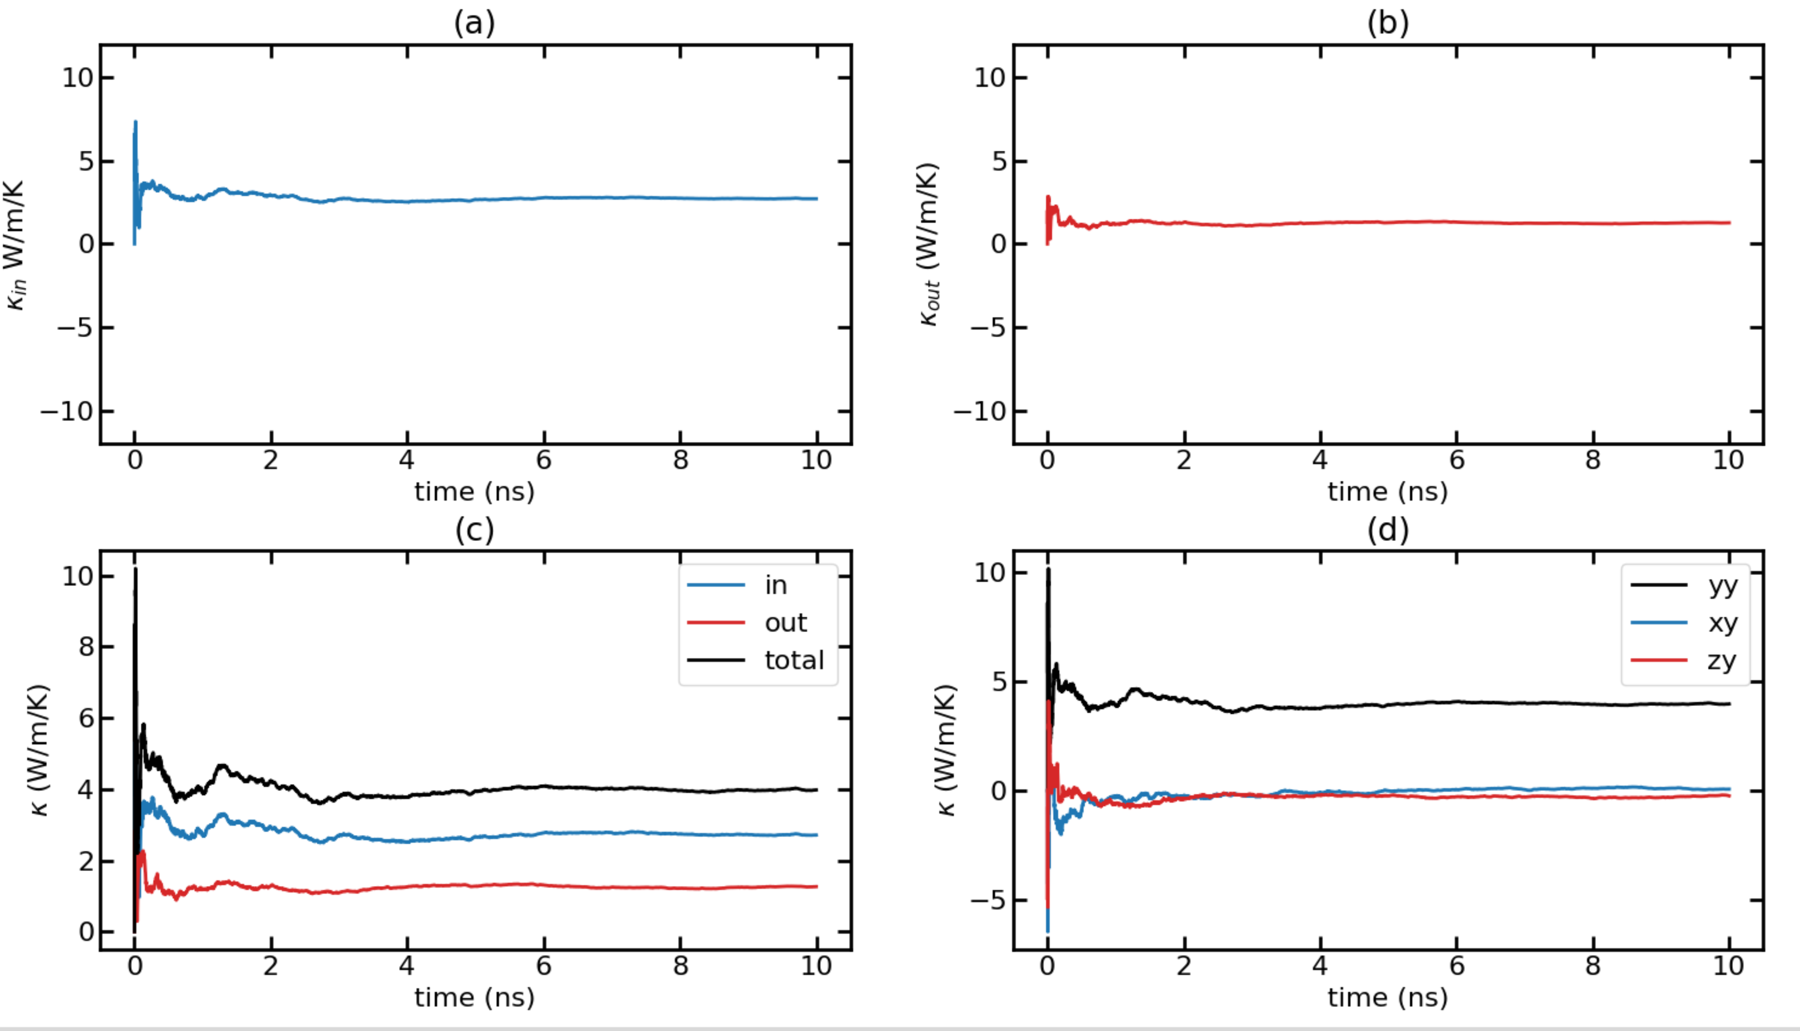
Time-dependent thermal conductivity (k(t) Vs. t) for T = 500K with F = 0.00024 Run 3

Slide 32
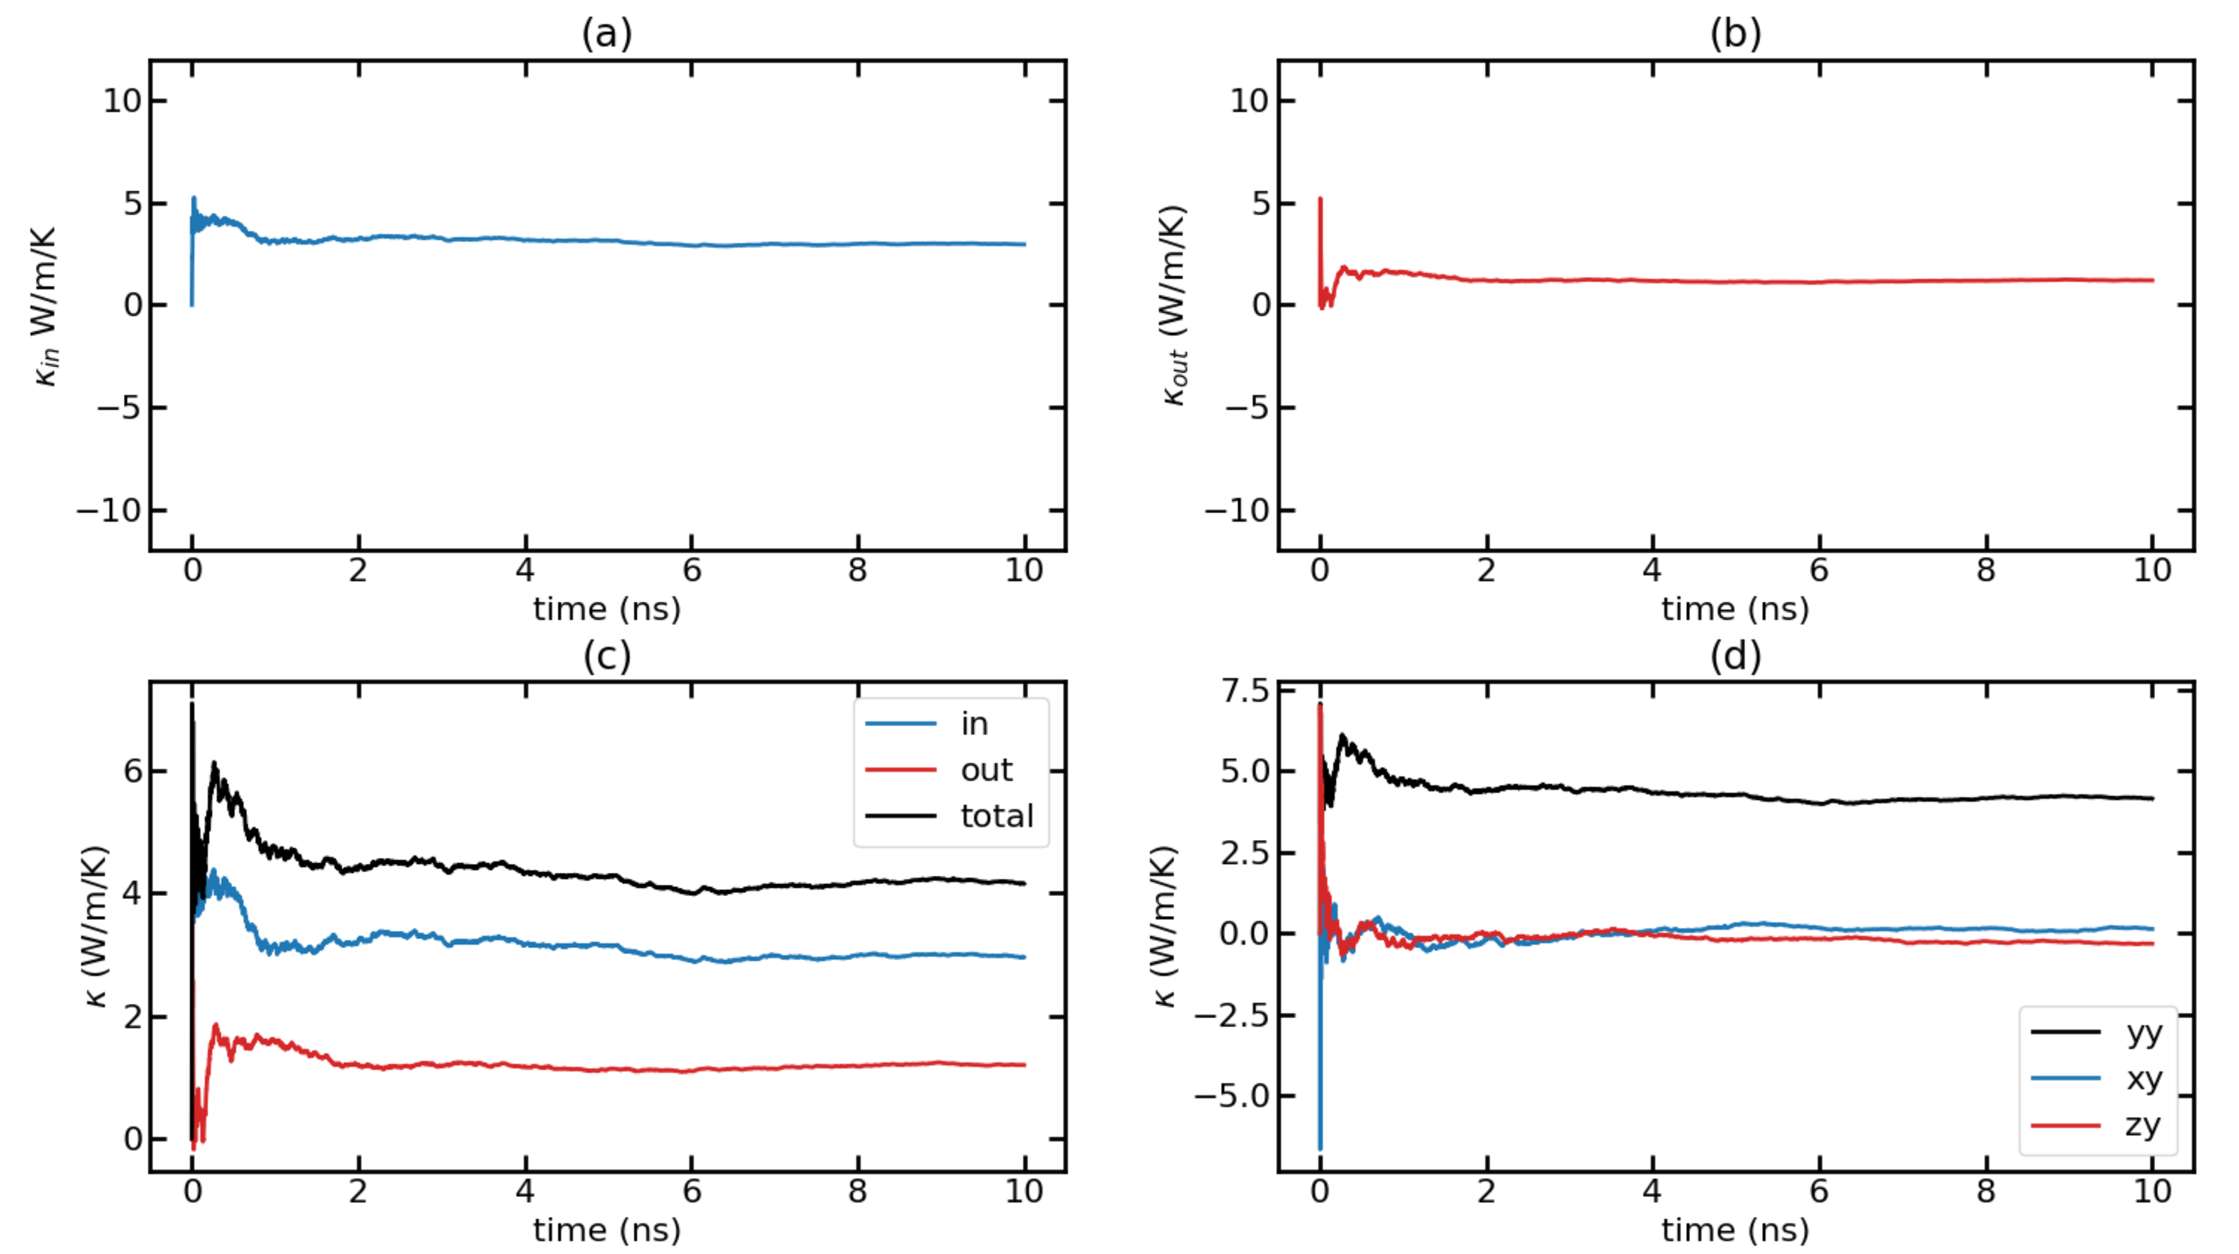
Time-dependent thermal conductivity (k(t) Vs. t) for T = 500K with F = 0.00024 Run 4

Slide 33
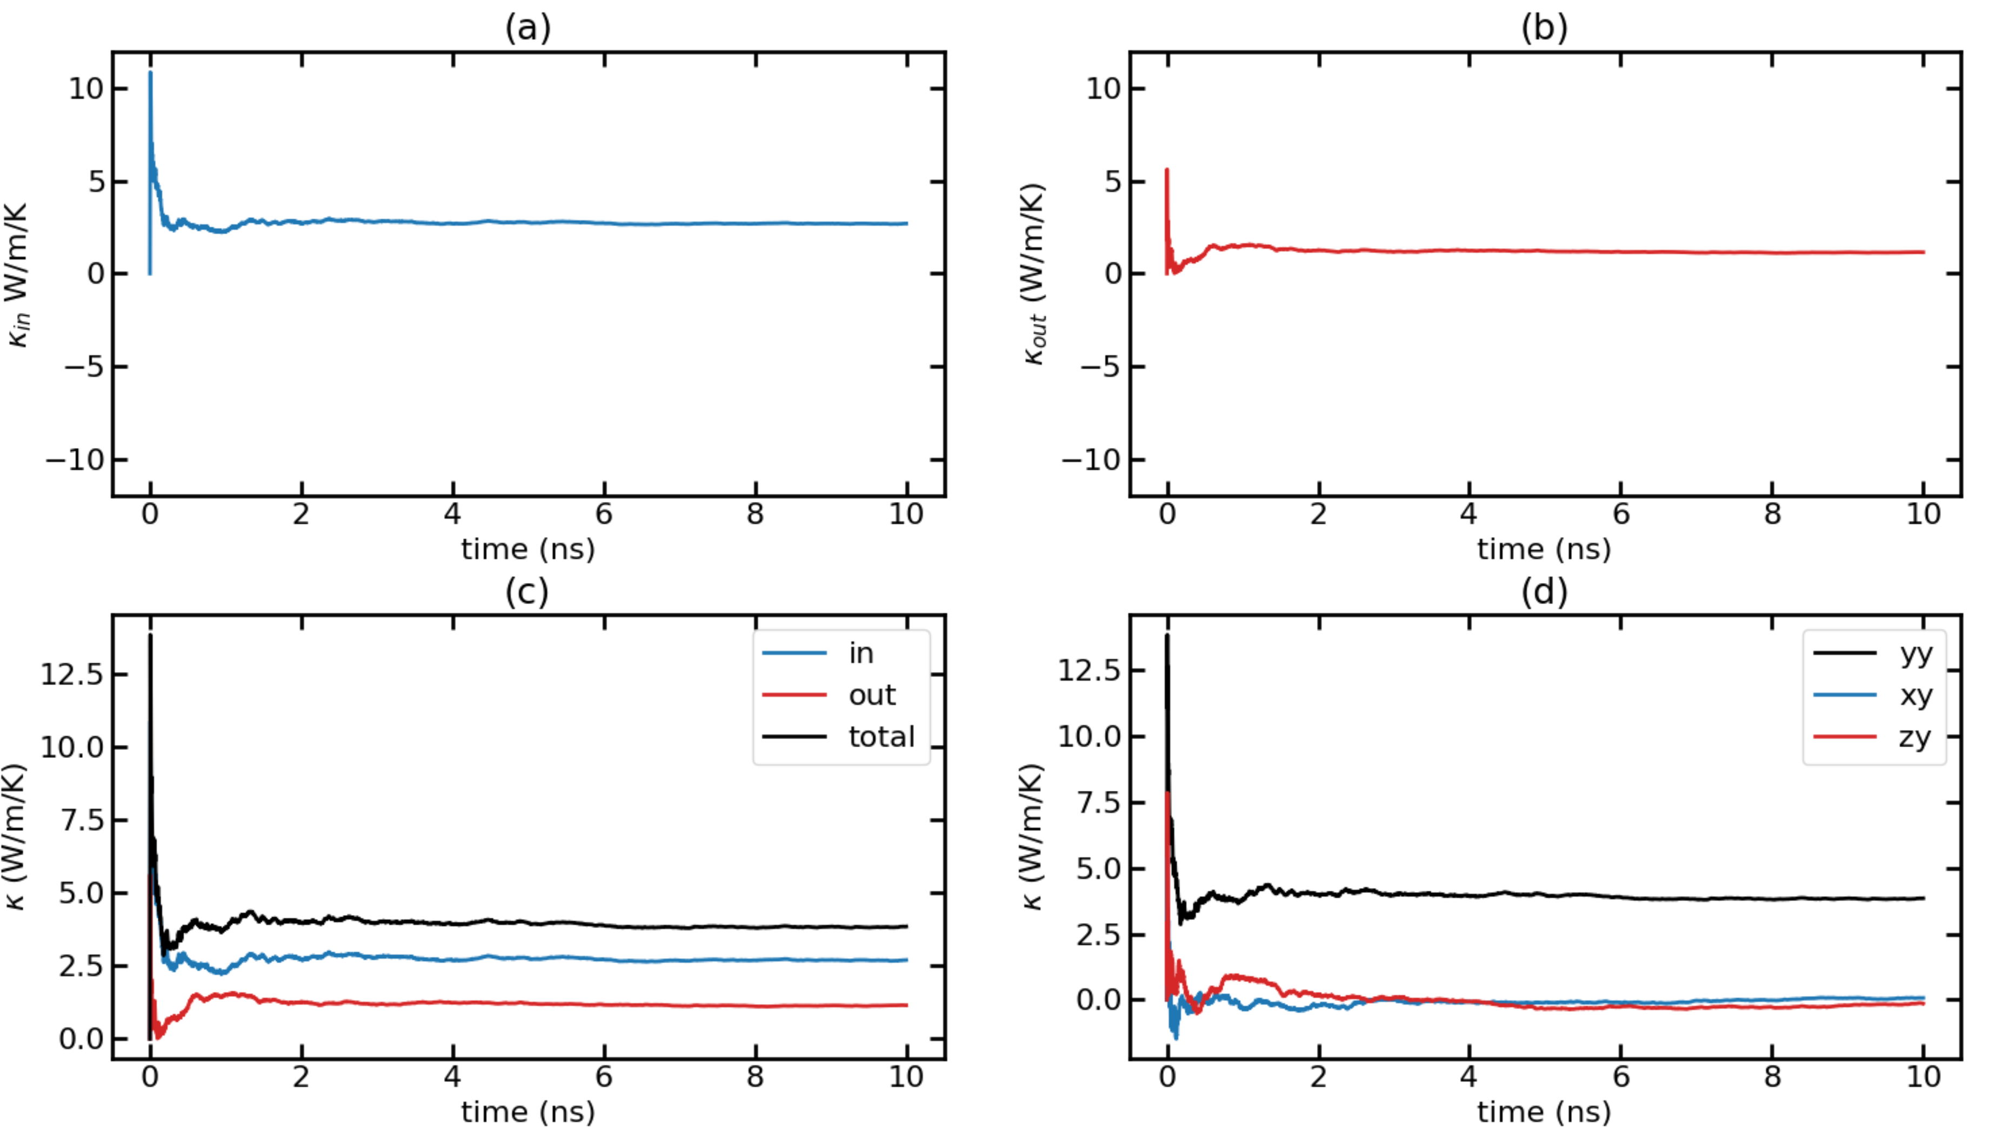
Time-dependent thermal conductivity (k(t) Vs. t) for T = 500K with F = 0.00024 Run 5

Slide 34
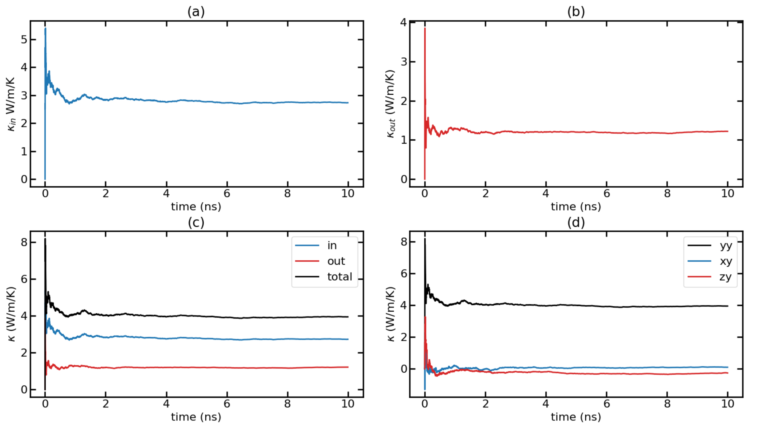
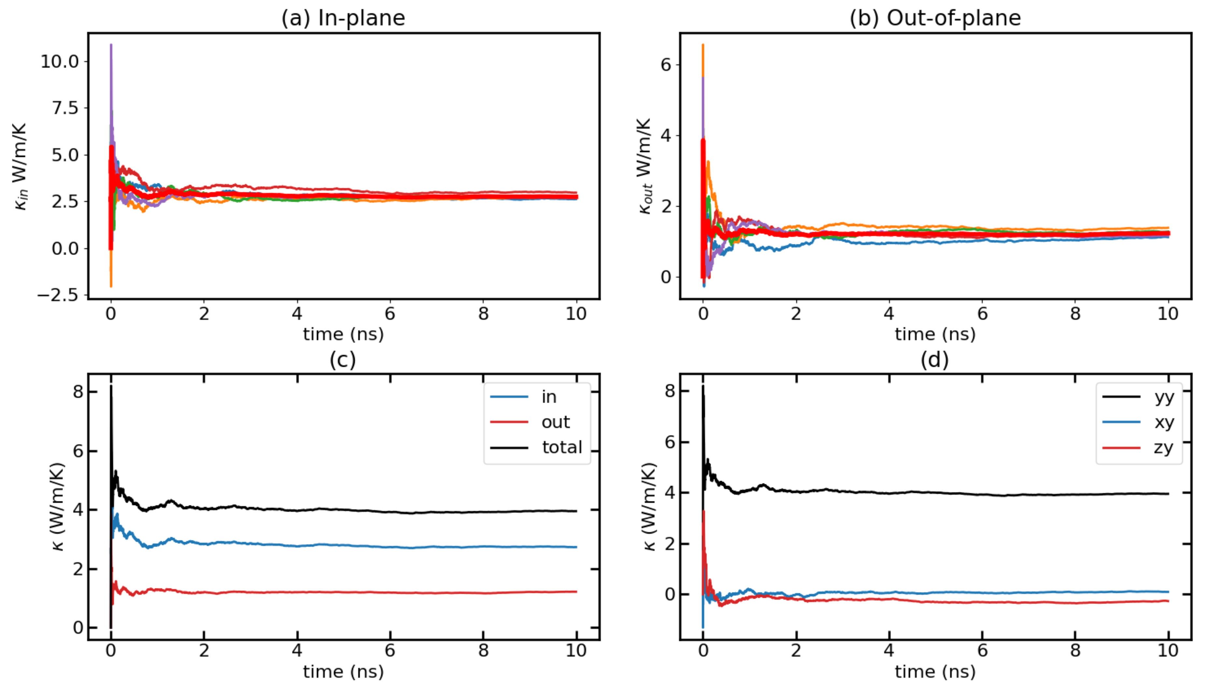
Time-dependent thermal conductivity (k(t) Vs. t) for T = 500K with F = 0.00024 Avg Runs

Slide 35
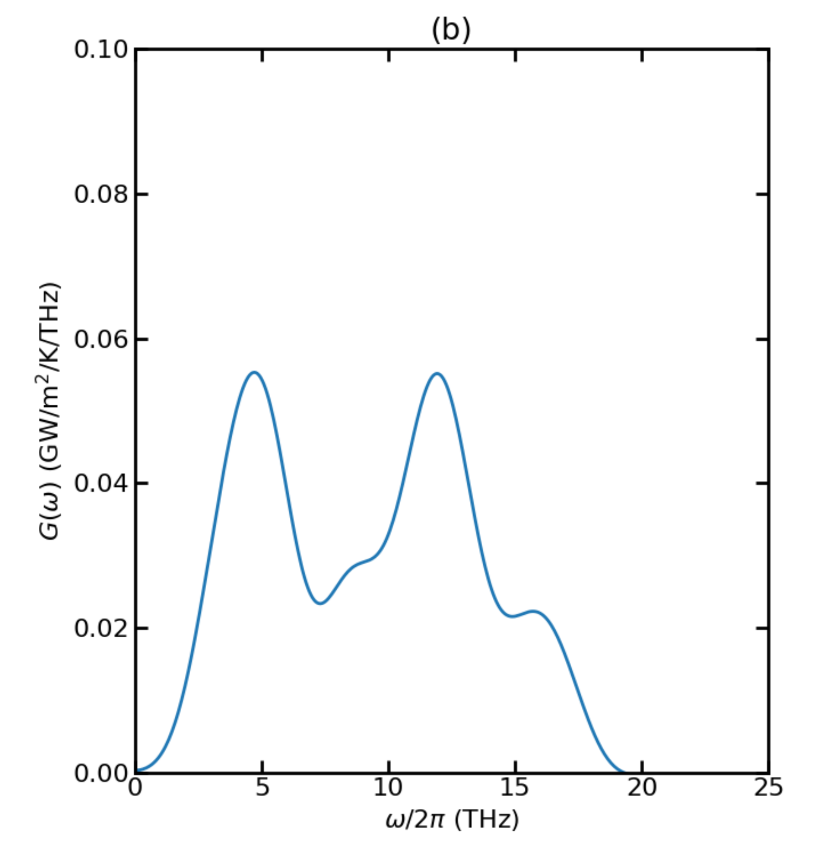
Thermal Conductance for T = 700K

Slide 36
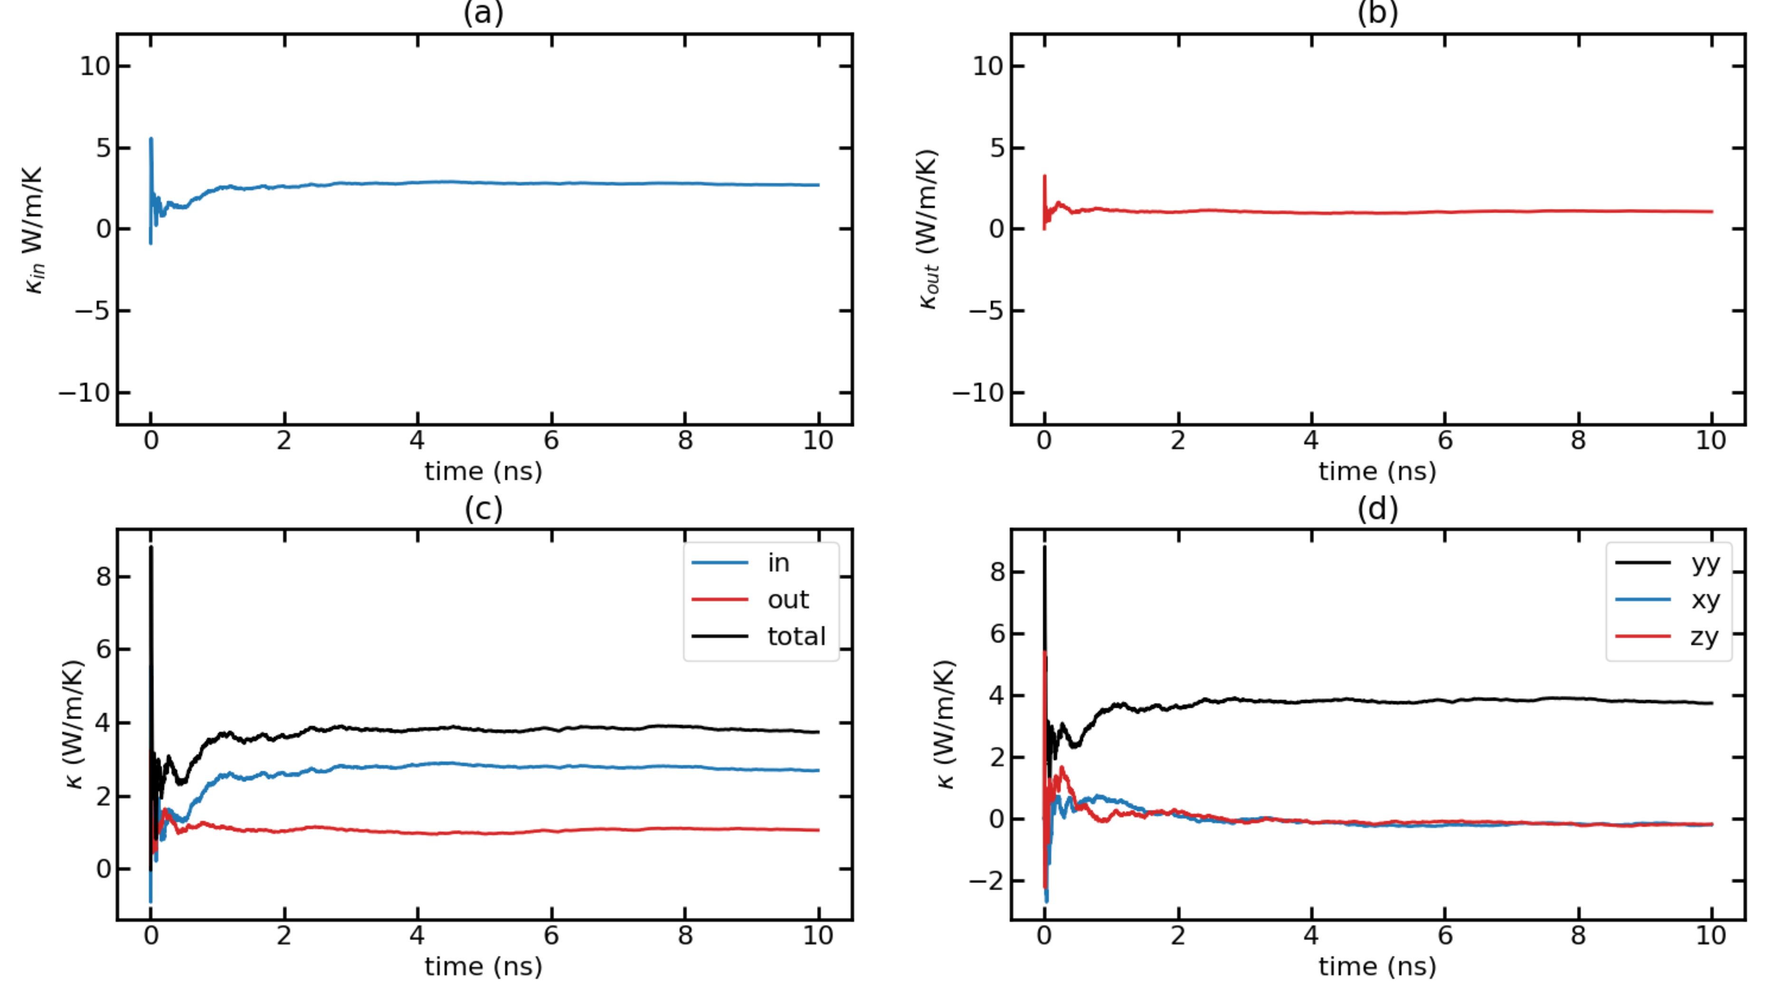
Time-dependent thermal conductivity (k(t) Vs. t) for T = 700K with F = 0.00032 Run 1

Slide 37
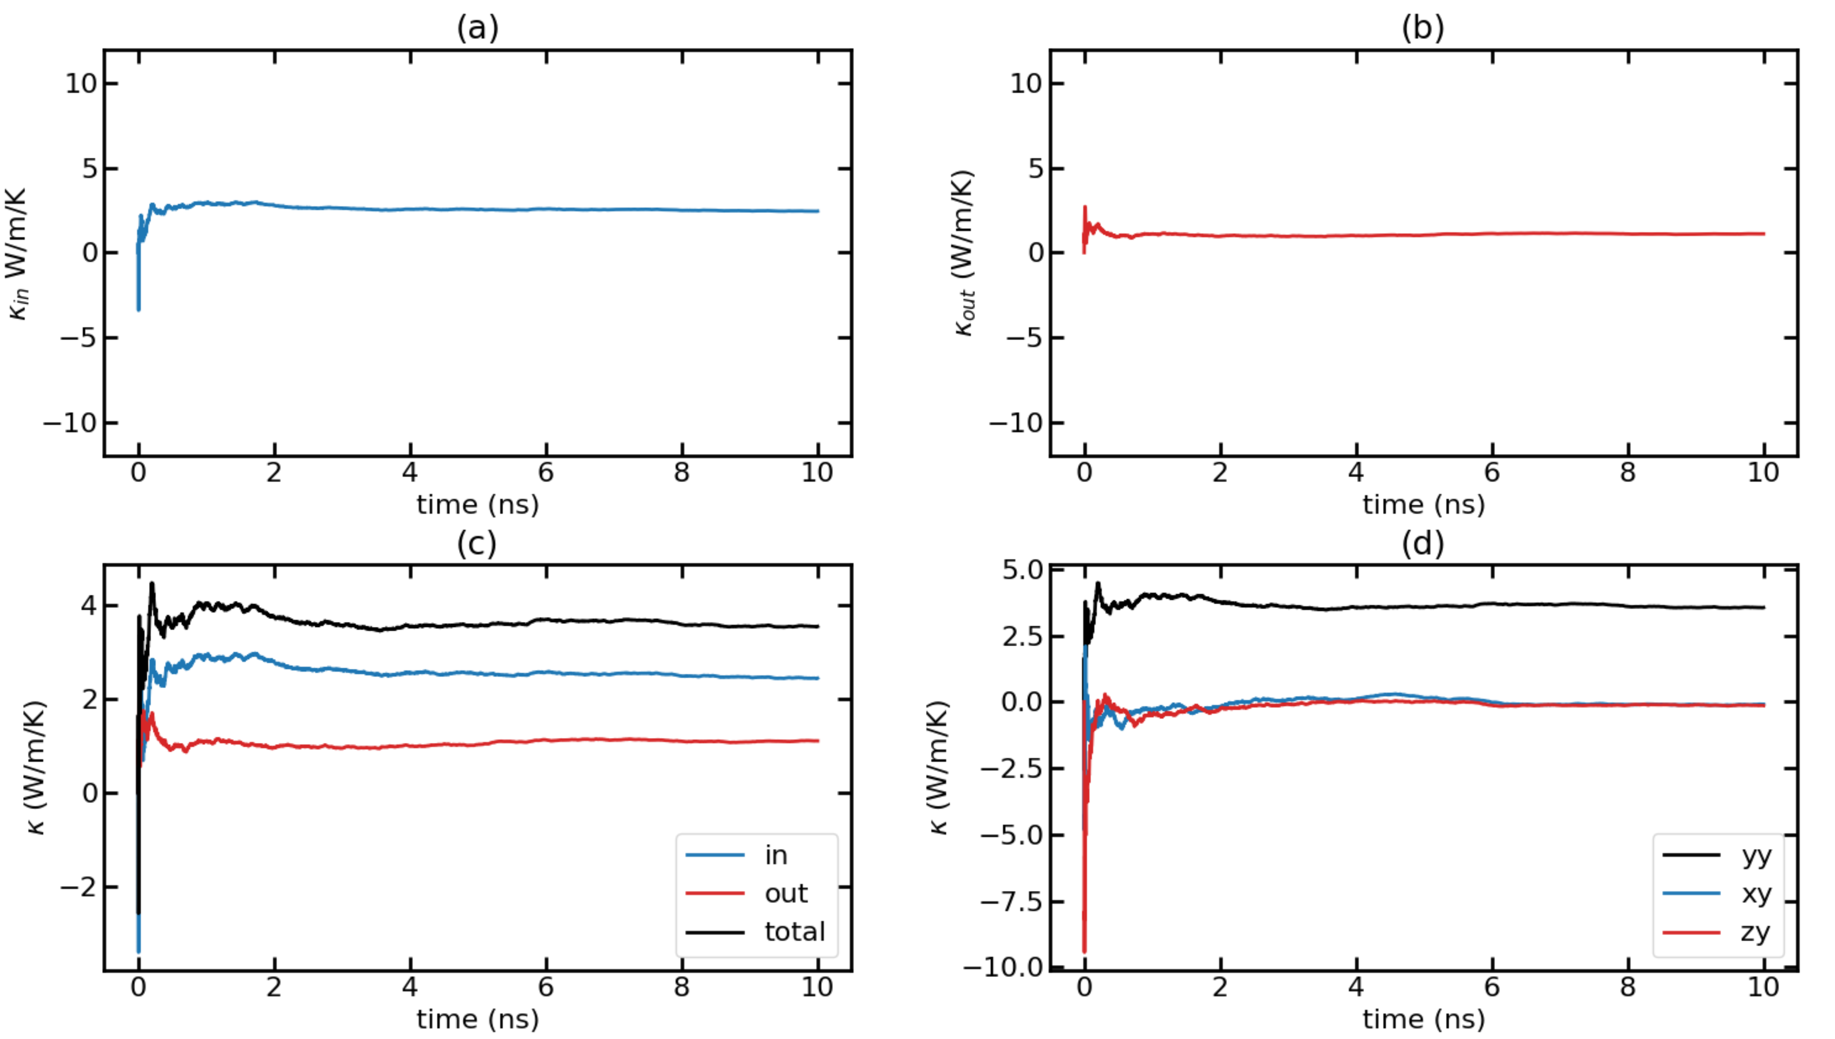
Time-dependent thermal conductivity (k(t) Vs. t) for T = 700K with F = 0.00032 Run 2

Slide 38
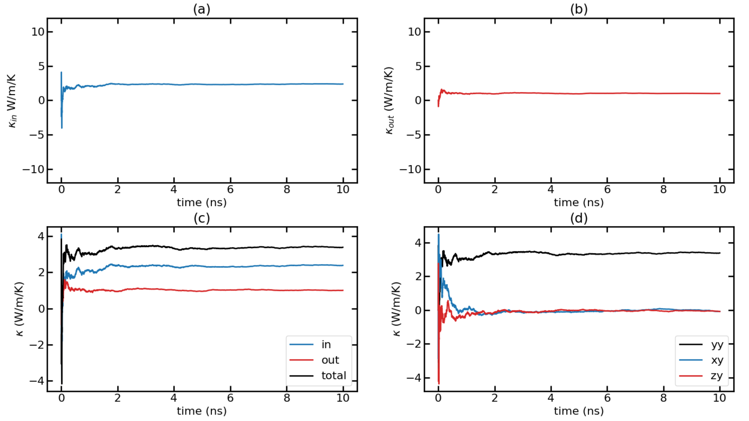
Time-dependent thermal conductivity (k(t) Vs. t) for T = 700K with F = 0.00032 Run 3

Slide 39
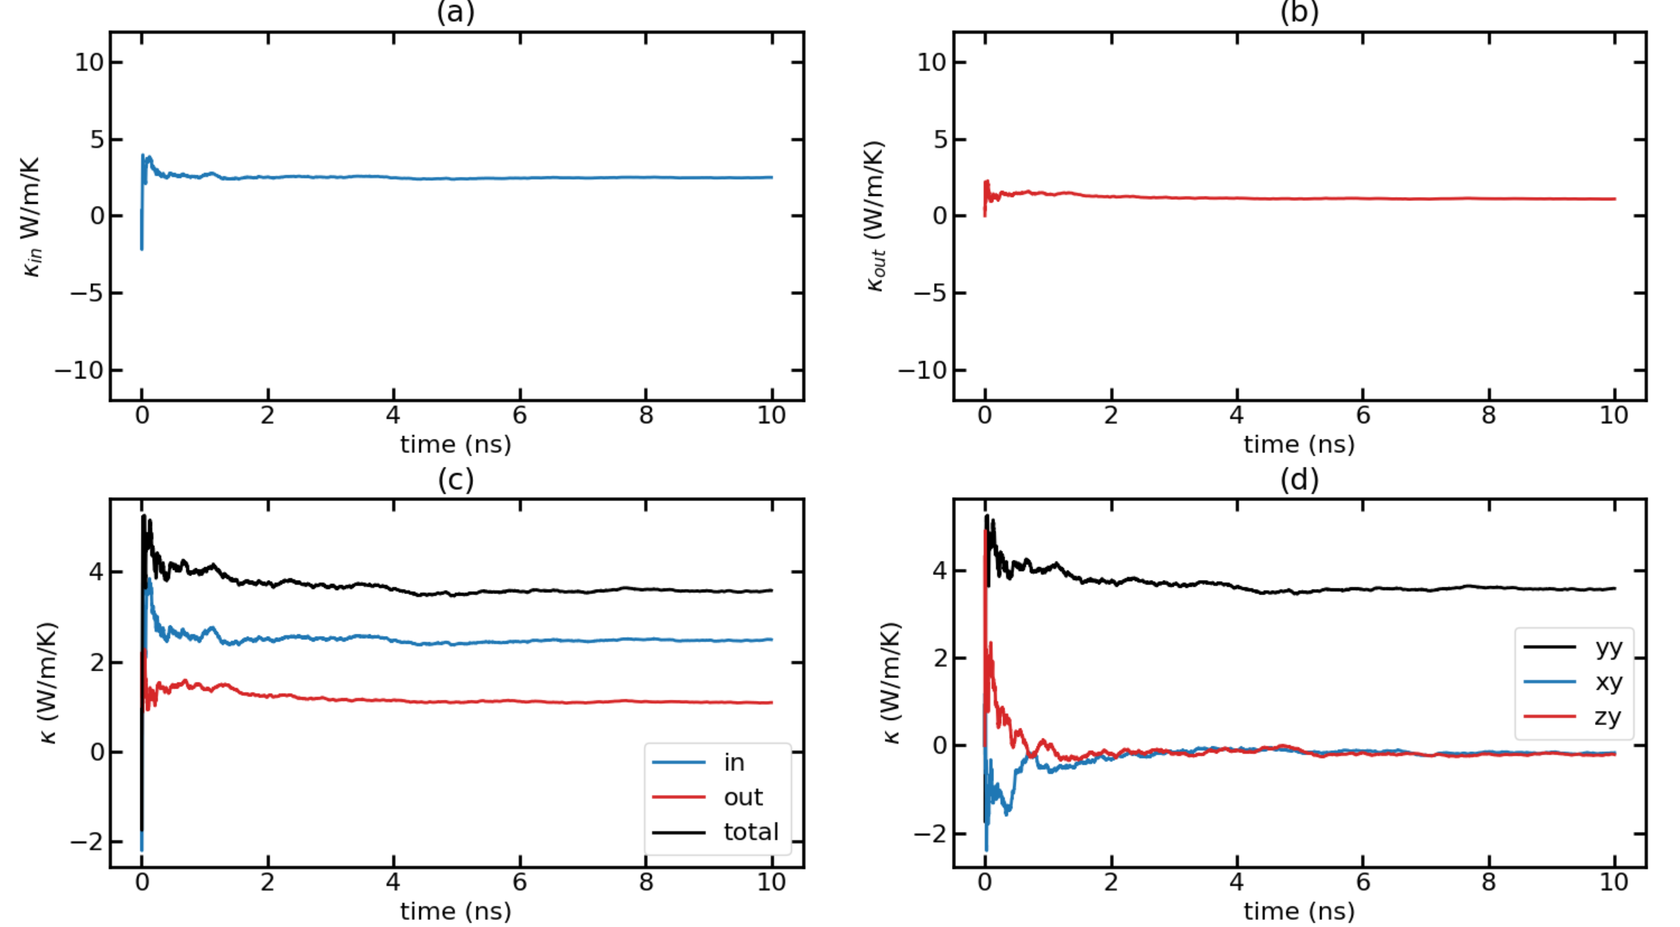
Time-dependent thermal conductivity (k(t) Vs. t) for T = 700K with F = 0.00032 Run 4

Slide 40
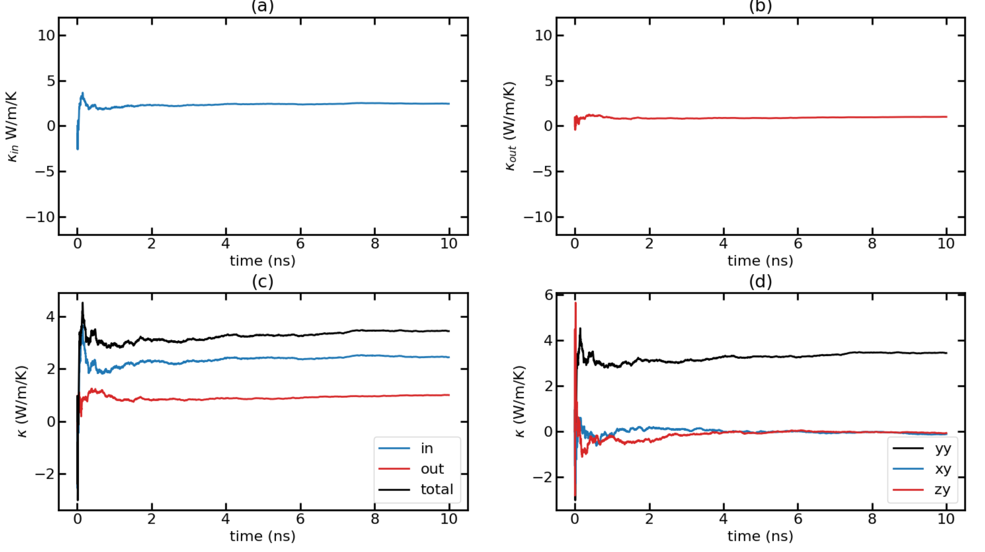
Time-dependent thermal conductivity (k(t) Vs. t) for T = 700K with F = 0.00032 Run 5

Slide 41
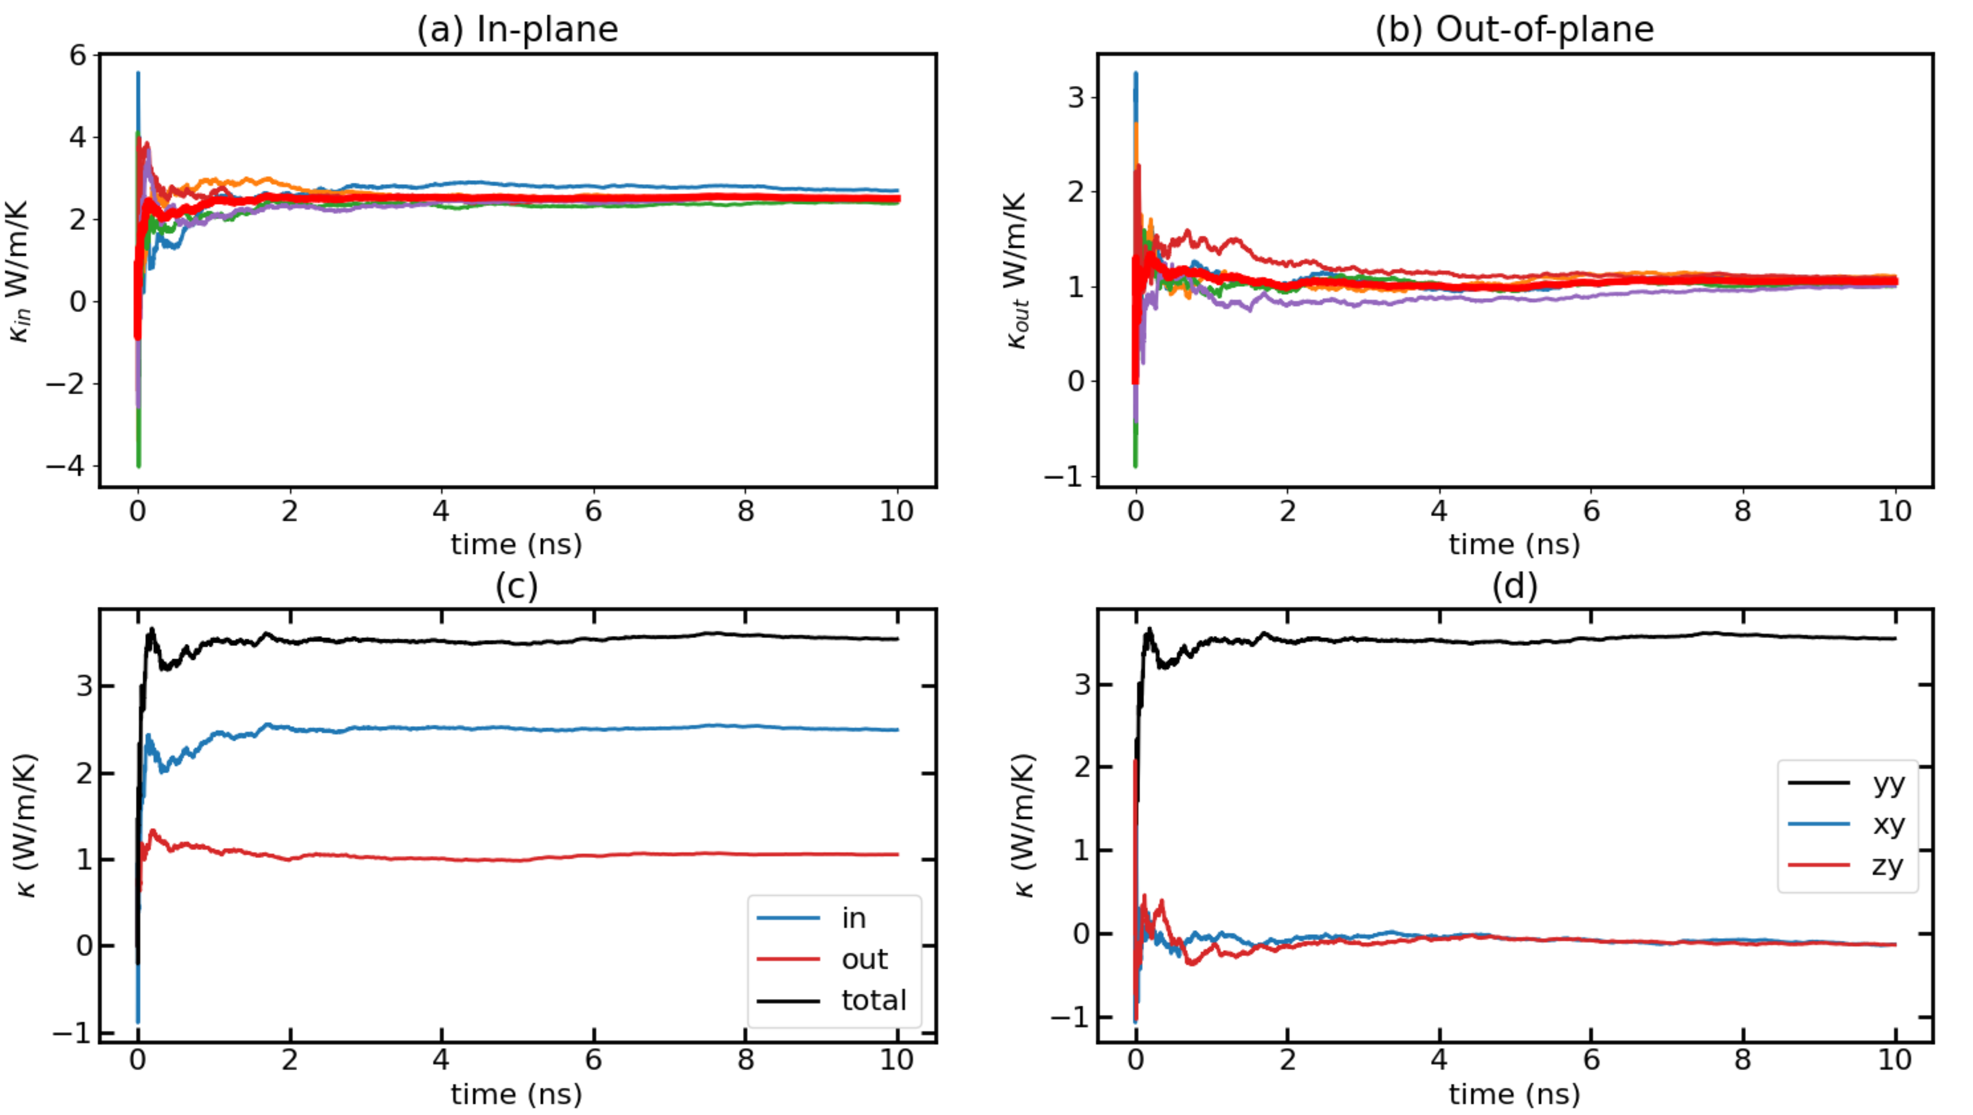
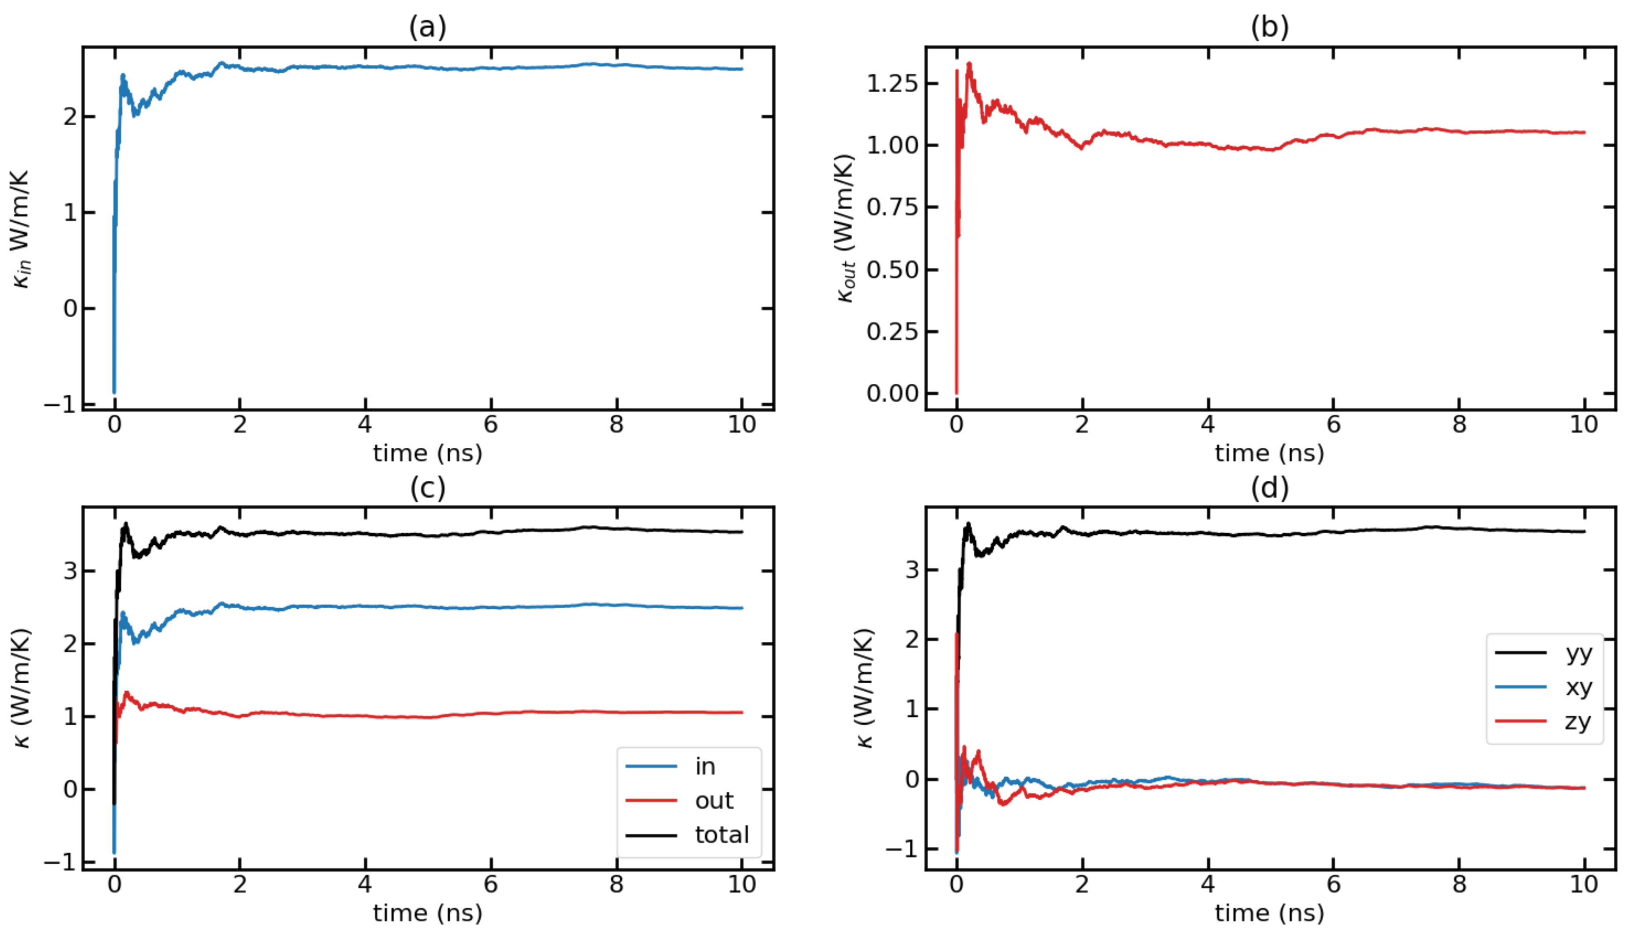
Time-dependent thermal conductivity (k(t) Vs. t) for T = 700K with F = 0.00032 Avg Runs

Slide 42
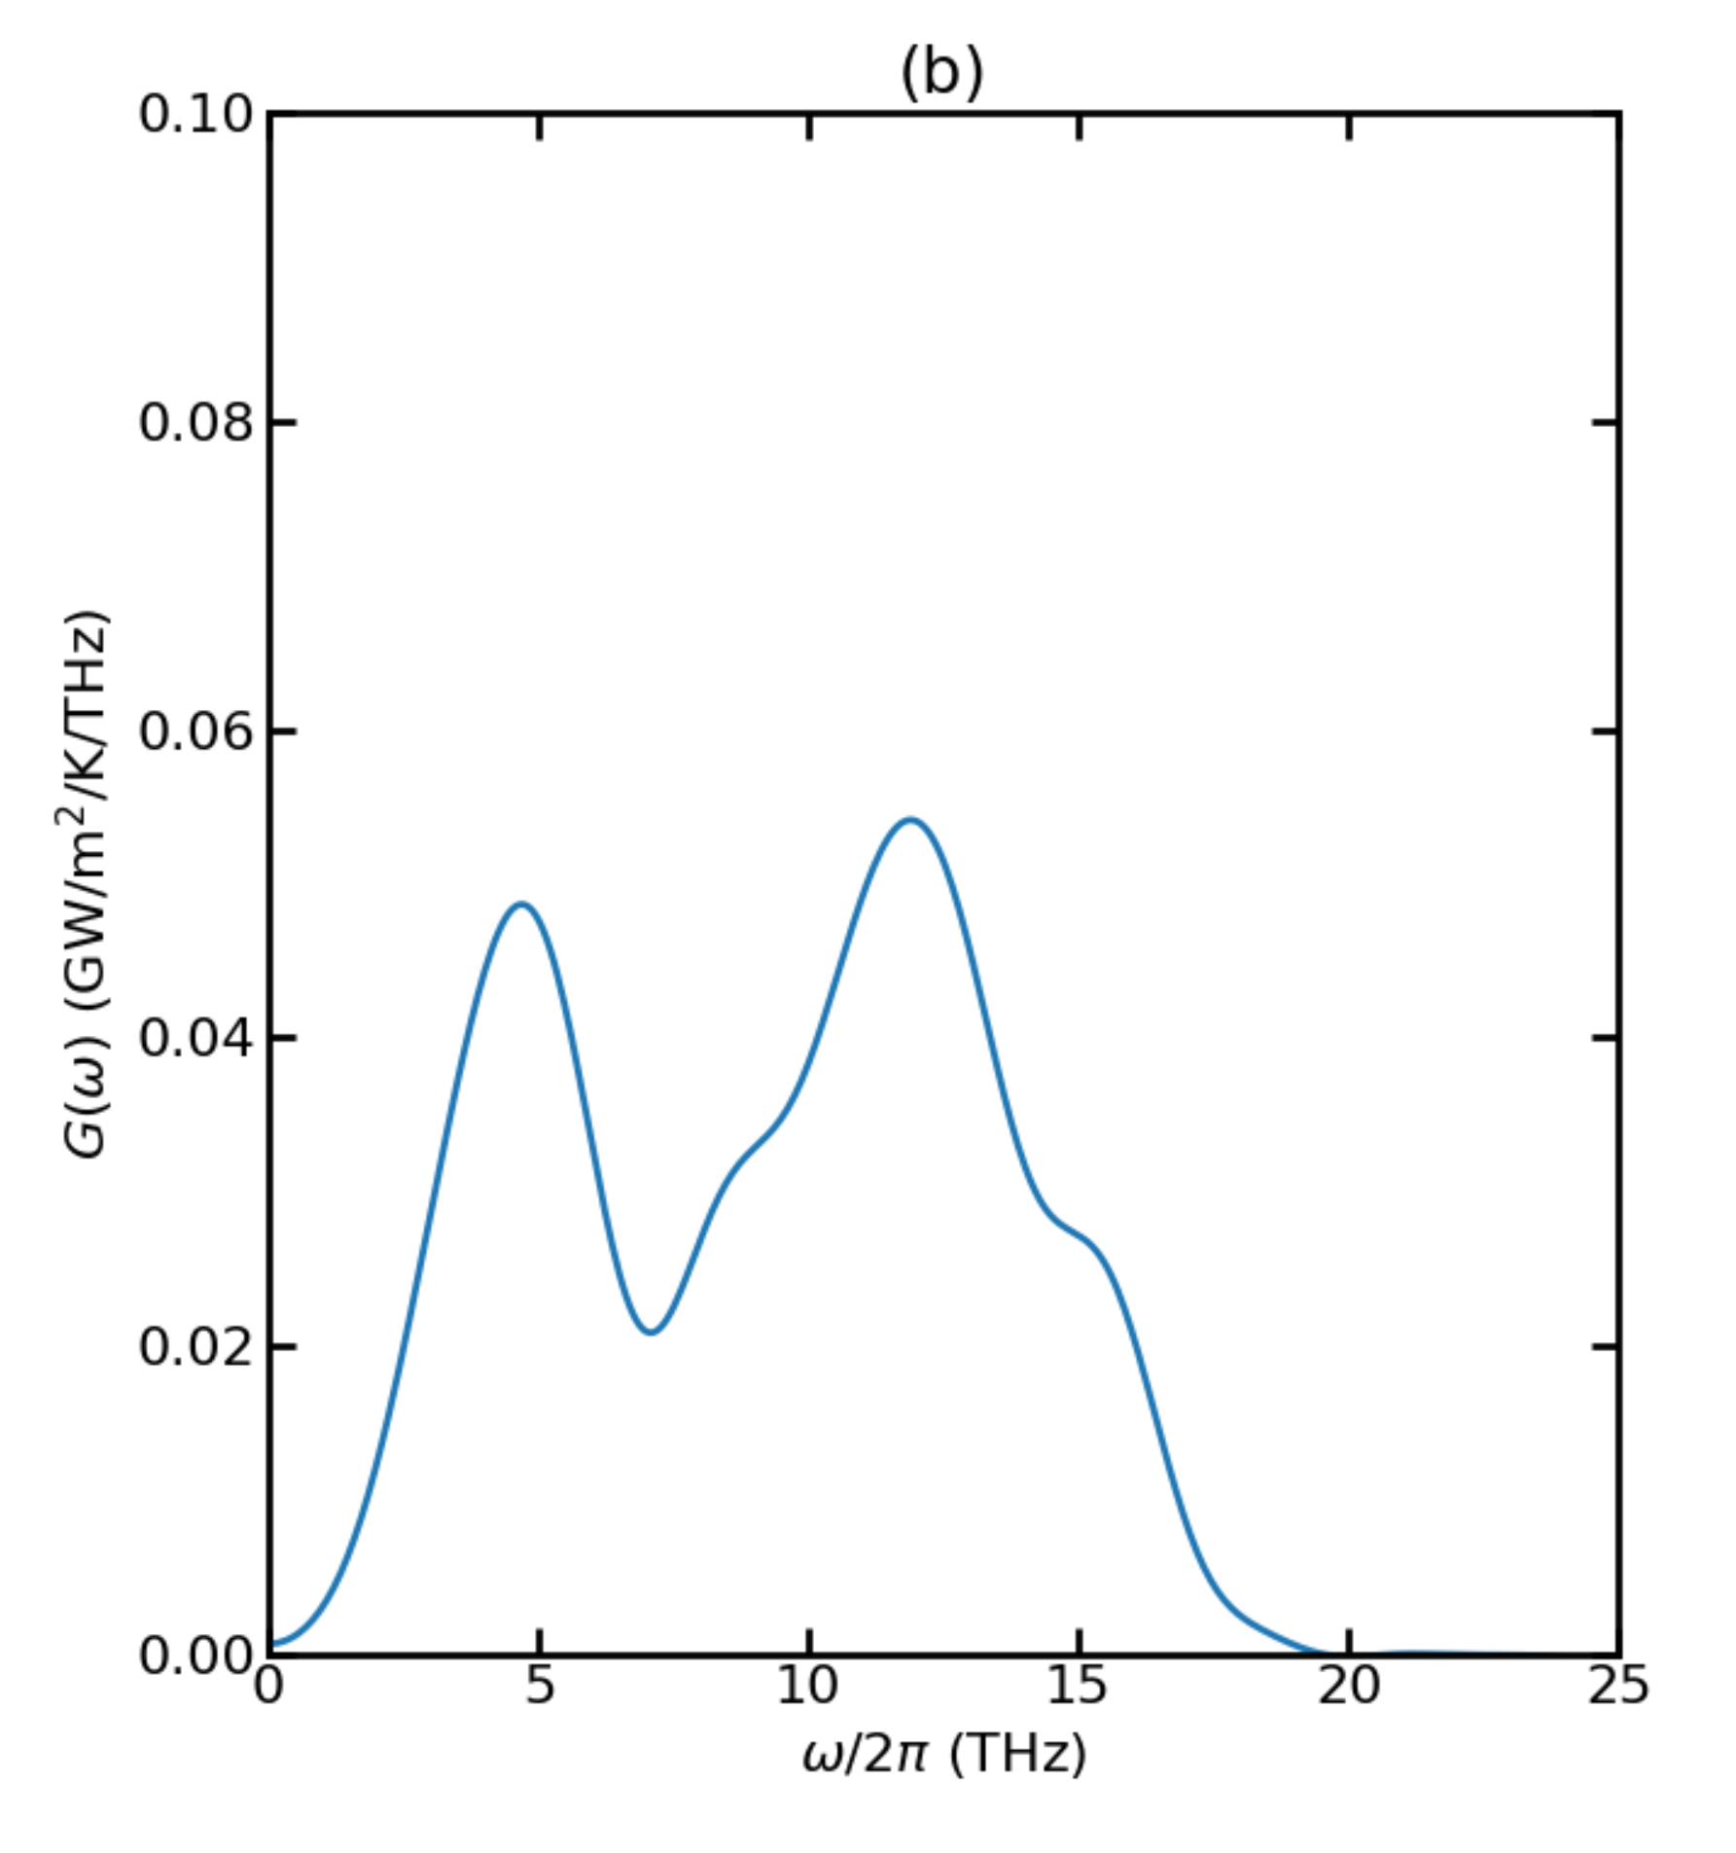
Thermal Conductance for T = 900K

Slide 43
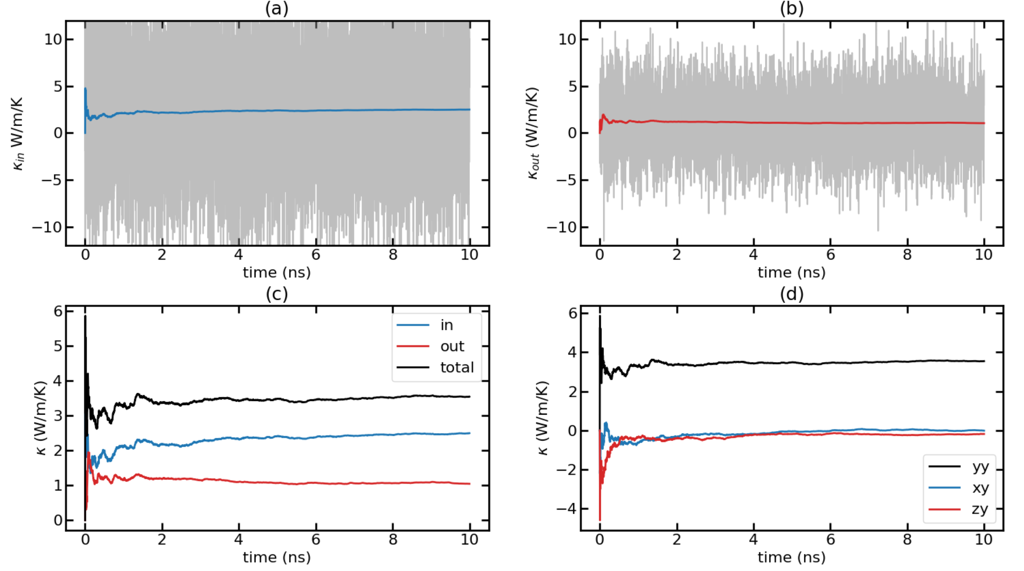
Time-dependent thermal conductivity (k(t) Vs. t) for T = 900K with F = 0.0004 Run 1

Slide 44
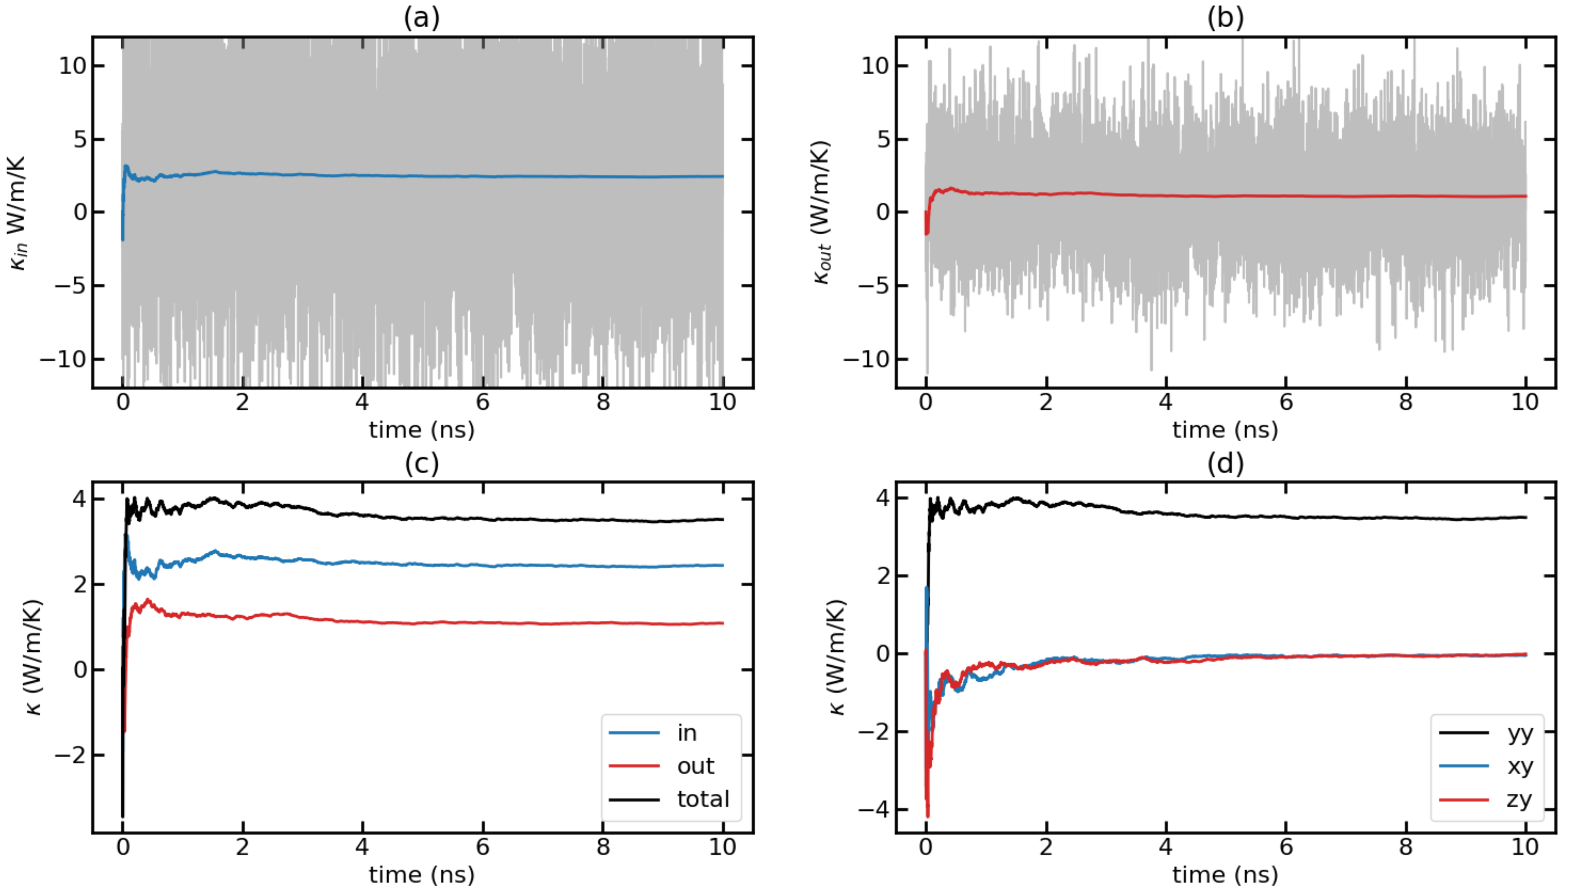
Time-dependent thermal conductivity (k(t) Vs. t) for T = 900K with F = 0.0004 Run 2

Slide 45
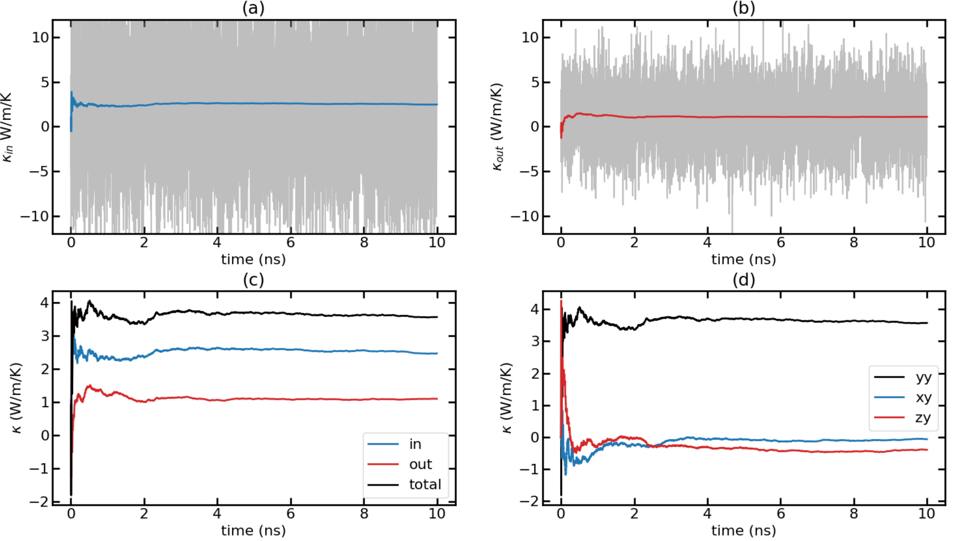
Time-dependent thermal conductivity (k(t) Vs. t) for T = 900K with F = 0.0004 Run 3

Slide 46
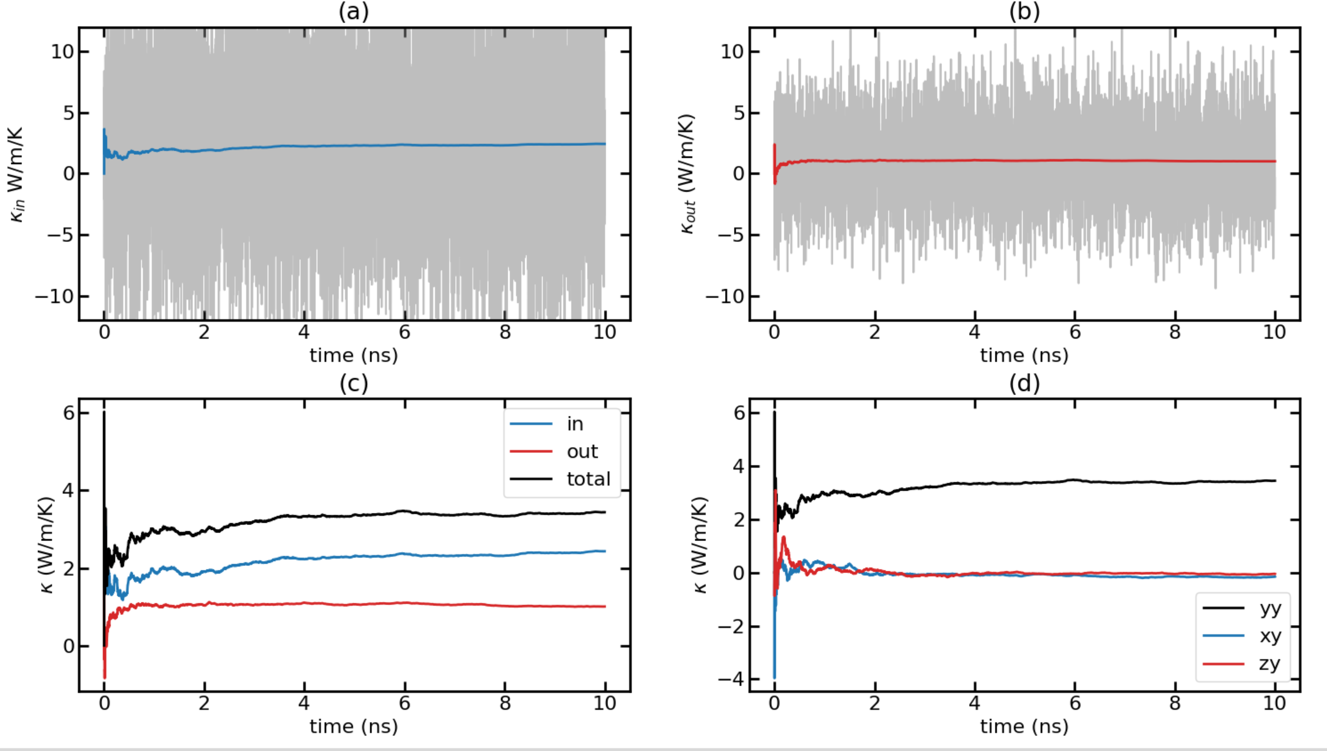
Time-dependent thermal conductivity (k(t) Vs. t) for T = 900K with F = 0.0004 Run 4

Slide 47

Time-dependent thermal conductivity (k(t) Vs. t) for T = 900K with F = 0.0004 Run 5

Slide 48


Time-dependent thermal conductivity (k(t) Vs. t) for T = 900K with F = 0.0004 Avg Runs

Slide 49


Temp 300K - F = 0.000035 with 10 runs

Slide 50


Temp 300K - F = 0.000005 with 10 runs

Slide 51


Temp 300K - F = 0.00007 with 10 runs

Slide 52


Temp 300K - F = 0.0001 with 10 runs

Slide 53


Temp 300K - F = 0.00014 with 10 runs

Slide 54

Plot of k(w) versus F-values at T=300K

Slide 55


Temp 300K - F = 0.0002 with 2 runs

Slide 56


Temp 300K - F = 0.0004 with 2 runs

Slide 57


Temp 300K – F = 0.0008 with 2 runs

Slide 58
Plot of k(w) versus F-values for Temp = 300K

Slide 59
Plot of k(w) versus F-values for Temp = 300K (Zoom In)

Slide 60
Temp 300K – F = 0.00014 with 10 runs

Slide 61


Temp 100K - Plot for F = 0.00014 with 2 runs

Slide 62
Temp 300K - Plot for F = 0.00014 with 10 runs

Slide 63


TEMP 500K - Plot for F = 0.00014 with 2 runs

Slide 64


TEMP 700K - Plot for F = 0.00014 with 5 runs

Slide 65


TEMP 900K - Plot for F = 0.00014 with 5 runs

Slide 66


TEMP 900K - Plot for F = 0.0002 with 3 runs

Slide 67


TEMP 900K - Plot for F = 0.0004 with 3 runs

Slide 68

Plot of k(w) versus F-values for Temp = 900K

Slide 69

3D Plot of k(w) versus Temp(K) using F = 0.00014

Slide 70

Plot of k(w) versus Temp(K) with F = 0.00014

Slide 71


Temp 100K – F = 0.000035

Slide 72


Temp 100K – F = 0.00005

Slide 73


Temp 100K – F = 0.00007

Slide 74


Temp 100K – F = 0.00009

Slide 75


Temp 100K – F = 0.0001

Slide 76


Temp 100K – F = 0.00011

Slide 77


Temp 100K – F = 0.00014

Slide 78

Plot of k(w) versus F-values for Temp = 100K
Thoughts: Optimize may be either around 0.00005 or 0.0001

Slide 79
TEMP 900K - Plot for F = 0.00014 with 5 runs

Slide 80
TEMP 900K - Plot for F = 0.0002 with 3 runs

Slide 81


TEMP 900K - Plot for F = 0.0003 with 3 runs

Slide 82
TEMP 900K - Plot for F = 0.0004 with 3 runs

Slide 83


TEMP 900K - Plot for F = 0.0004 with 5 runs

Slide 84


TEMP 900K - Plot for F = 0.0005 with 3 runs

Slide 85


TEMP 900K - Plot for F = 0.0006 with 3 runs

Slide 86

Plot of k(w) versus F-values for Temp = 900K
Thoughts: Do more runs at 0.0004 to determine the optimize F-values

Slide 87
Possible Graph Fits for T vs F-optimized

Slide 88
Possible Graph Fits for T vs F-optimized

Slide 89


TEMP 500K - Plot for F = 0.00024 with 5 runs

Slide 90


TEMP 700K - Plot for F = 0.00032 with 5 runs

Slide 91
Plot K(w) versus Temp using Optimized F-values

Slide 92
3D Plot using Optimized F with all Temp

Slide 93

Temp = 100K – Avg Plot of lambda vs frequency (cut out the part that Gc or kw = 0 at after around 18THz)

Slide 94

Temp = 300K – Avg Plot of lambda vs frequency (cut out the part that Gc or kw = 0 at after around 18THz)

Slide 95

Temp = 500K – Avg Plot of lambda vs frequency (cut out the part that Gc or kw = 0 at after around 18THz)

Slide 96

Temp = 700K – Avg Plot of lambda vs frequency (cut out the part that Gc or kw = 0 at after around 18THz)

Slide 97

Temp = 900K – Avg Plot of lambda vs frequency (cut out the part that Gc or kw = 0 at after around 18THz)

Slide 98

MFP versus Temp using Optimized F for each Temp

Slide 99
GPUMD – UVA Research Slides (Lazy Version)
J14 Potential
Huy Nguyen – Summer 2024
Using the Optimized F for MgNiO at different Temperatures

Slide 100
MD runs for HEO Potential
Using the Optimized F for MgNiO at different Temperatures

Slide 101

Temp_300K with F=0.00014

Slide 102

Temp_300K with F=0.00018

Slide 103

Temp_300K with F=0.00018

Slide 104


Temp_300K with F=0.00018

Slide 105
Npt runs for 300K
Lx: 42.73543636 to 42.72573034
Ly: 42.73551282 to 42.71805649
Lz: 42.7354391 to 42.76046392
No much change in Volume when doing the npts → we can use same V and same model

Slide 106

Temp_500K with F=0.00024

Slide 107

Temp_500K with F=0.00024

Slide 108

Temp_500K with F=0.00024

Slide 109


Temp_500K with F=0.00024

Slide 110

Temp_700K with F=0.00032

Slide 111

Temp_700K with F=0.00032

Slide 112

Temp_700K with F=0.00032

Slide 113

Temp_700K for L plot

Slide 114


Temp_700K with F=0.00032

Slide 115

Temp_900K with F=0.0004

Slide 116

Temp_900K with F=0.0004 (+)

Slide 117

900K NEW with F=0.0004

Slide 118

Temp_900K with F=0.0004

Slide 119

Temp_900 with L-plot

Slide 120


900K NEW with F=0.0004

Slide 121
Npt runs for 900K
Lx: 42.73706887 to 43.23188962
Ly: 42.73706887 to 43.24999569
Lz: 42.73706887 to 43.22970881
→ V did not change much so we can use the original model

Slide 122


Avg Plots for TC with different F

Slide 123

TC vs Temp plots for HEO

Slide 124


Avg Plots for mFp with different F

Slide 125

TC plot for HEO and MgNiO

Slide 126
CoNiO Potential
Using MgNiO at first, but substitute Mg with Ni

Slide 127


CoNiO - 300K - ballistic

Slide 128

CoNiO - 300K – 0.00008 – 10M Runs

Slide 129

CoNiO - 300K – 0.00008 – 10M Runs

Slide 130


CoNiO - 300K – 0.00008 – 10M Runs

Slide 131

CoNiO - 300K – 0.00009 – 10M Runs

Slide 132

CoNiO - 300K – 0.00009 – 10M Runs

Slide 133


CoNiO - 300K – 0.00009 – 10M Runs

Slide 134

CoNiO - 300K – 0.0001

Slide 135

CoNiO - 300K – 0.0001

Slide 136


CoNiO - 300K – 0.0001

Slide 137

CoNiO - 300K – 0.0001 – 10M Runs

Slide 138

CoNiO - 300K – 0.0001 – 1M Runs

Slide 139


CoNiO - 300K – 0.0001 – 10M Runs

Slide 140

CoNiO - 300K – 0.00011

Slide 141

CoNiO - 300K – 0.00011

Slide 142


CoNiO - 300K – 0.00011

Slide 143

CoNiO - 300K – 0.00011 – 10M runs

Slide 144

CoNiO - 300K – 0.00011 – 10M runs

Slide 145


CoNiO - 300K – 0.00011 – 10M runs

Slide 146

CoNiO - 300K – 0.00012

Slide 147

CoNiO - 300K – 0.00012

Slide 148


CoNiO - 300K – 0.00012

Slide 149

CoNiO - 300K – 0.00012 – 10M runs

Slide 150

CoNiO - 300K – 0.00012 – 10M runs

Slide 151


CoNiO - 300K – 0.00012 – 10M runs

Slide 152

CoNiO - 300K – 0.00001 and 0.0005

Slide 153

CoNiO - 300K – 0.00009

Slide 154

CoNiO - 300K – 0.00013 and 0.00014
Weird behavior and inconsistency

Slide 155

CoNiO - 300K – 0.00018

Slide 156

CoNiO - 300K – 0.0002

Slide 157


CoNiO - 500K – 0.0001

Slide 158

CoNiO - 500K – 0.00015 – 10M

Slide 159


CoNiO - 500K – 0.00015

Slide 160


CoNiO - 500K – 0.00015 – 10M

Slide 161

CoNiO - 500K – 0.00018 – chạy lại Run2

Slide 162

CoNiO - 500K – 0.00018 – 10M

Slide 163


CoNiO - 500K – 0.0002

Slide 164

Paper References

